Slide 1
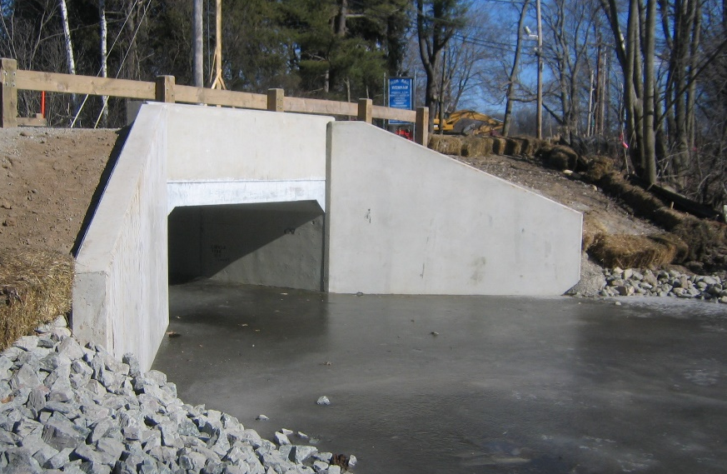
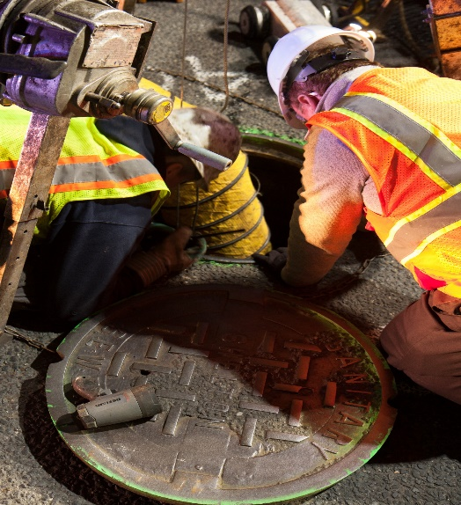
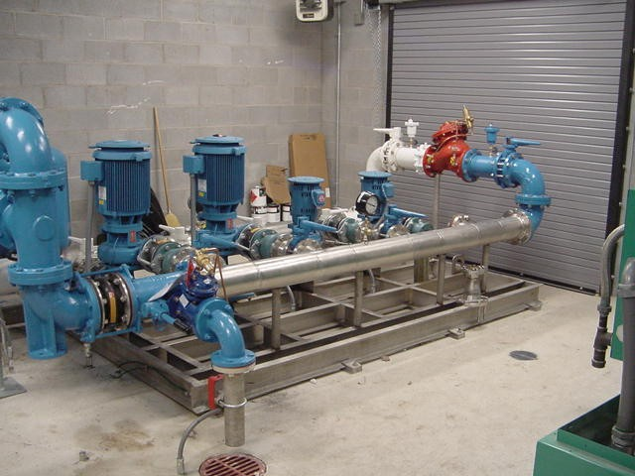

CT Council of Small Towns
Planning & Economic Development Conference
November 17, 2022

Slide 2
So Many Funding Sources, It’s Almost Too Many
Program | Water | Wastewater | Stormwater
CWF / DWSRF | ü | ü
EPA Section 319 (Decentralized WW Sys.) |  | ü
NOAA Regional Coastal Resilience (Studies) |  | ü | ü
FEMA BRIC / HMGP / FMA | ü | ü | ü
USACE Section 14 / 205 / 208 |  | ü
USDA Rural Development Grants | ü | ü
Small Town Economic Assistance Program |  | ü
LOTCIP, LBP |  |  | ü
CRF, CIF, TRIP | ü | ü | ü
And more….
Notes:
The question right now isn’t “Can I find a grant program” it’s “How does my municipality commit our limited staff time and/or resources towards evaluating grant programs and project fits to maximize your chances of getting funded”? …in sometimes short timeframes

Slide 3
Hazard Mitigation Grant Program (HMGP)
Disaster or Emergency
Presidential Disaster Declaration
HMGP Application Period:
1 year from Date of Declaration
HMGP Notice of Sub-Application Intent
FEMA Review
and RFI
FEMA Award and DEMHS Sub-Award
HMGP
Sub-Application Submission
Begin Period of Performance
HMGP (Section 404 Robert T. Stafford Act) is awarded upon Presidential Disaster Declaration
  15% of the total Public Assistance Award set aside for HMGP (up to the first $2 Billion)
  Application Period is 1 year from Disaster Declaration
  Projects chosen and submitted by State to FEMA
    State ranking process only
Eligible Sub-Applicants
  State/Local Government
  Non-Profit Organizations
  Indian Tribal Nations
Cost Share is 75% Federal, 25% Non-Federal
Notes:
Refer to the flowchart – don’t need to go over the first bullet, it was covered in the previous slide

Slide 4
Project Example – Willington Avenue, Stafford Springs
Storm Drainage Improvements
Road Reconstruction
Funding for construction to be derived from:
  FEMA HMGP Grants- $1.5 M
  90% FEMA match
Sewer Replacement
  Combined Sewer at one point
  Replace vs. lining
Notes:
CIF – eligible projects appear to include construction of water/sewer utilities or extending them into village centers
CRF – consolidation of small water systems, protection of critical facilities such as wastewater treatment plants
TRIP – potential stormwater funding

Slide 5
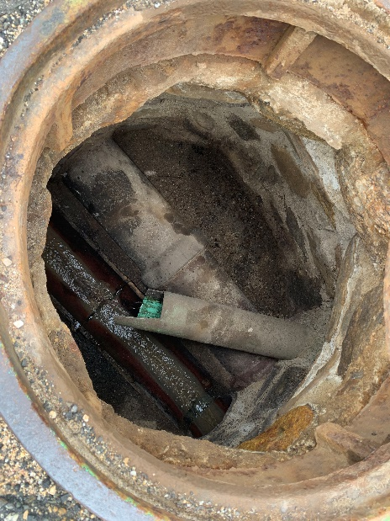
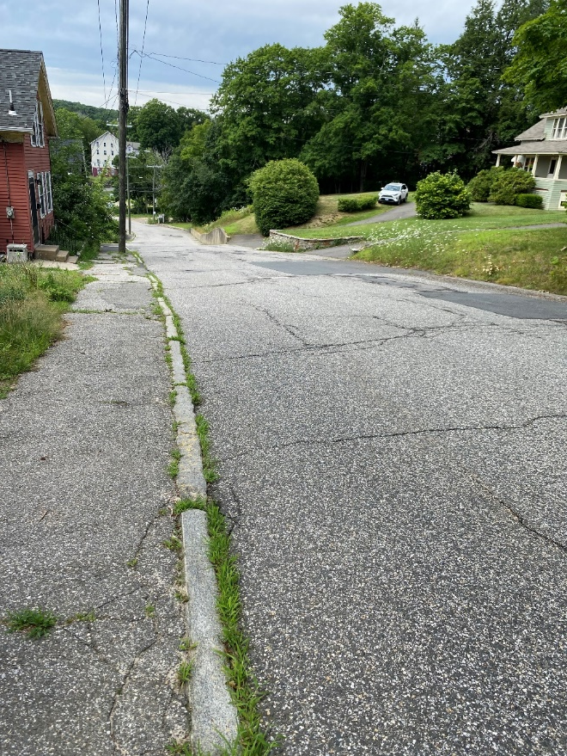
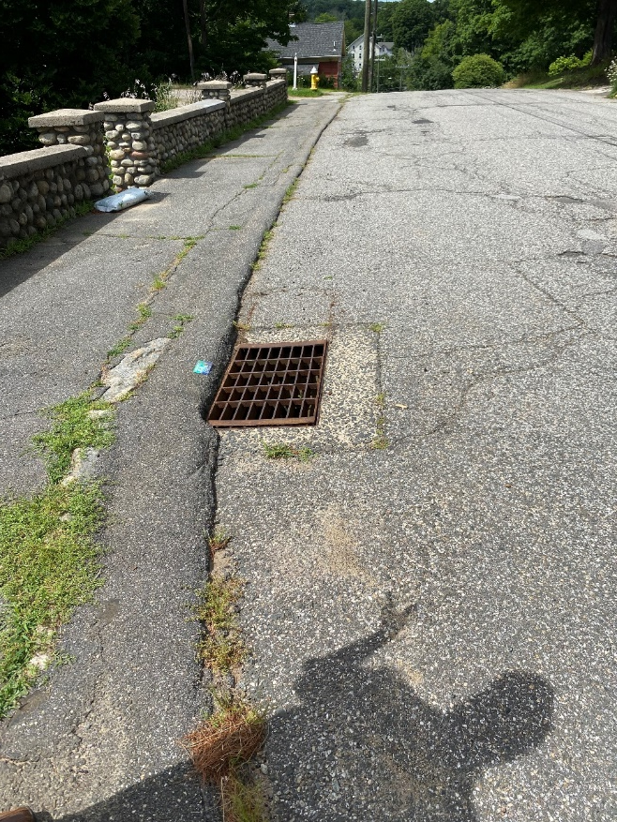
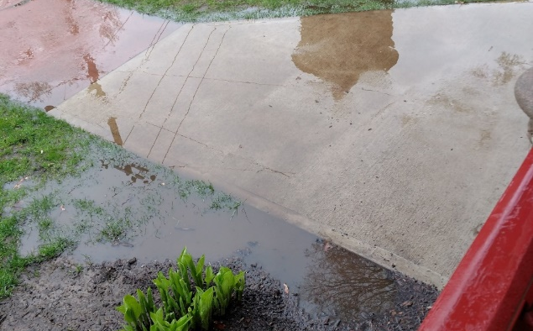
Project Example – Willington Avenue, Stafford Springs

Slide 6
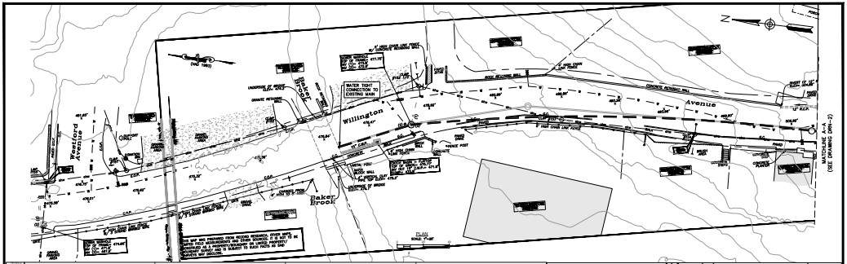
Project Example – Willington Avenue, Stafford Springs

Slide 7
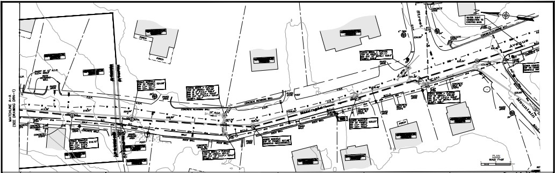
Project Example – Willington Ave, Stafford Springs

Slide 8
Project Example – Linear Trail and Sewer extension, Ledyard
Linear Multipurpose Trail
Sewer extension study in Ledyard Center
Funding for sewer construction to be derived from:
Funding for Trail and Roadway
  LOTCIP Funds - $2.7 M
Funding for sewer construction to be derived from:
  ARPA Funds - $1.2 M
Notes:
CIF – eligible projects appear to include construction of water/sewer utilities or extending them into village centers
CRF – consolidation of small water systems, protection of critical facilities such as wastewater treatment plants
TRIP – potential stormwater funding

Slide 9
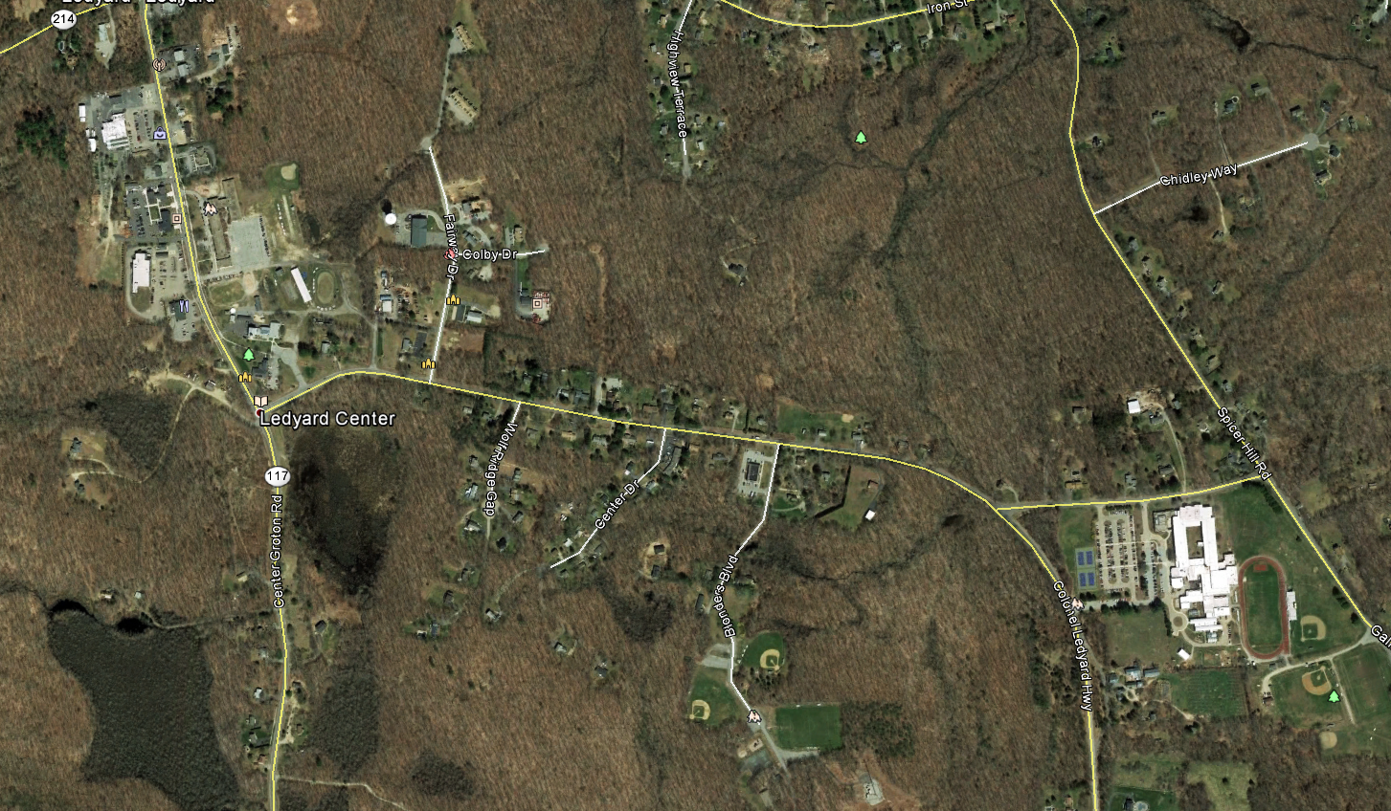
PROJECT AREA
DOWNTOWN
LEDYARD CENTER SCHOOL REDEVELOPMENT
FAIR
GROUNDS
LIBRARY
Colonel Ledyard Hwy
NEW
GAS STATION
SUPERINTENDENT
OF SCHOOLS
Gallup Hill Road
LEDYARD
HIGH SCHOOL
PARK & REC

Slide 10
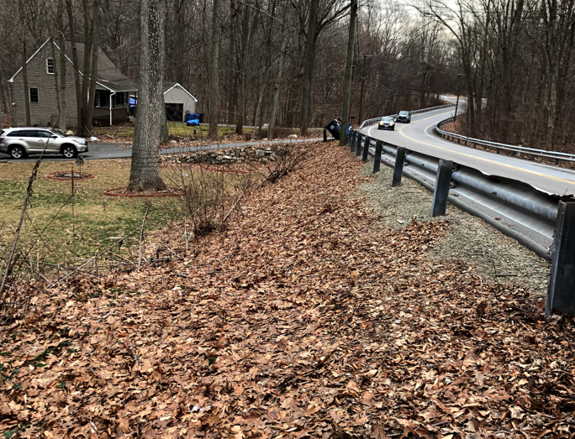
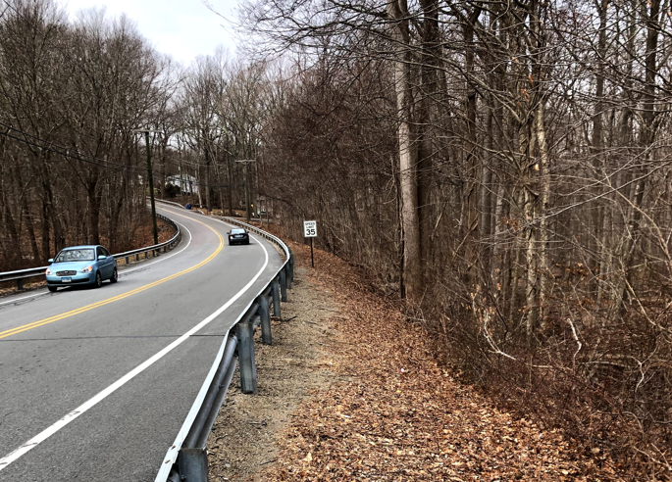
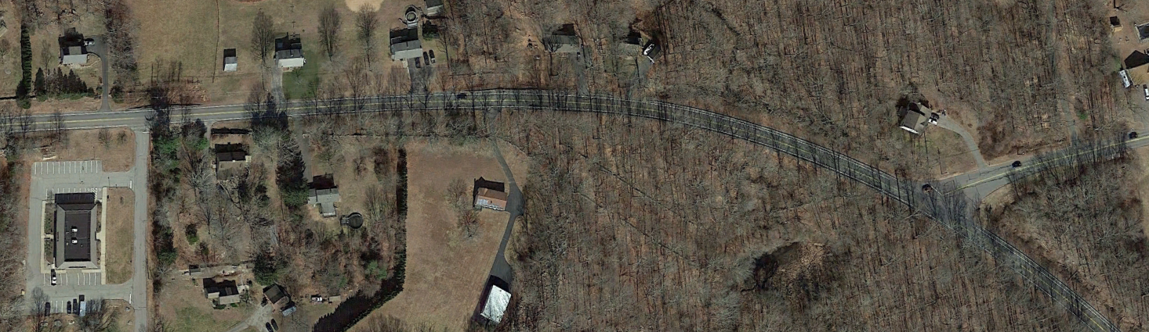
EXISTING CONDITIONS
Colonel Ledyard Hwy
Gallup Hill Rd.
Blonders Blvd.
Ledyard Public Schools Superintendent

Slide 11
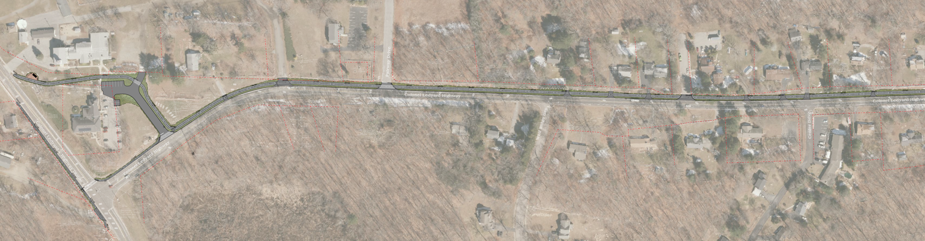
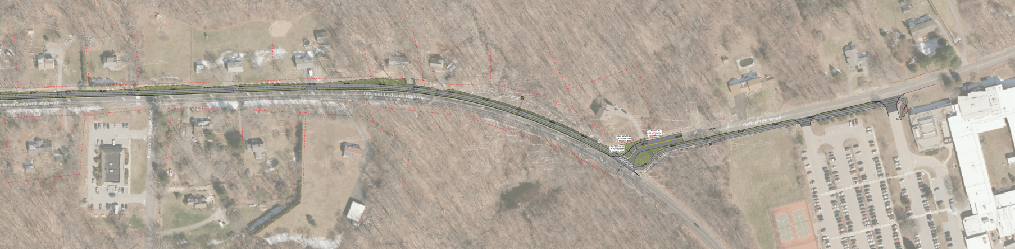
OVERALL IMPROVEMENTS

Slide 12
Proposed Sewer Extension
Initial Phase Town constructs Low Pressure Sewer (LPS) under multi use pathway. Significant cost synergies with multi-use pathway.
Center Phase Developers extend LPS across parcels
Final Phase Town replaces 3-inch LPS bottleneck
along Gallup Hill Rd from High School
to Pennywise Ln & reduce I/I at treatment plant
Future Build-Out Developers extend LPS west of Route 117

Slide 13
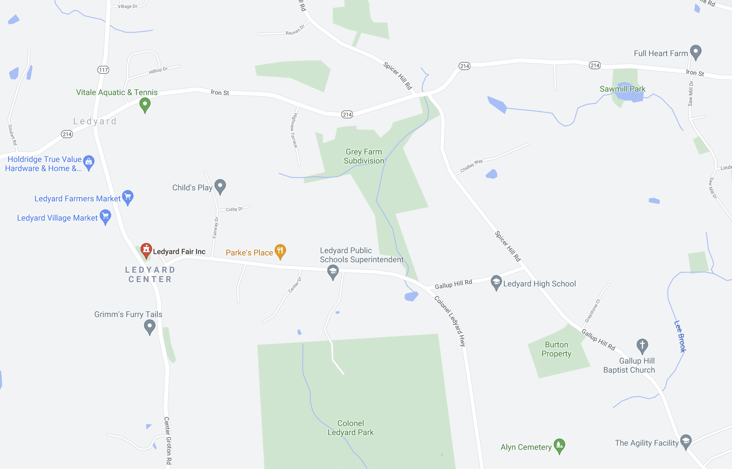
Proposed Sewer Extension
Center Phase
Pipe Capacity
Initial = 49,000 GPD
Final = 110,500 GPD
Rt 117
Future
Build-Out
Initial Phase
Final Phase
Low Pressure Sewers
with Grinder Pumps
Notes:
Initial Phase Town constructs Low Pressure Sewer (LPS) under multi use pathway. Significant cost synergies with multi-use pathway.
Center Phase Developers extend LPS across parcels
Final Phase Town replaces 3-inch LPS bottleneck along Gallup Hill Rd from High School to Pennywise Ln & reduce I/I at treatment plant
Future Build-Out Developers extend LPS west of Route 117

Slide 14
Proposed Sewer Extension
Multi-Use Pathway $2.7M (LOTCIP Funded)
Sewer Initial Phase $1.2M (ARPA Funded)
Sewer Center Phase $ TBD by Private Developers
Sewer Final Phase $950,000 by Town
Future Build-Out $ TBD by Private Developers
Construction in 2023
Preliminary values as of 8/24/2021

Slide 15
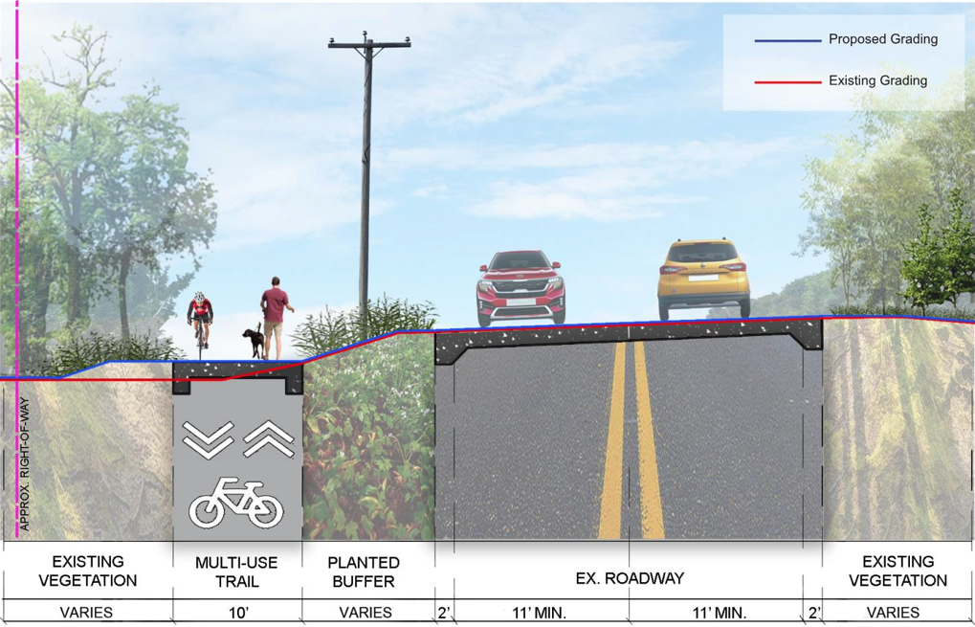
IMPROVEMENTS
Typical Sections
Sloped Condition

Slide 16
New Funding Sources This Year
Community Investment Fund (DECD)
  Provides funding for economic development in 55 municipalities denoted as public investment communities or alliance districts
  Supports “establishment of or improvements to water and sewer infrastructure to support smaller scale economic development”
Climate Resilience Fund (DEEP)
  Designed to support planning and assessment that will lead to federally funded projects
Transportation Rural Improvement Program (DOT)
  Provides funding to rural municipalities for construction of transportation projects
Municipal Resilience Grant Program (CIRCA)
  Provided funds for evaluation of stormwater authorities
Notes:
CIF – eligible projects appear to include construction of water/sewer utilities or extending them into village centers
CRF – consolidation of small water systems, protection of critical facilities such as wastewater treatment plants
TRIP – potential stormwater funding

Slide 17
thank you
westonandsampson.com

