Slide 1
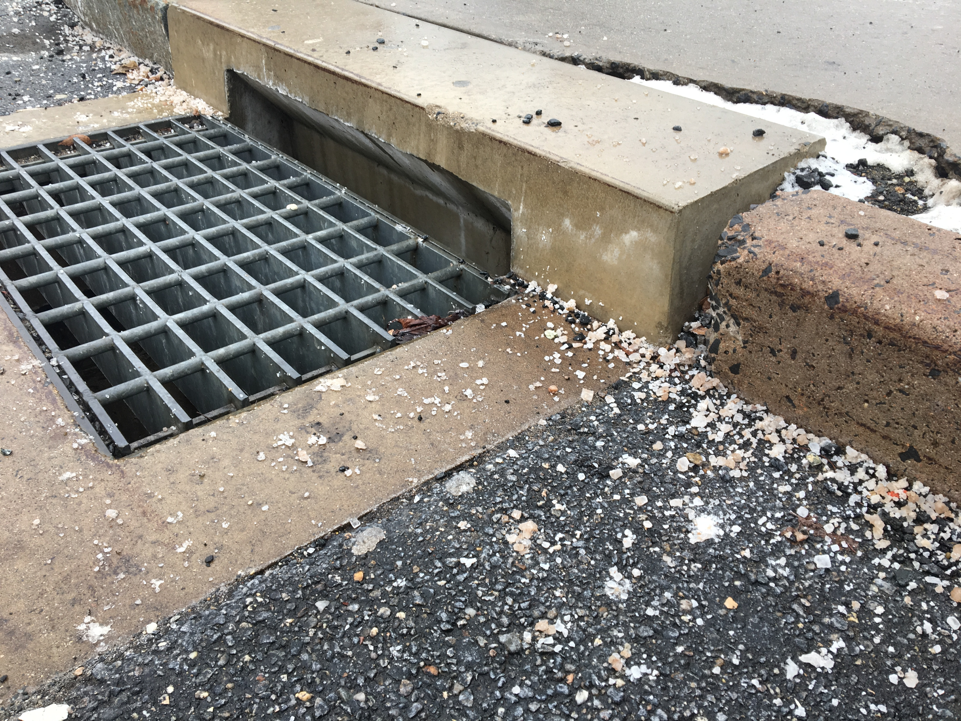
Upcoming MS4 General Permit Requirements: Year 3
COST Stormwater Management Workshop
October 22, 2019
Amanda Ryan - UConn CLEAR

Slide 2

Center for Land Use Education & Research
Water (NEMO)
Land Use & Climate Resiliency
Geospatial Tools & Training
Conservation & STEM Education
MISSION: to provide information and assistance to land use decision makers and other audiences in support of better land use decisions, healthier natural resources, and more resilient communities.

Slide 3
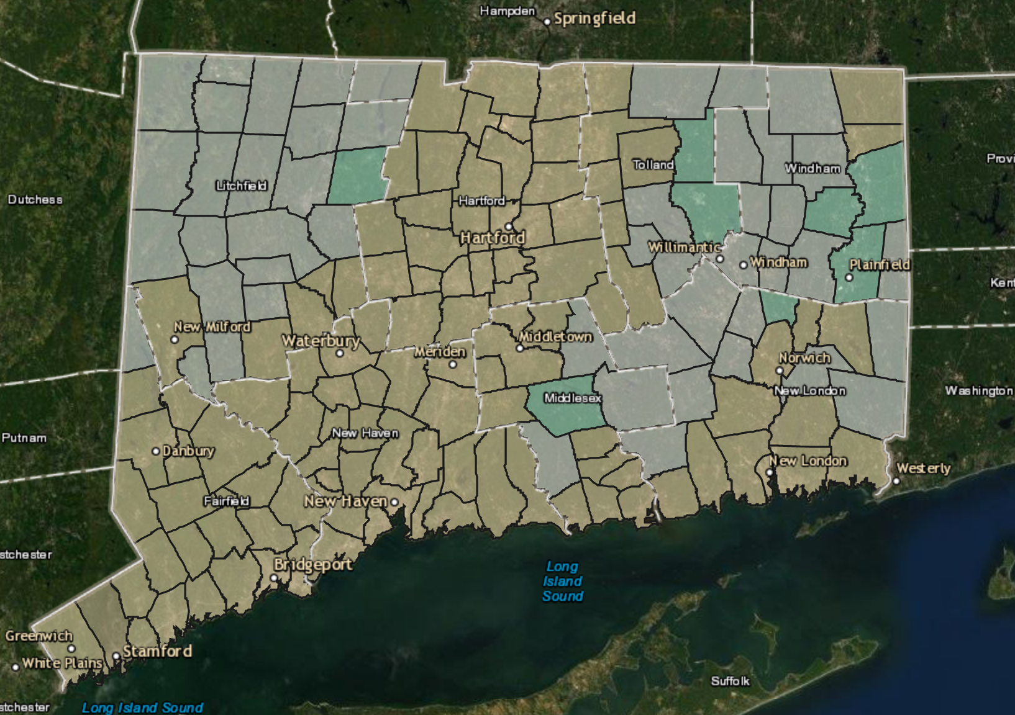
MS4 Municipalities

Slide 4
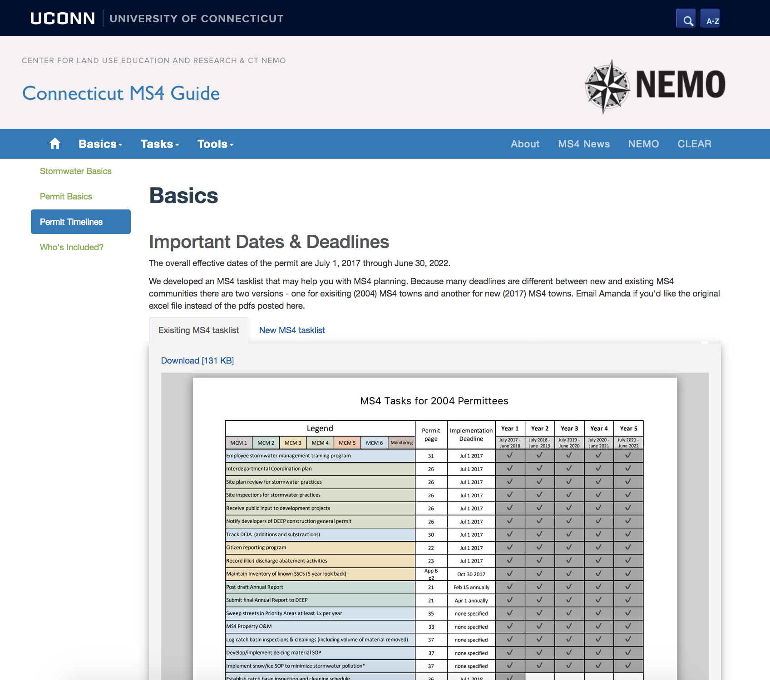
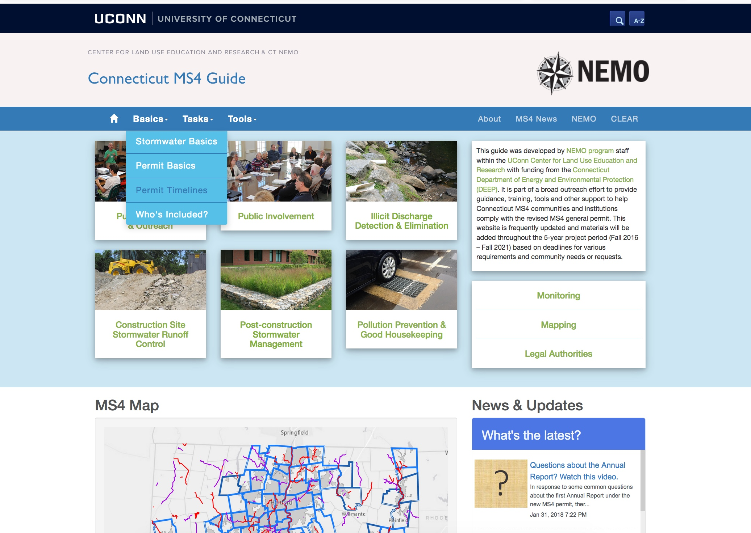
MS4 task list

Slide 5
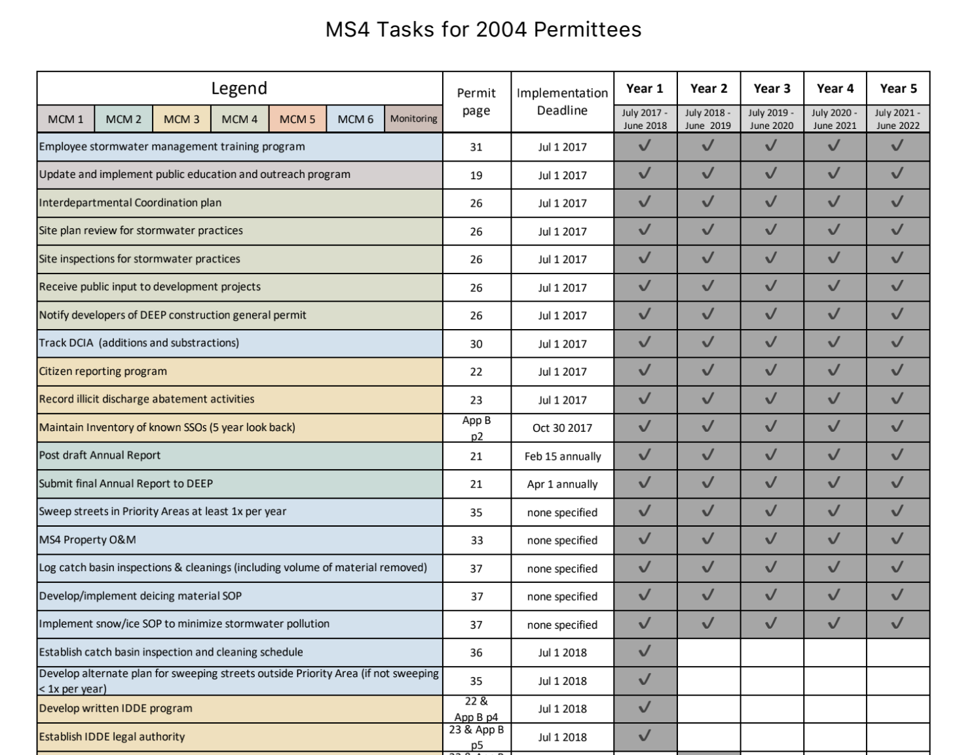
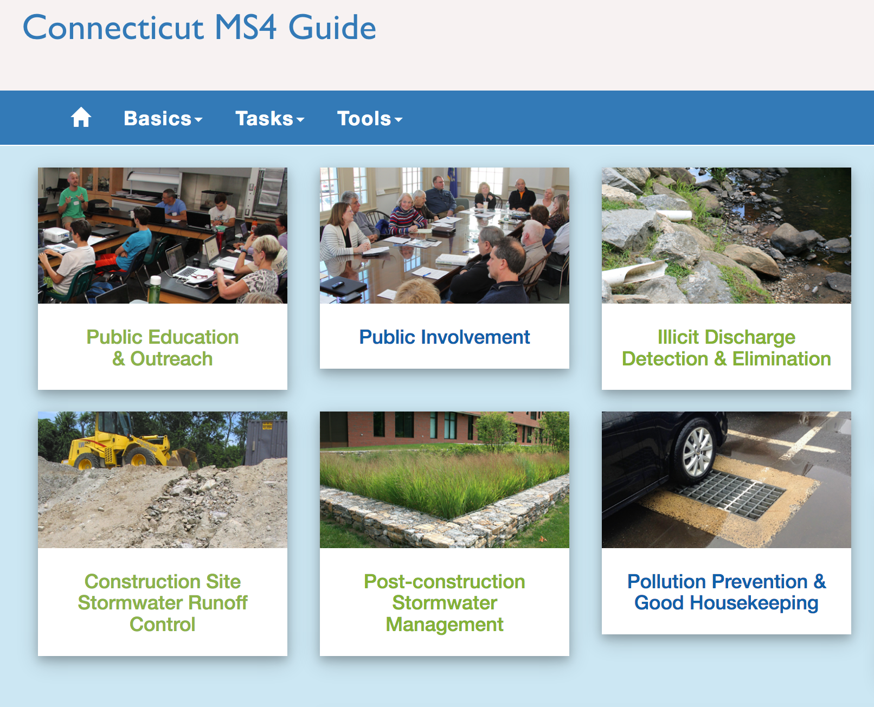

Ongoing tasks
  Public outreach program
  Public involvement
  IDDE
    Citizen reports
    Document illicit discharge responses
    Keep inventory of SSOs
  Construction sites
  Track DCIA
  Housekeeping
    Use best mgmt practices on municipal property
    Sweep streets (Priority Areas) at least 1x per year
    Log catch basin inspections / cleaning (vol of material)
    Implement deicing material SOP

Slide 6
Where you ‘should’ be...
Year 2 - Existing
Outfalls mapped
Construction legal authority
SW pond maintenance plan
Year 2 - New
Training program for employees
IDDE written program
IDDE legal authority

Slide 7
Year 3 tasks
Existing MS4
New MS4
Baseline DCIA
Retrofit Plan
Monitoring
System mapping
Inspect all priority area catch basins
Baseline DCIA
Inspect all priority area catch basins
Map outfalls
Construction legal authority
SW pond maintenance plan

Slide 8
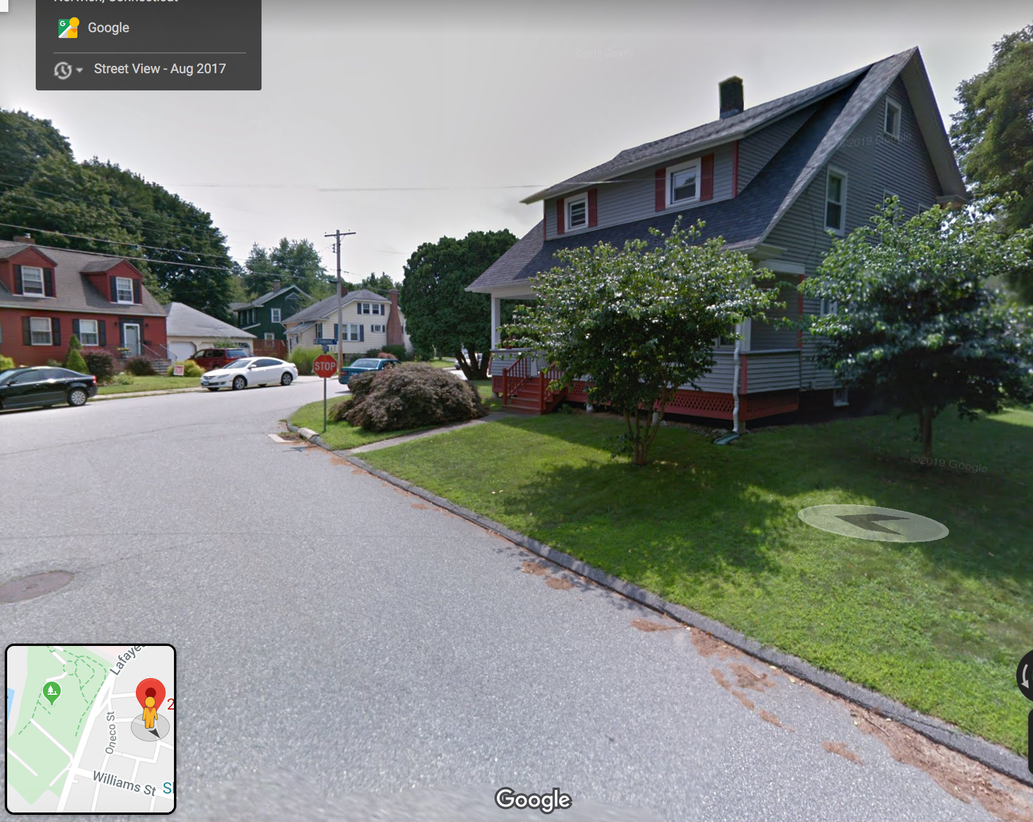
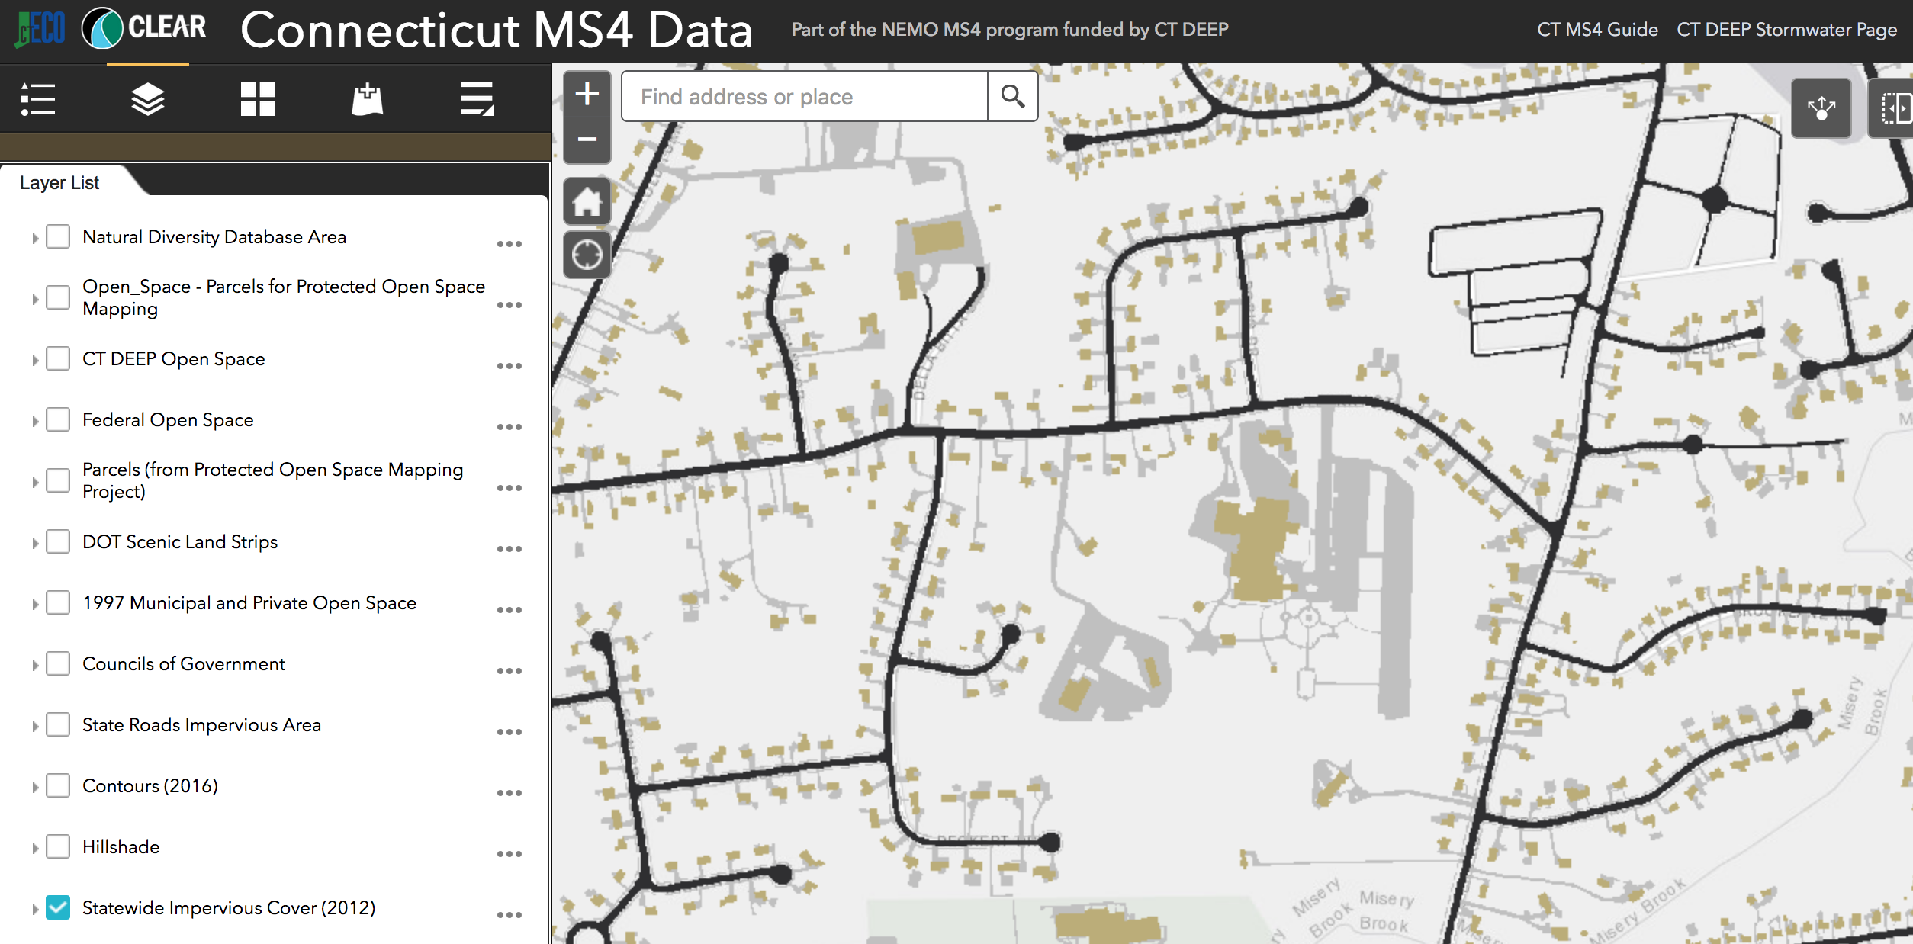
Baseline DCIA

Slide 9
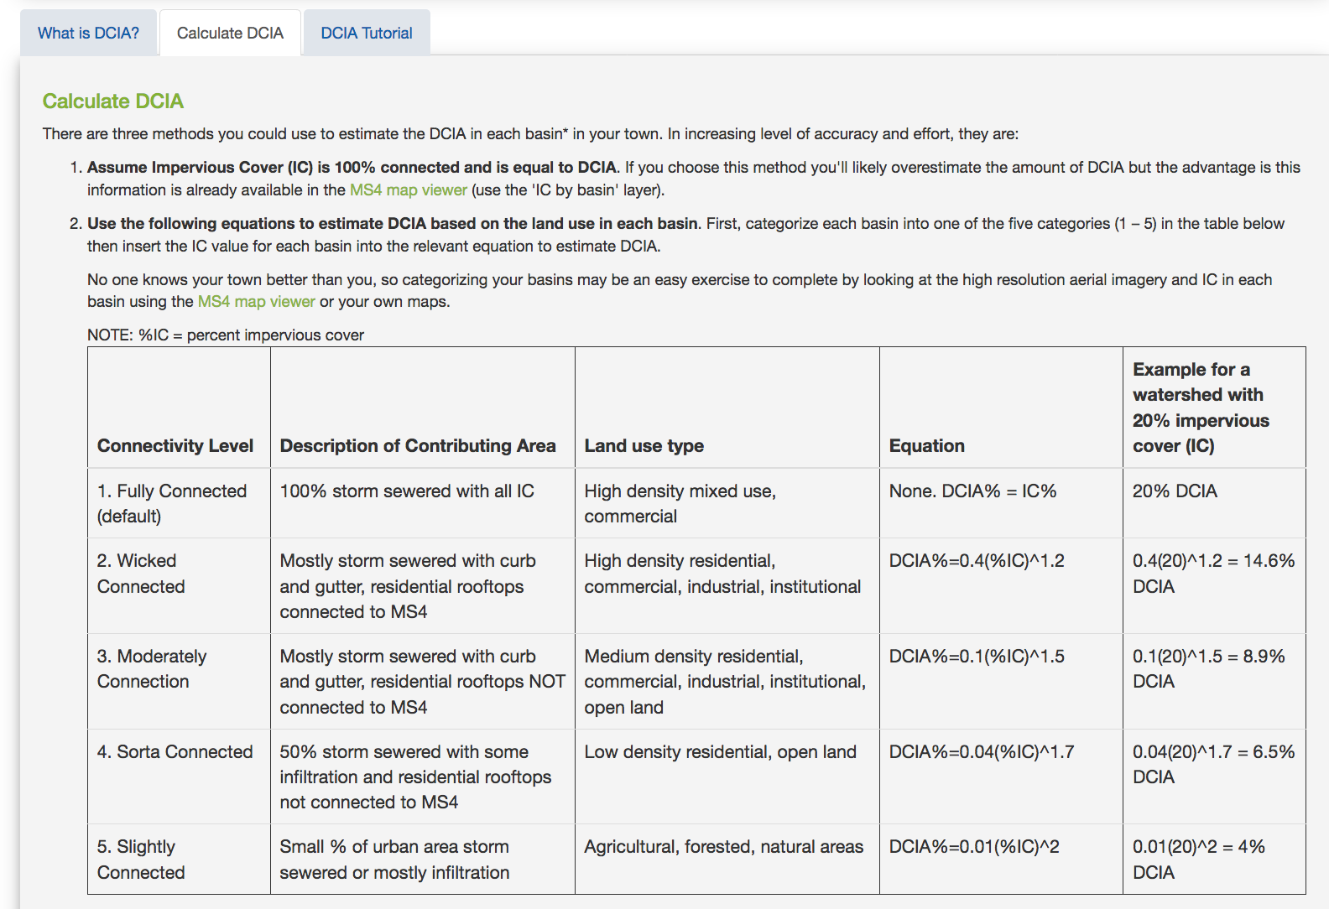
Getting from IC to DCIA
Three options:
IC = DCIA
Use equations to estimate
Map analysis & field verification

Slide 10
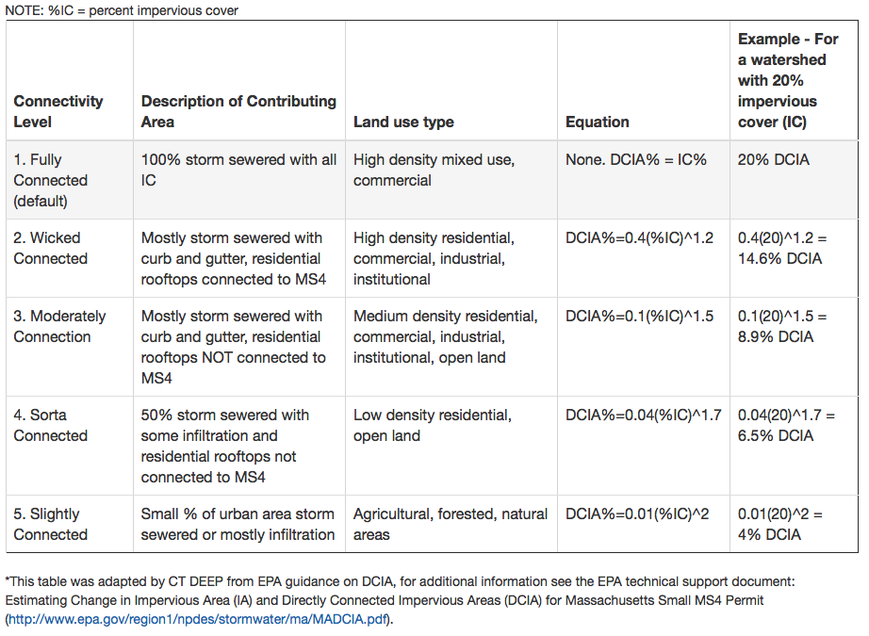
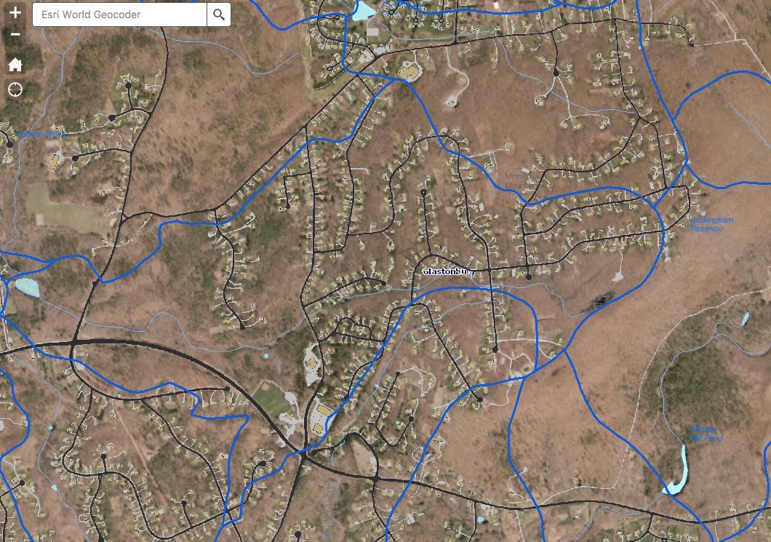
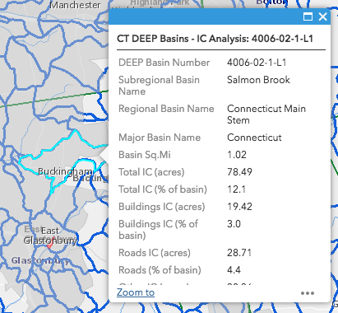
How to use DCIA equations
Salmon Brook example:
  12.1% IC
  Moderately Connected
  0.1(%IC)^1.5
  0.1(12.1)^1.5
  = 4.2% DCIA
  = 0.042*78.49 acres
    3.3 acres DCIA for this basin

Slide 11
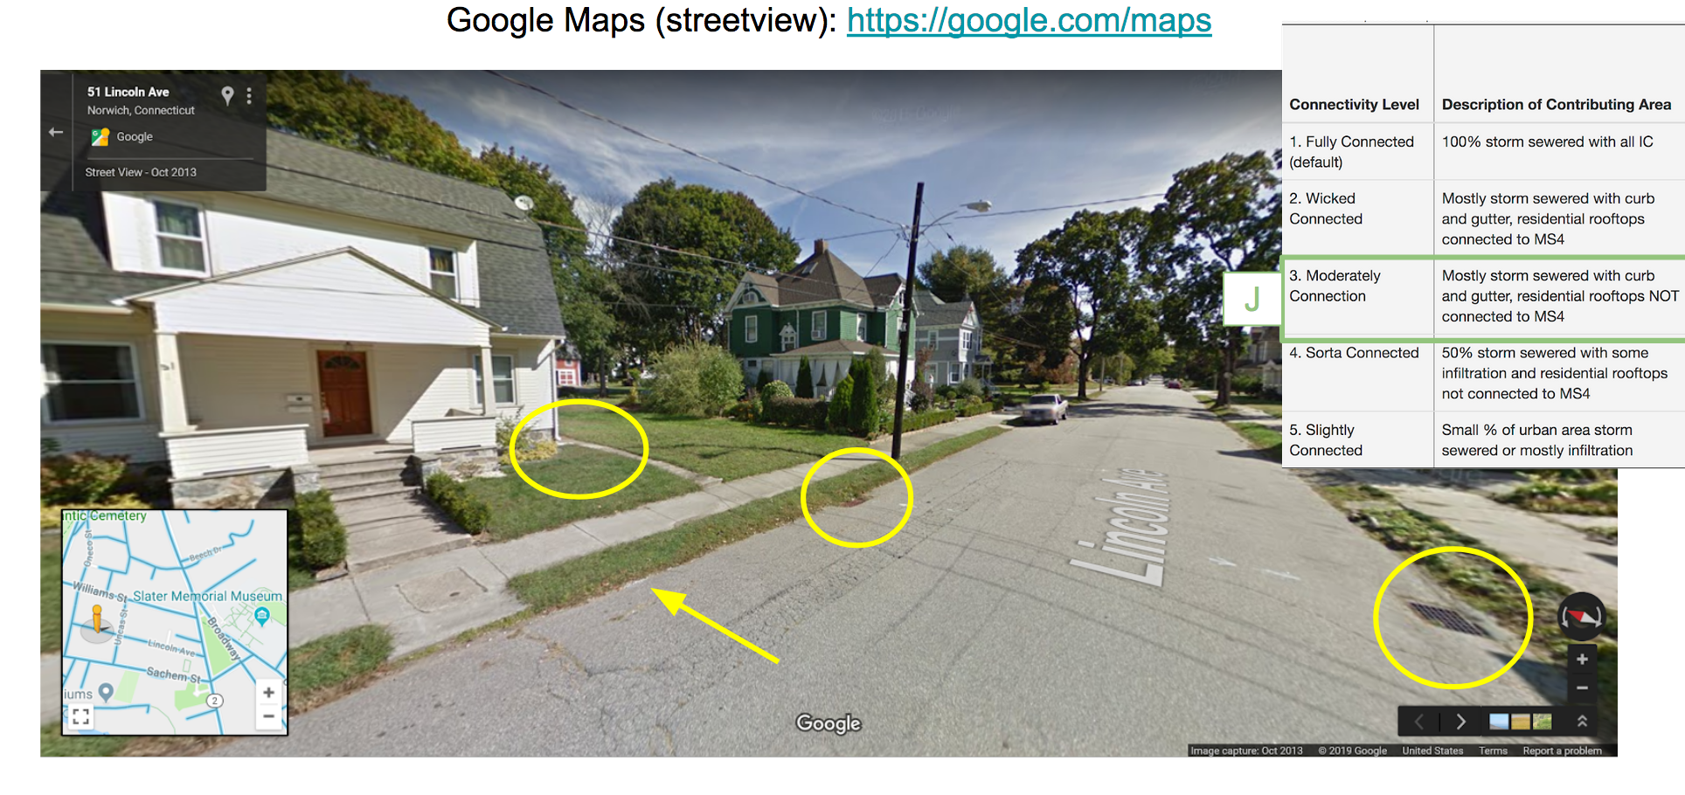
How to use DCIA equations

Slide 12
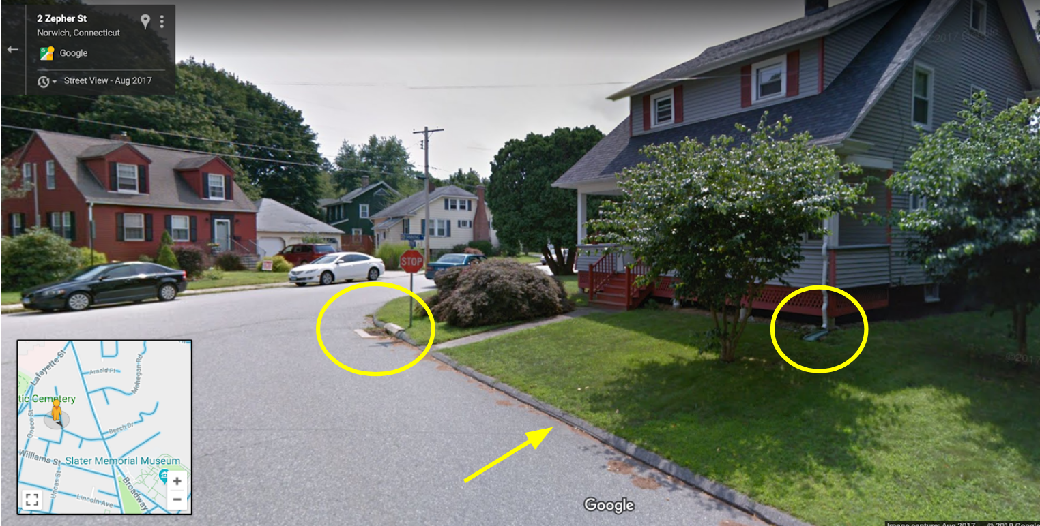
Retrofit Plan
ID sites that could work
Consider prioritizing priority area
Aim for 2% reduction

Slide 13
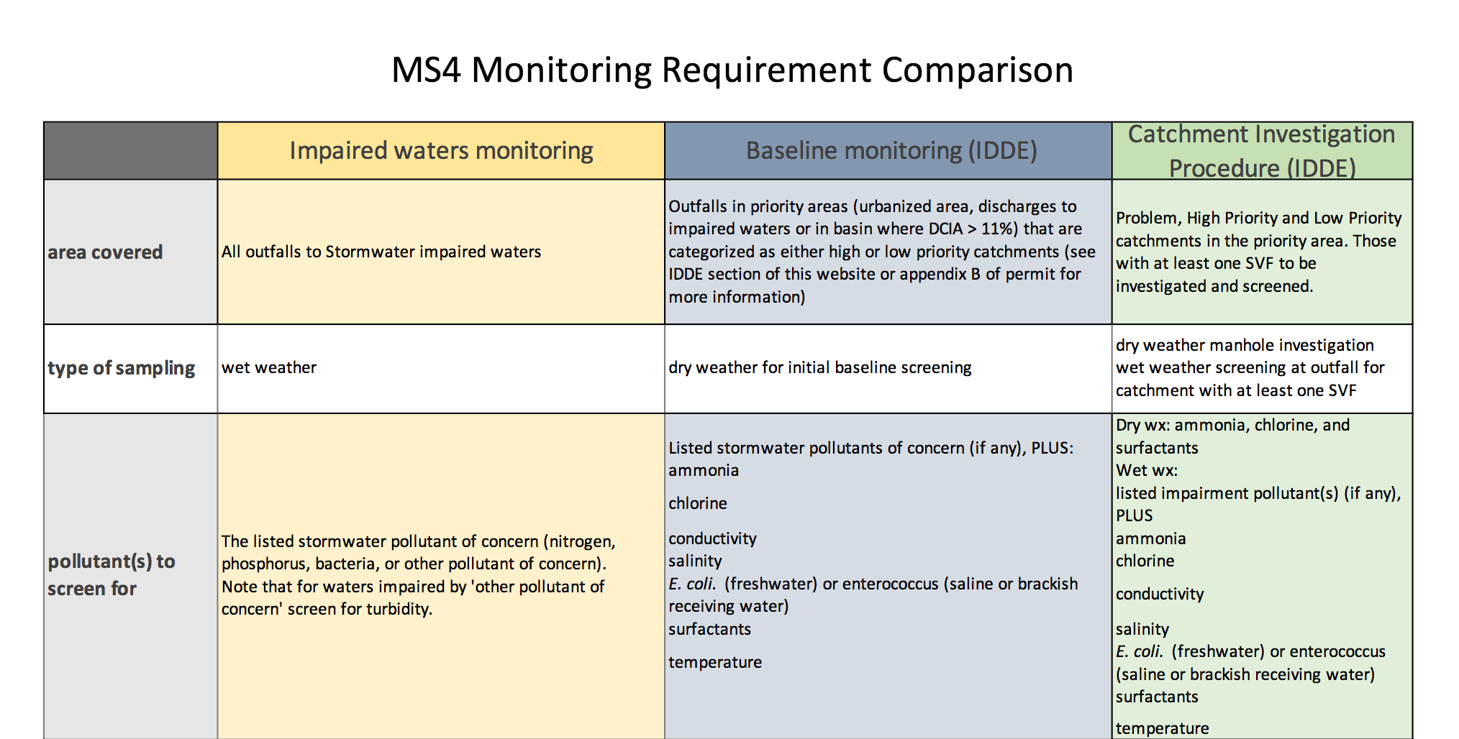
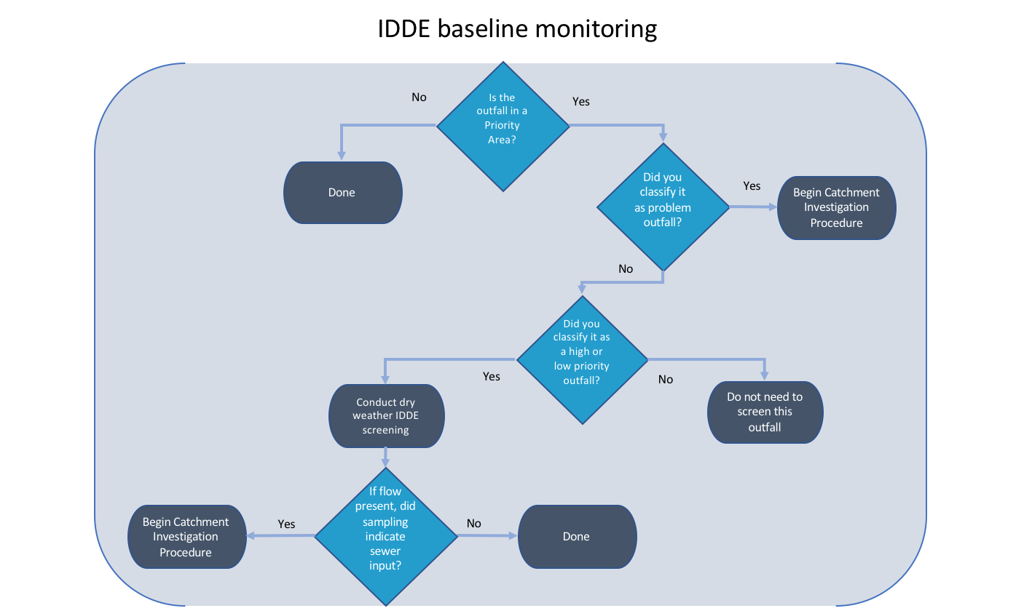
Monitoring
Two requirements:
  Impaired waters
  IDDE

Slide 14
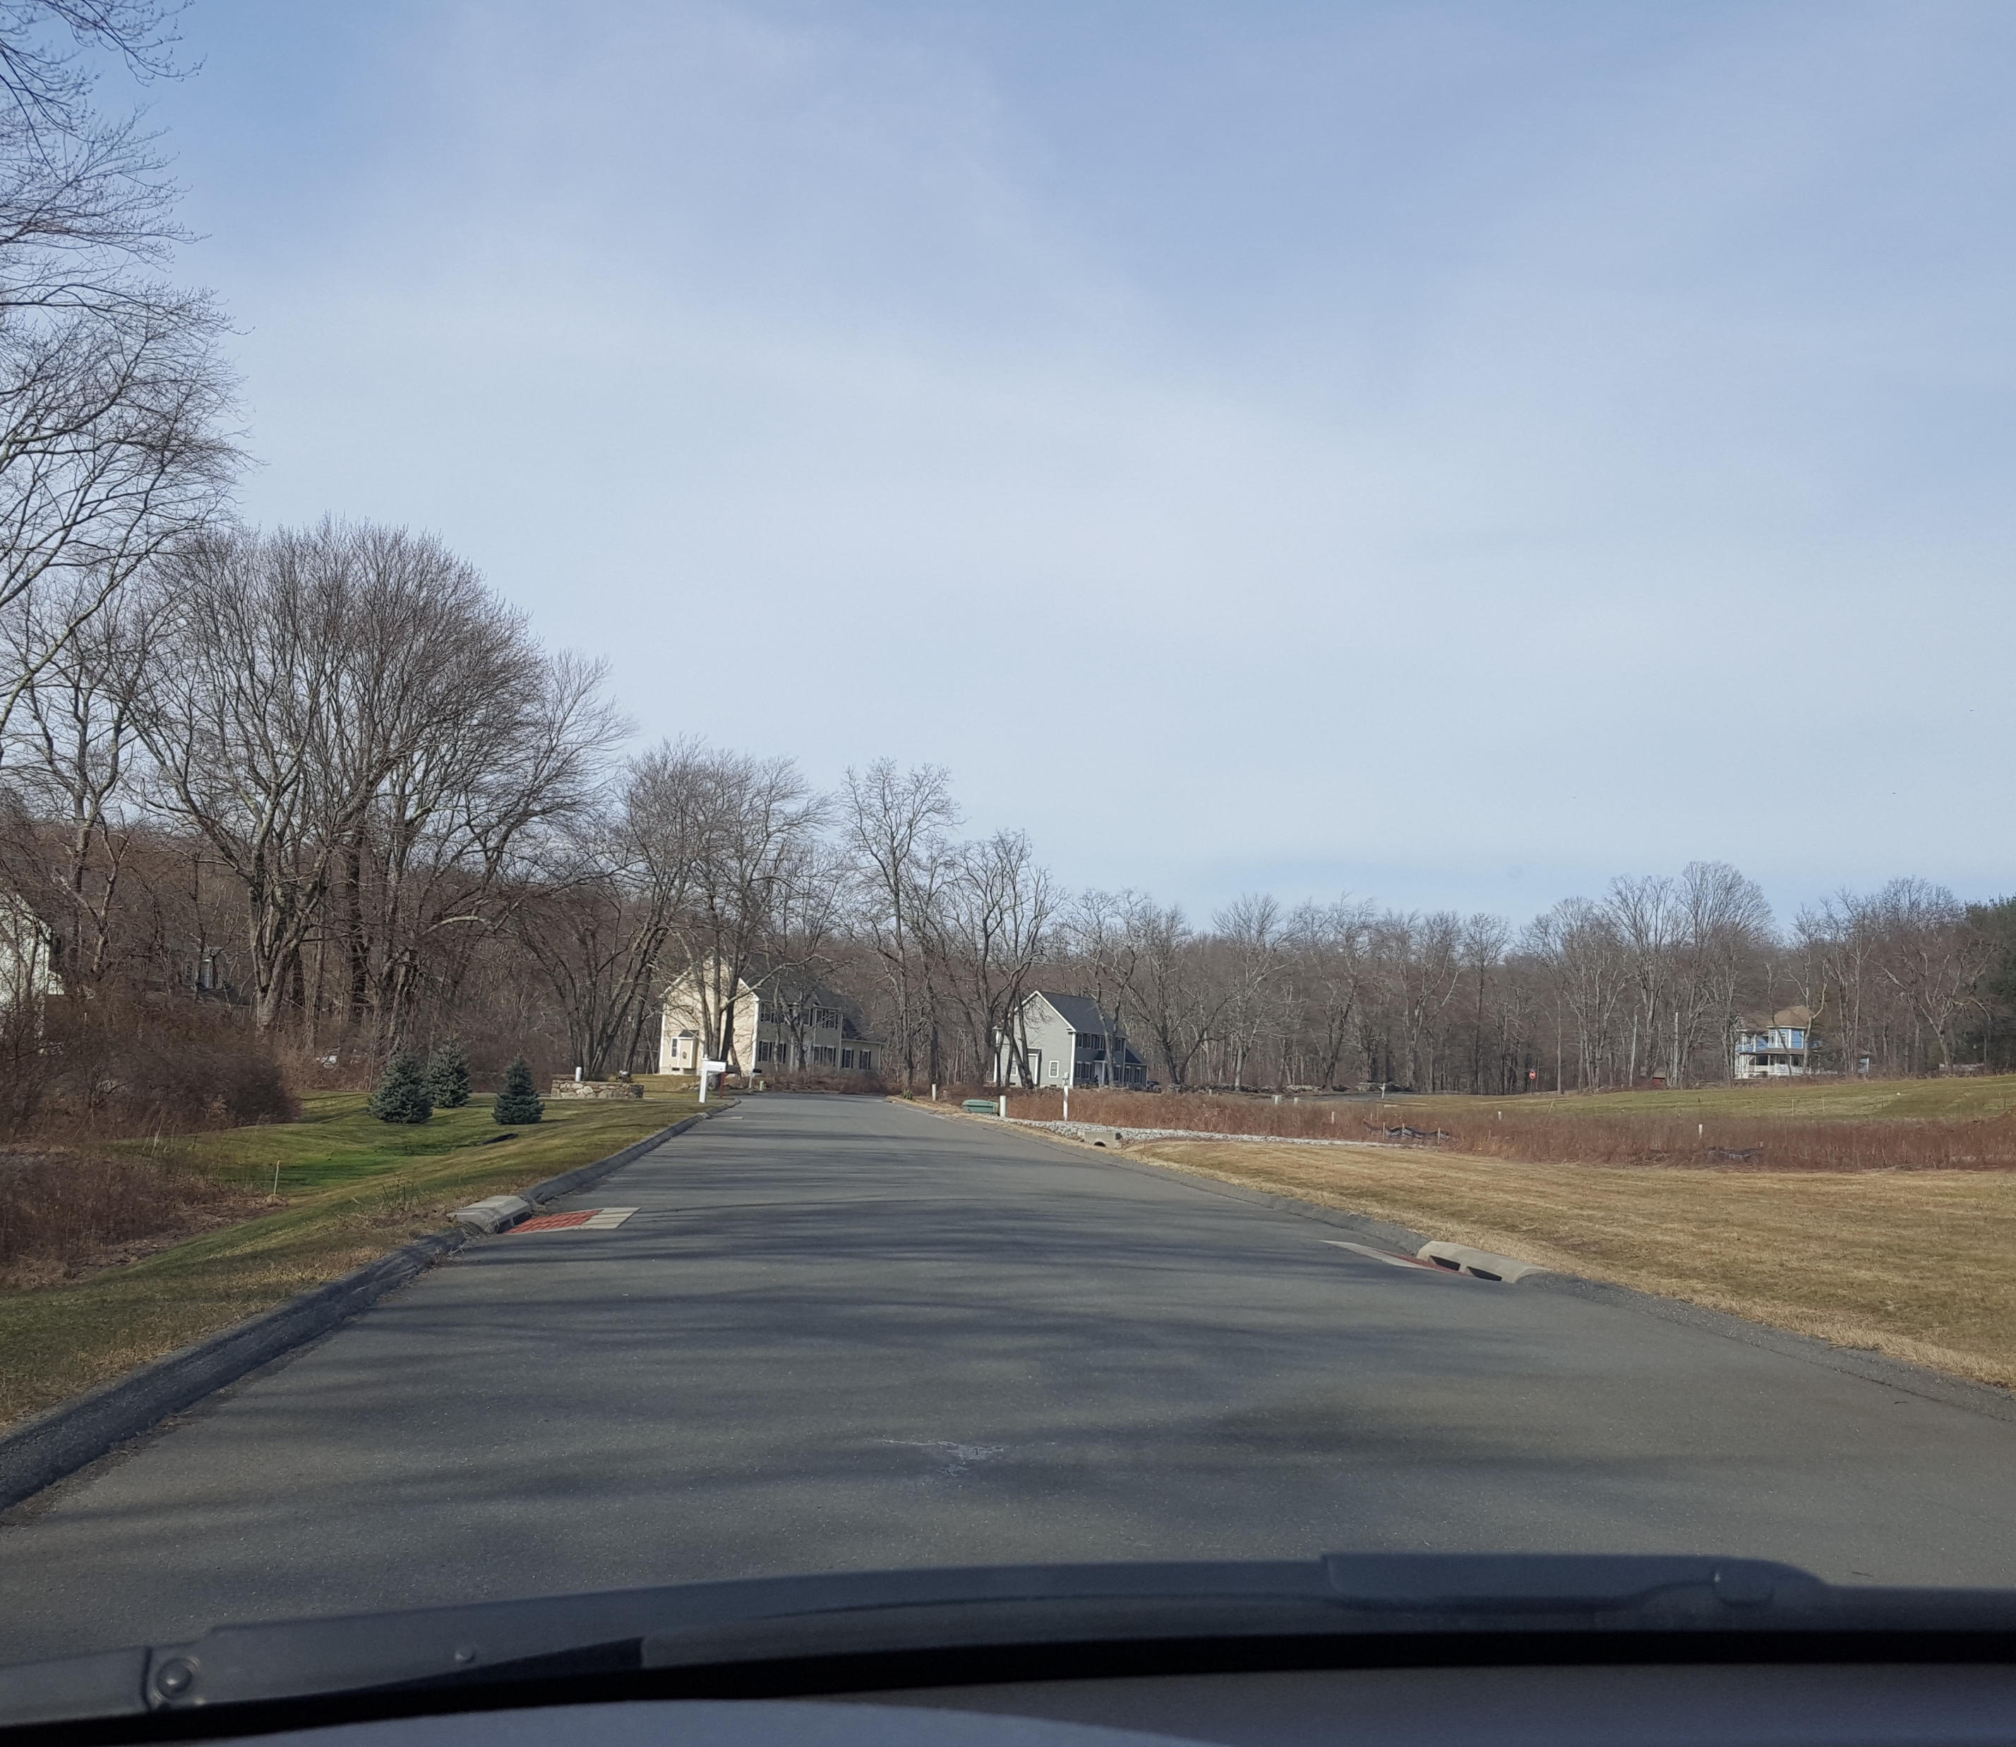
System Mapping
Required in Priority Areas:​
Outfalls* & receiving waters​
Interconnections​
Catch basins​
Pipes​
Open channel conveyances​
Manholes​
Municipally-owned stormwater treatment structures​
Don’t need to map catchment areas!

Slide 15
Inspect Catch Basins
In priority areas this year
Remaining catch basins by 2022
Clean when more than 50% full
Mitigate sources for problem catch basins

Slide 16
Year 3 tasks
Existing MS4
New MS4
Baseline DCIA
Retrofit Plan
Monitoring
System mapping
Inspect all priority area catch basins
Baseline DCIA
Inspect all priority area catch basins
Map outfalls
Construction legal authority
SW pond maintenance plan

Slide 17
Thank you!
Amanda.ryan@uconn.edu
www.nemo.uconn.edu/ms4

Slide 18
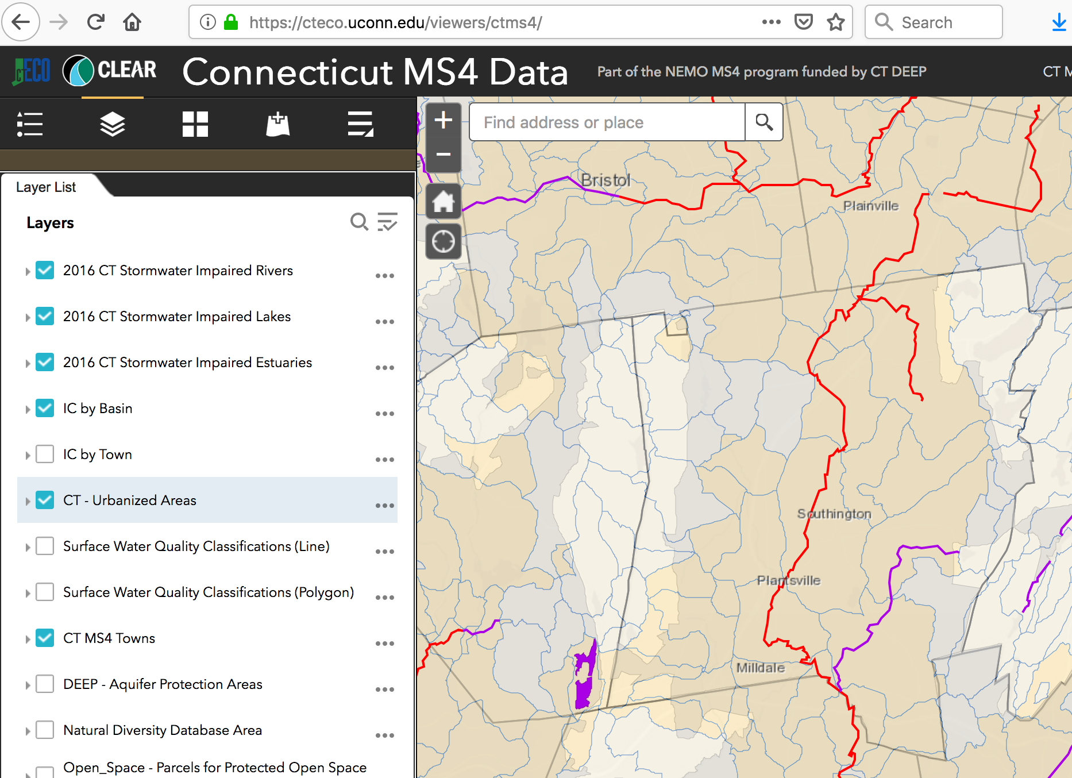
MS4 ‘Priority Areas’
Any place where you have:
An Urbanized Area
DCIA > 11% in a basin
Discharge to an impaired waterbody

Slide 19
MS4 Tools from UConn CLEAR
COST Stormwater Management Workshop
October 22, 2019
Amanda Ryan - UConn CLEAR

Slide 20
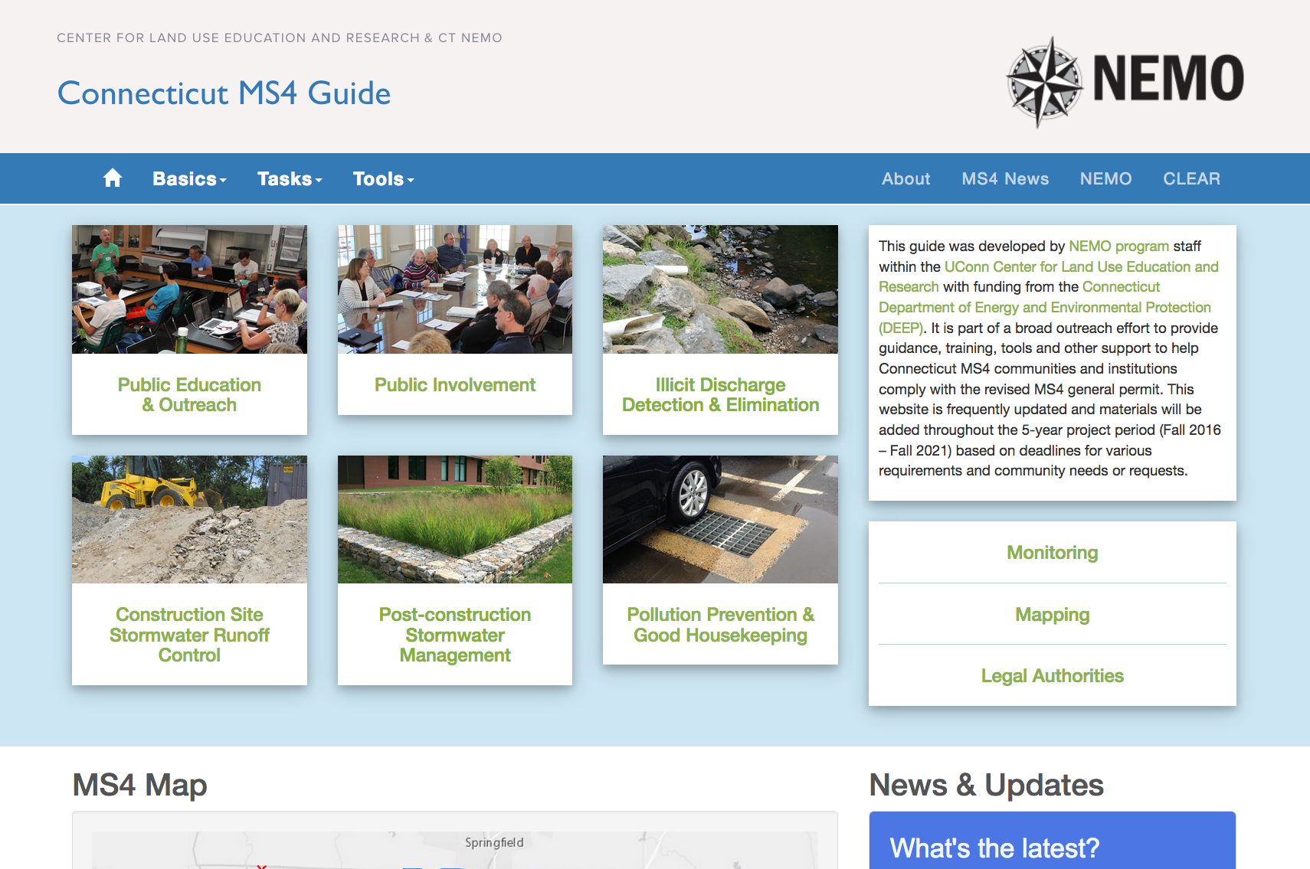

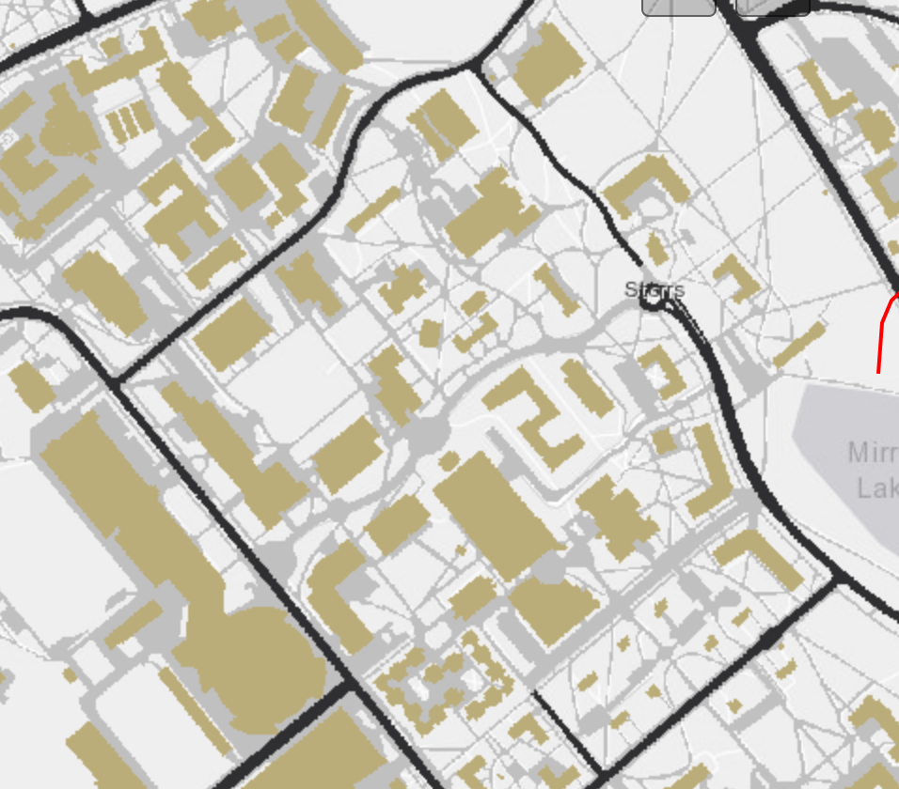
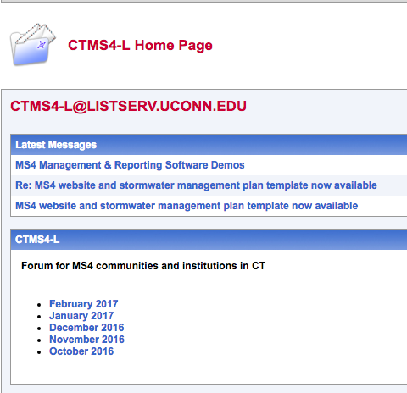

CLEAR’s MS4 Support
Funded by DEEP for 5 years
MS4 educator
website & listserv
workshops & webinars
maps & data
Amanda Ryan
http://nemo.uconn.edu/ms4
maps & data
http://s.uconn.edu/ctms4list
workshops & webinars

Slide 21
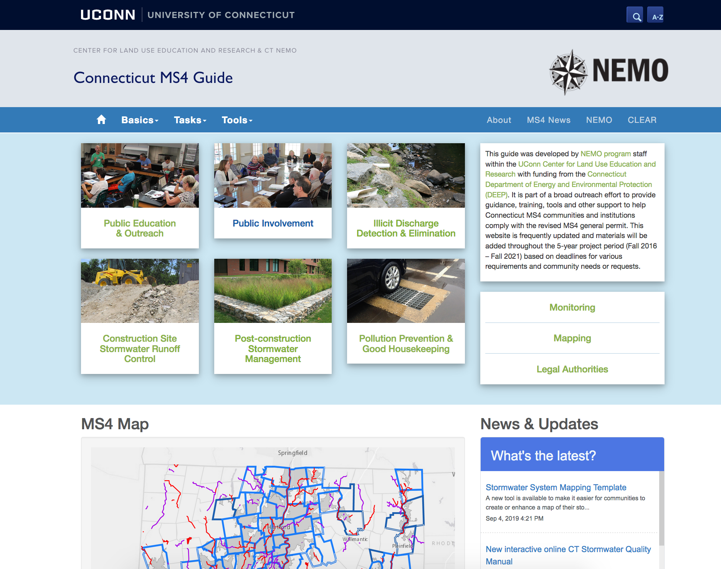
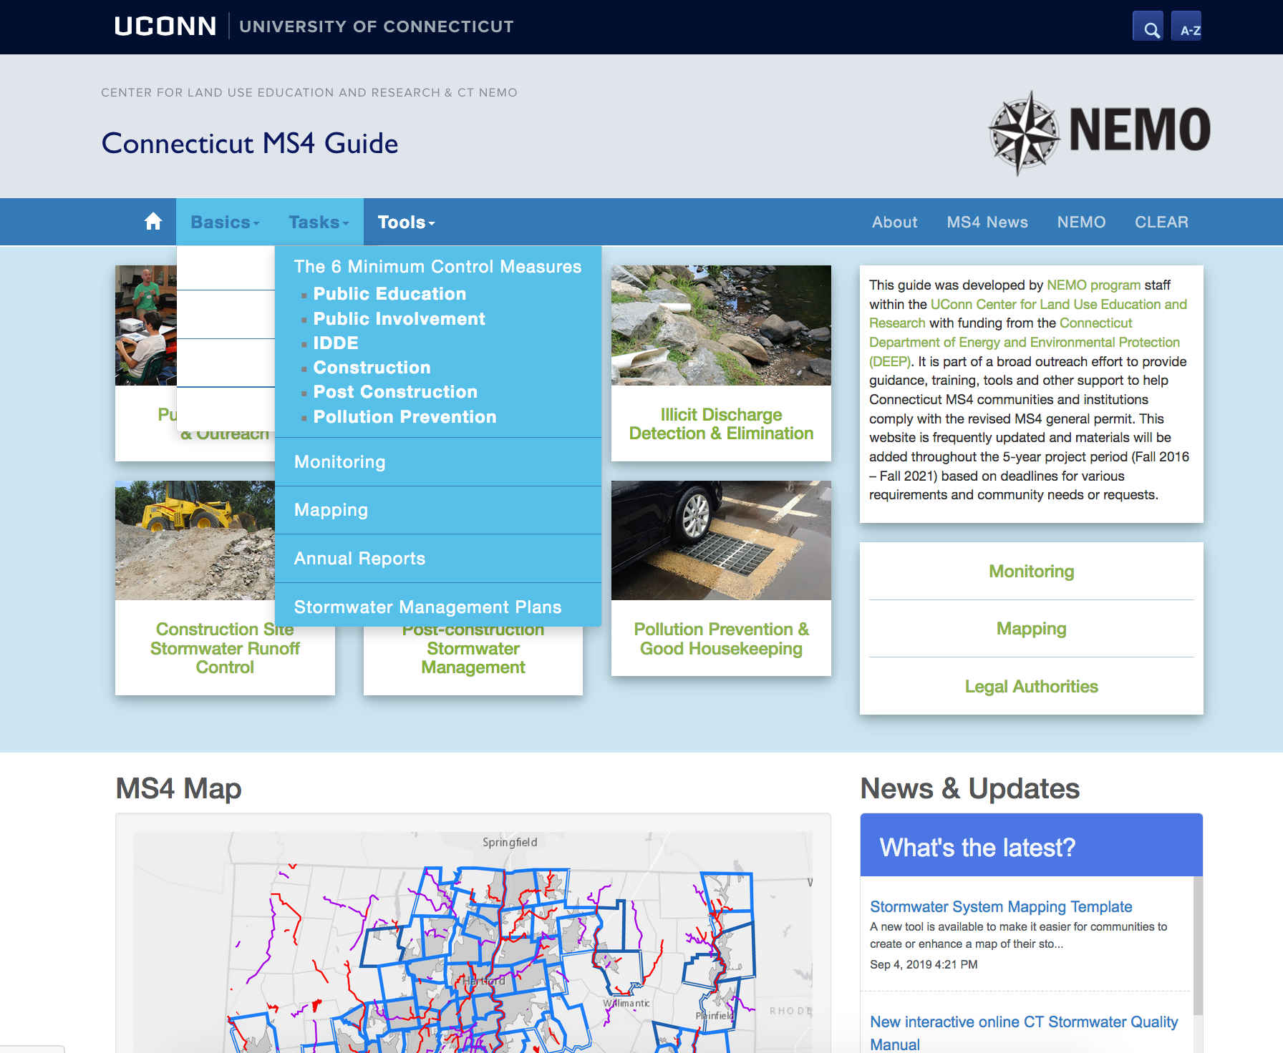
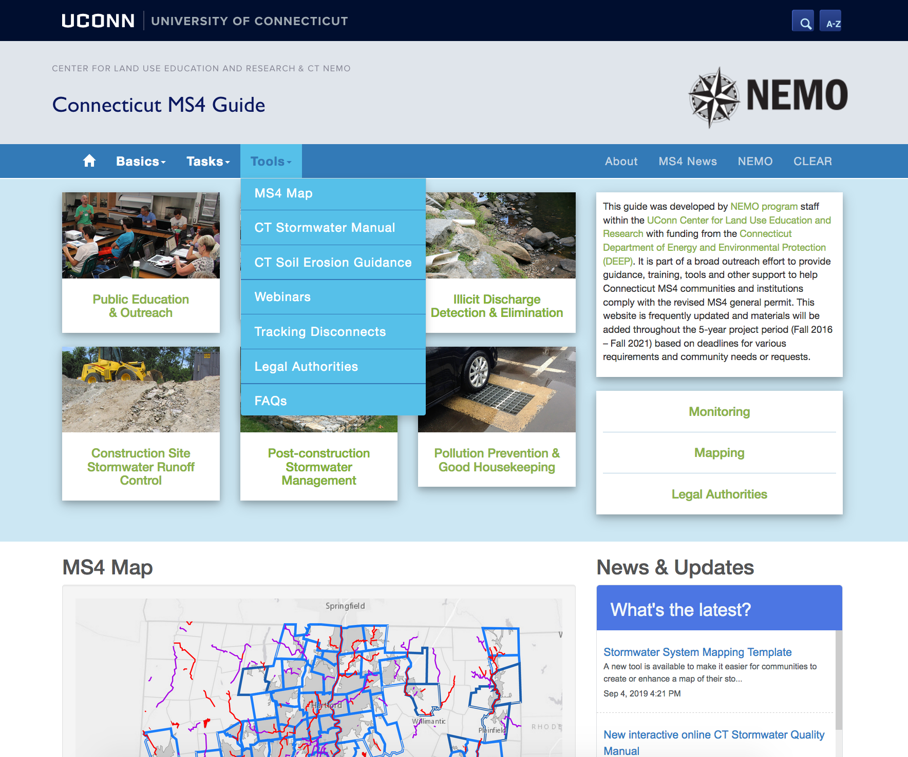
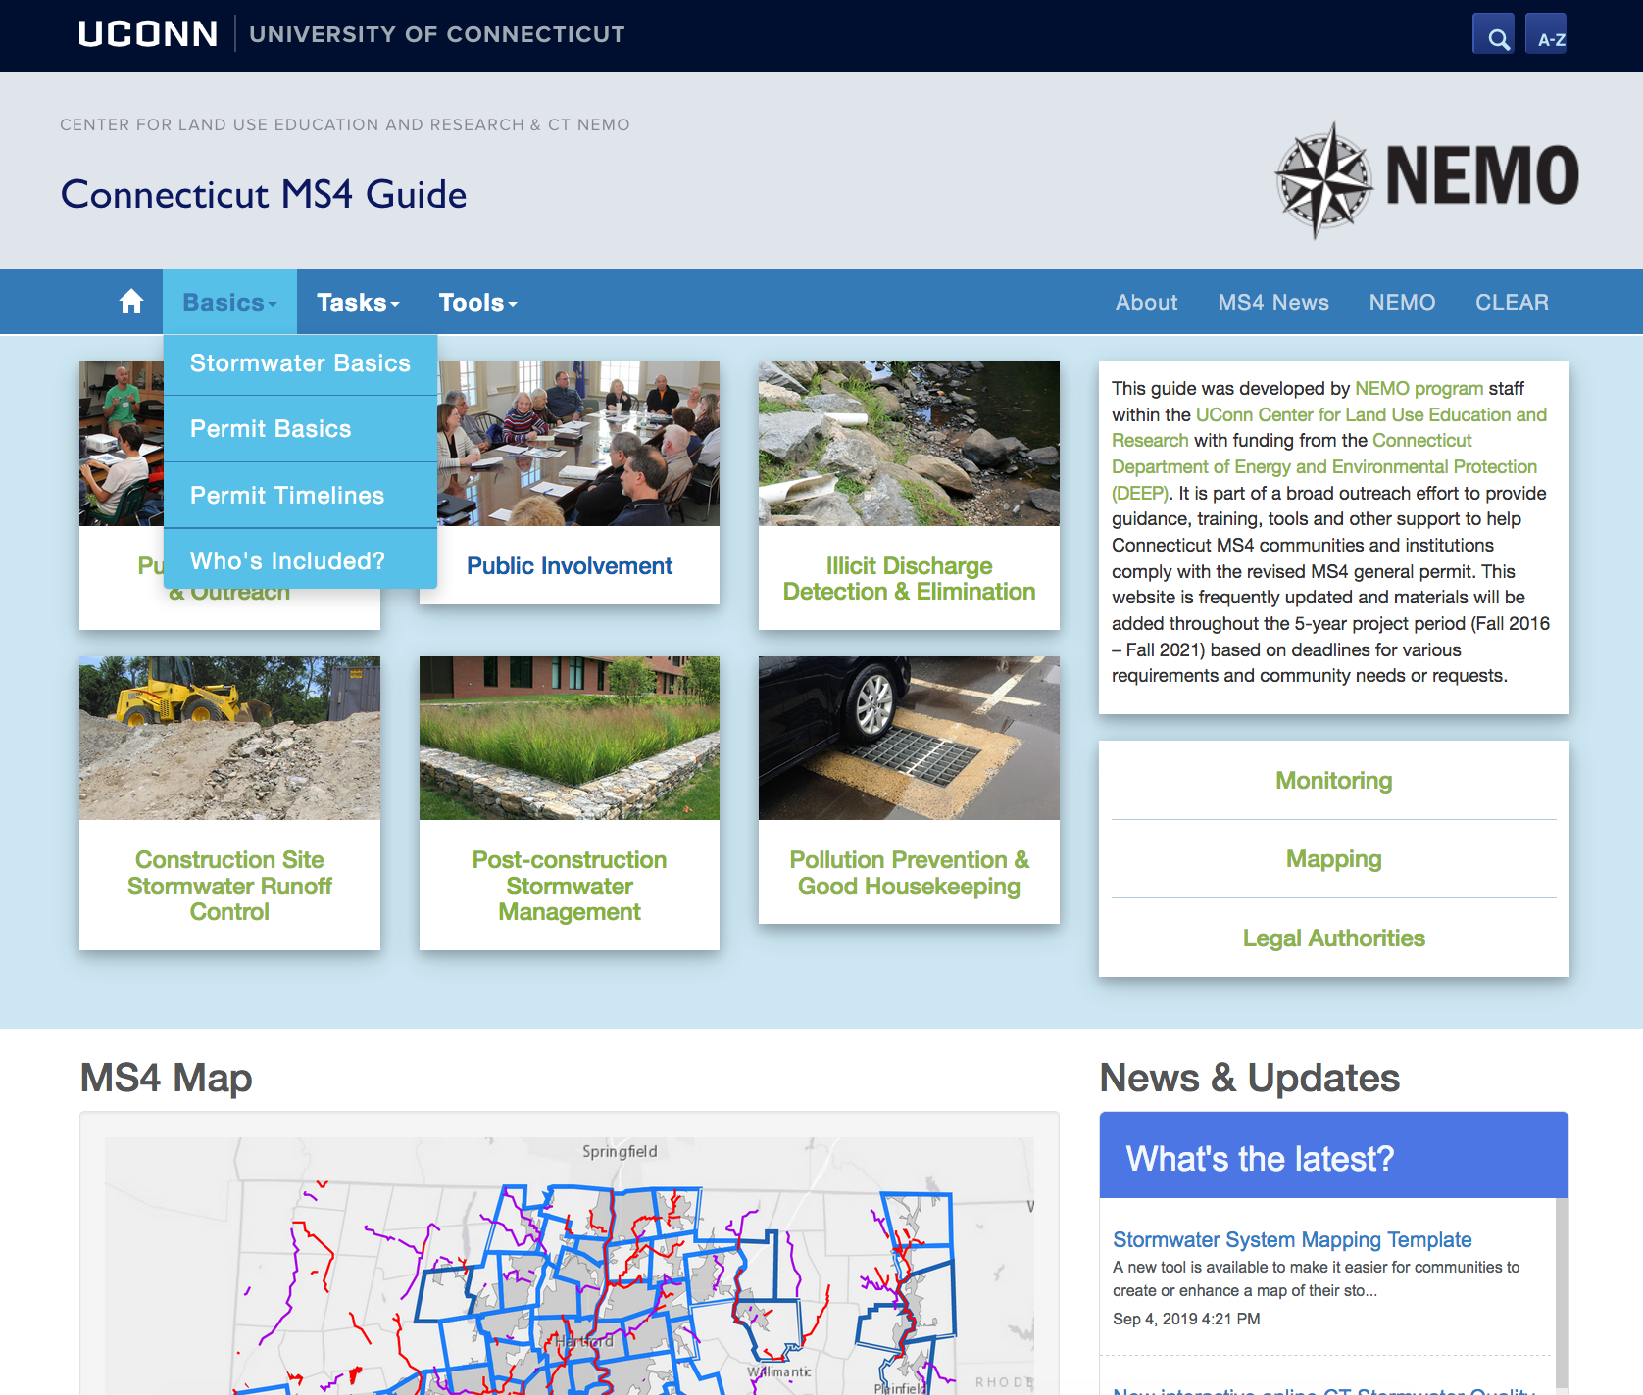
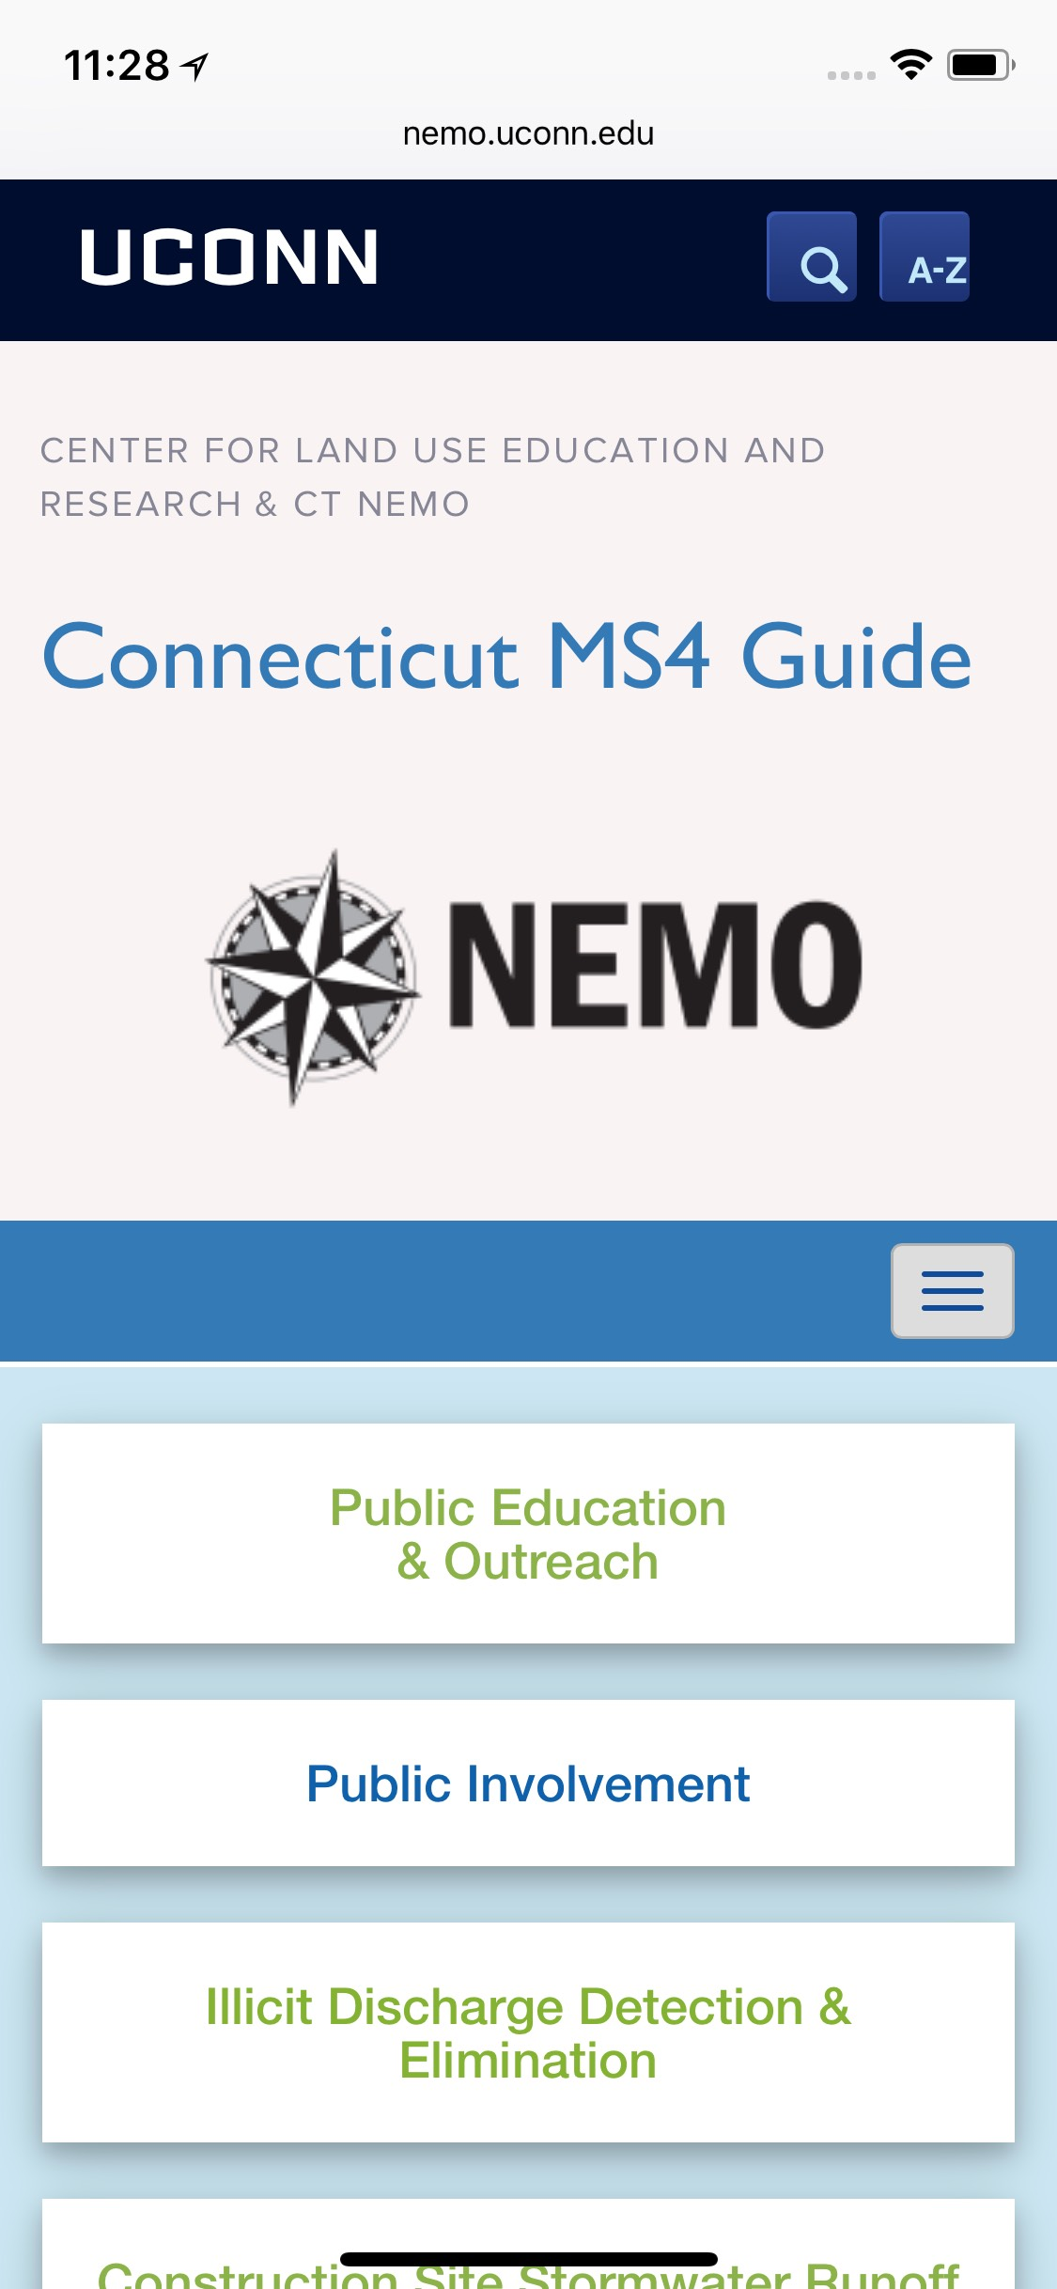
Online MS4 Guide
http://nemo.uconn.edu/ms4
Basics
Tasks
Tools

Slide 22
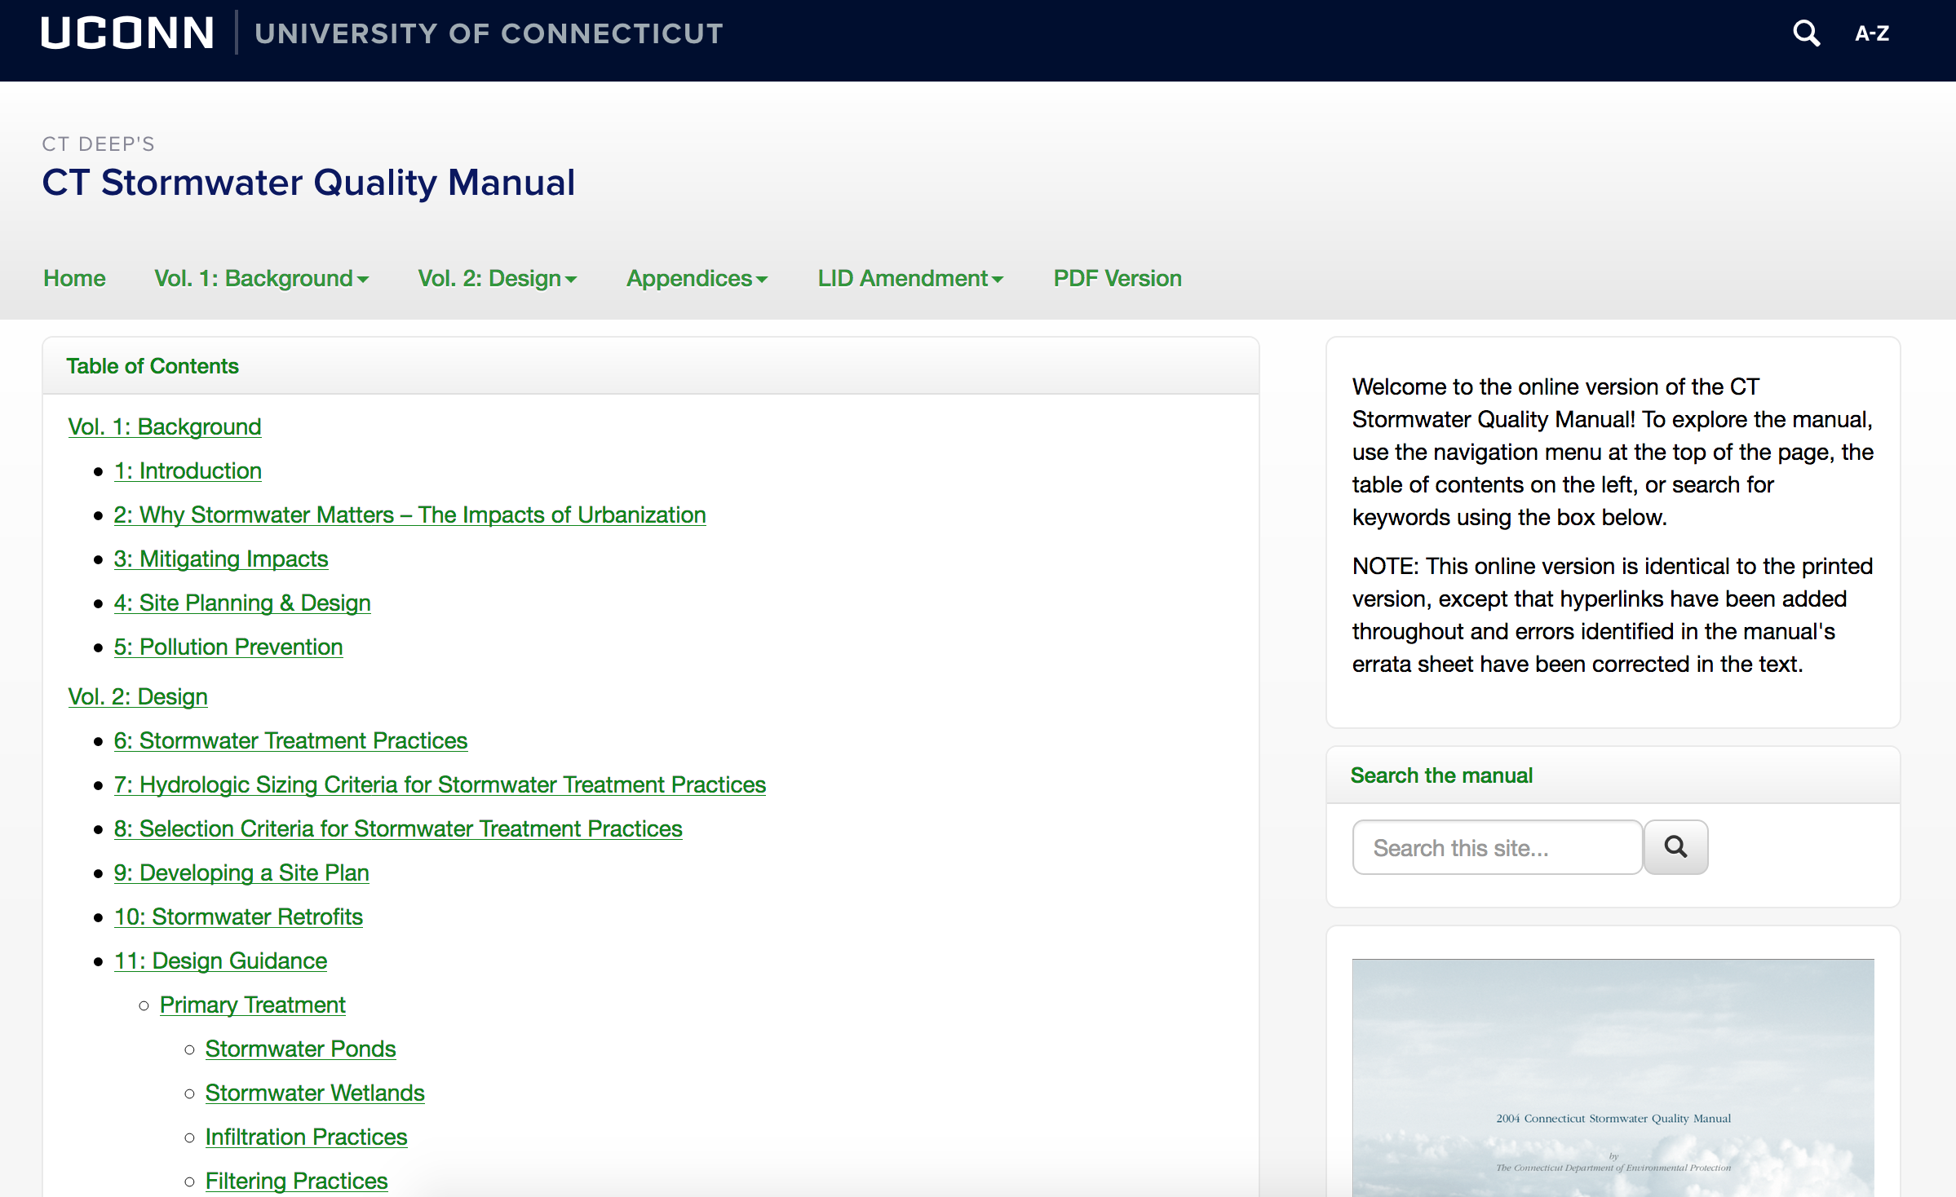
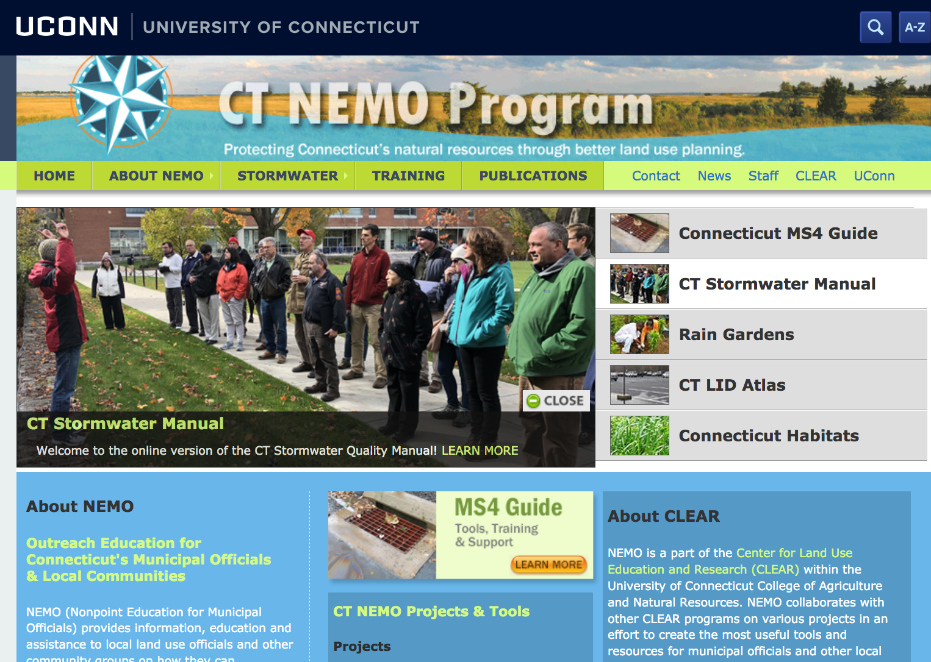
New & upcoming support
New
Monitoring workshop materials
Stormwater Utilities in CT webinar
Statewide stormwater infrastructure mapping schema
Online stormwater manual
Upcoming
‘Getting to 2% - Case Studies in Impervious Cover Disconnection’ webinar - November 14th
Last legal authority (fee in lieu / off-site mitigation)

Slide 23
Thank you!
Amanda Ryan
Amanda.ryan@uconn.edu

