Slide 1
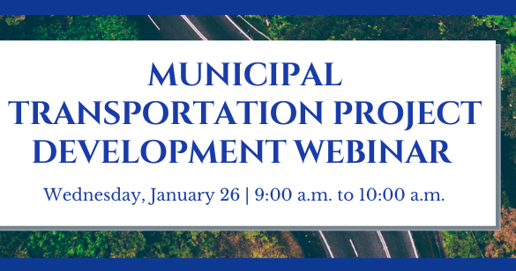

Slide 2
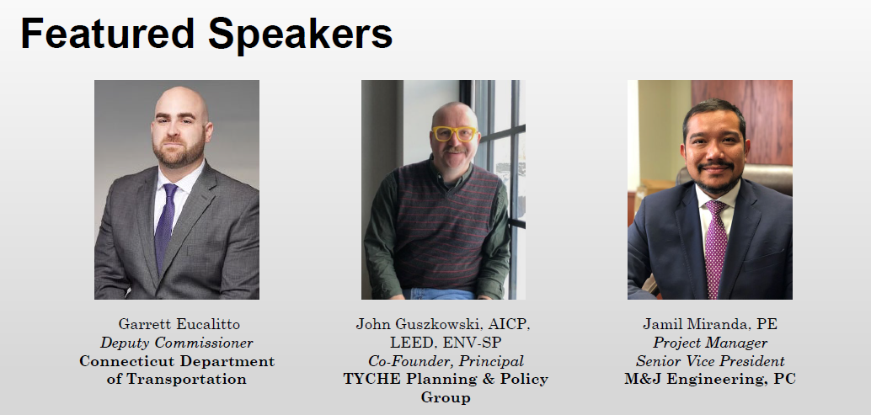

Slide 3

Overview of IIJA
Historic investments in the nation’s core infrastructure needs
Combines incremental funding for existing programs with many net-new opportunities
Mix of formula funding & competitive grants
Implementation timelines will vary significantly by program
Source: https://www.whitehouse.gov/briefing-room/statements-releases/2021/11/08/fact-sheet-the-bipartisan-infrastructure-deal-boosts-clean-energy-jobs-strengthens-resilience-and-advances-environmental-justice/

Slide 4
Overview of IIJA
For Connecticut, IIJA includes significant formula funding:
$3.5 billion for highway programs and $561 million for bridge replacement & repair with a focus on climate change mitigation, resilience, equity, and safety for cyclists and pedestrians
$1.3 billion to improve public transportation and further develop healthy and sustainable transportation options
$445 million to improve water infrastructure across the state and ensure that clean, safe drinking water is a right in all communities by eliminating Connecticut’s lead service lines and pipes
$100 million to provide broadband coverage across state, helping connect every citizen to reliable high-speed internet
$62 million for airport infrastructure development, improving and modernizing Connecticut’s airports
$53 million to support expansion of EV charging network, building a network of EV chargers to facilitate long-distance travel and provide convenient charging options
$90 million to protect transportation infrastructure and $13 million to protect against cyberattacks, preparing our infrastructure for the impacts of climate change and extreme weather events and cyber disruptions

Slide 5
Overview of Anticipated DOT Federal Formula Funding
Note: These values do not include matching State funds.

Slide 6
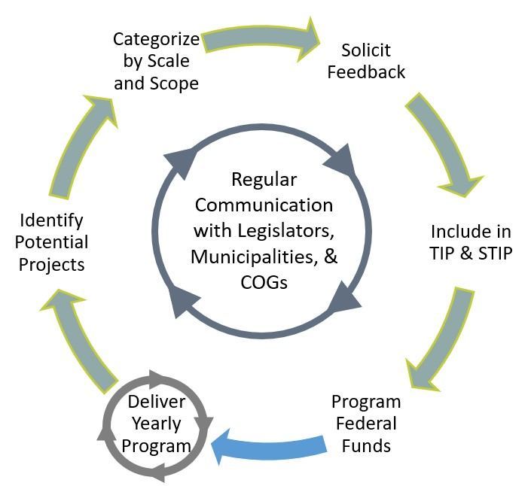

How Projects Advance with Federal Formula Funds

Slide 7
Overview of New Federal Formula Programs

Slide 8
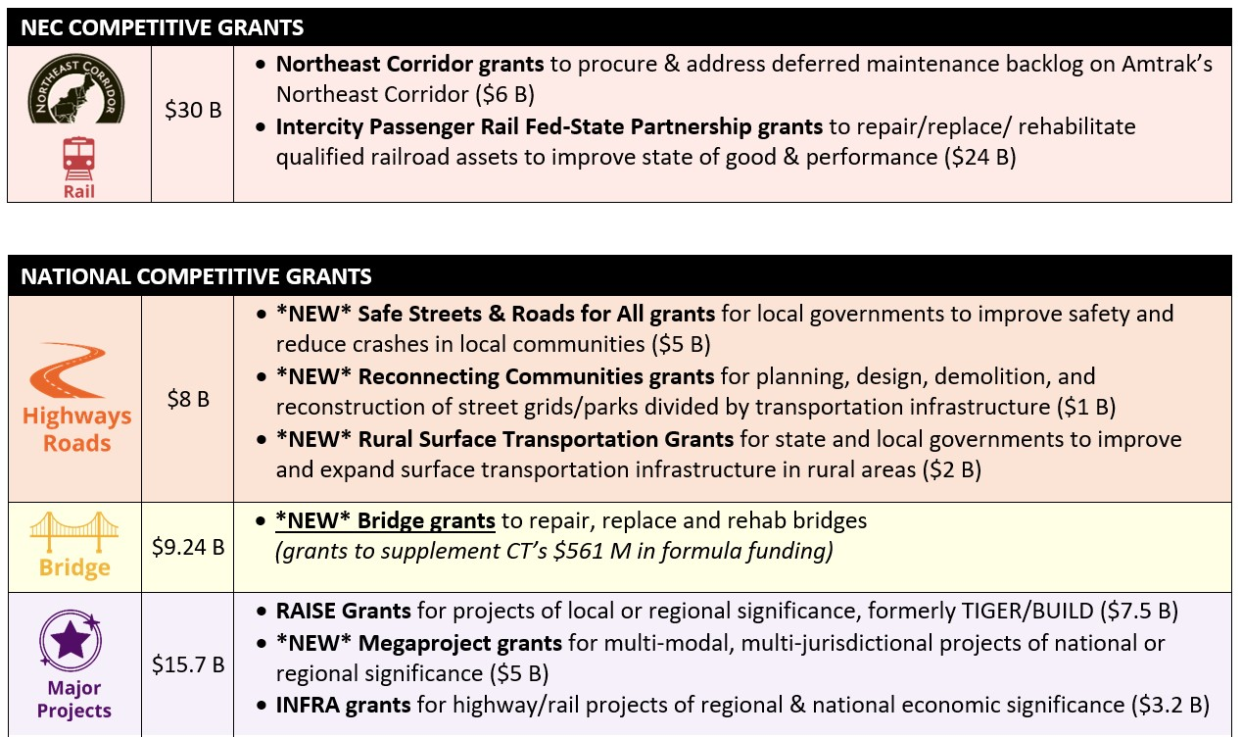
Overview of Discretionary Federal Grant Opportunities
Notes:
​

Slide 9
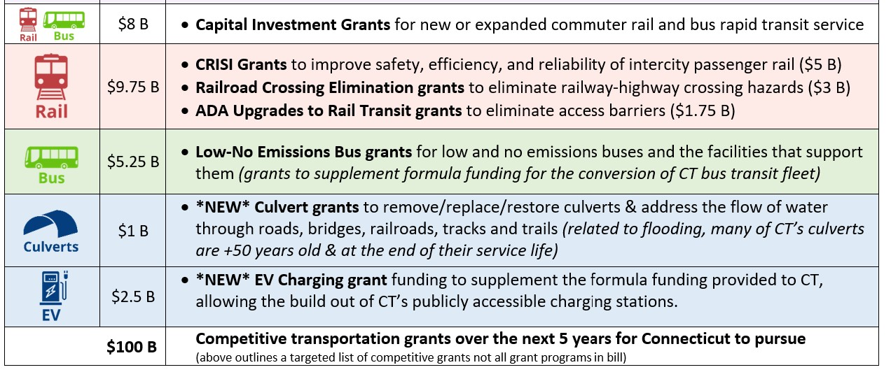
Overview of Discretionary Federal Grant Opportunities
Notes:
​

Slide 10
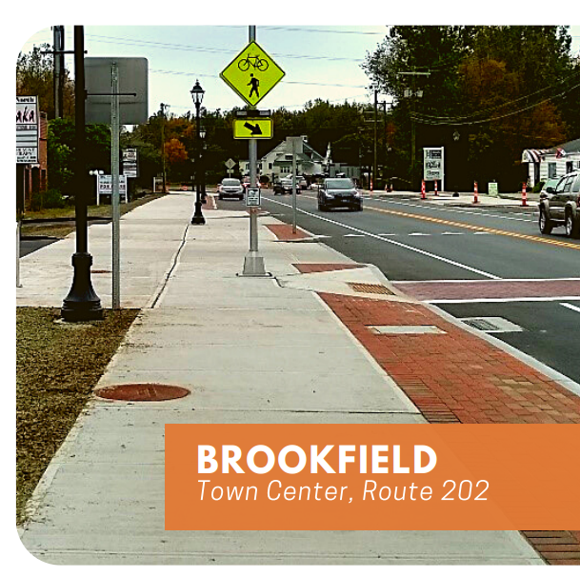
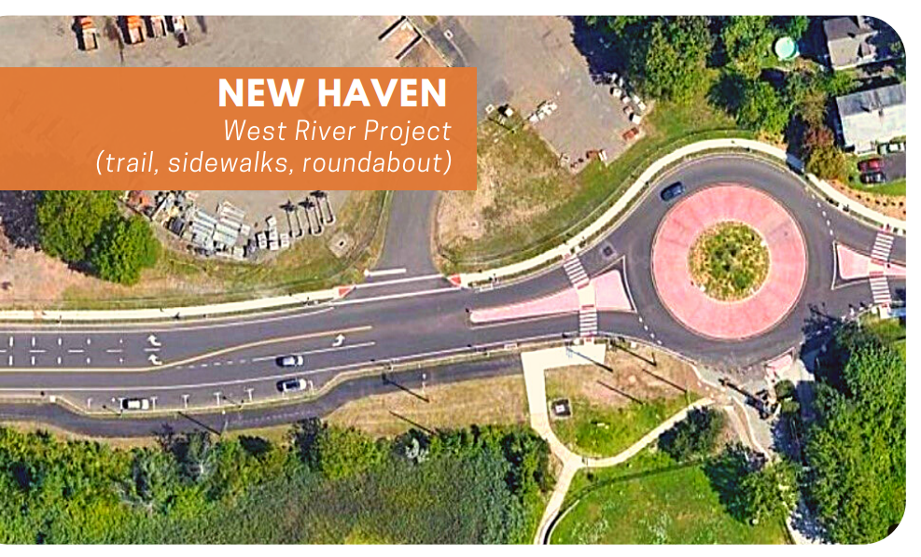
Safe Streets and Roads for All
IIJA contains $5 billion over 5 years in Safe Streets grants
CTDOT launched the Community Connectivity Grant Program in 2018 and awarded over $30 million in grants to 90 municipalities to improve safety in municipal centers.
Safe Streets and Roads for All is open to MPOs and Local Governments, not State DOTs.
The new grant program will support Vision Zero planning efforts, as well as capital projects to improve safety for all users.
Notes:
​

Slide 11
Implementation Approach
Guidance not yet issued on new programs, and no new funding has been distributed yet.
CTDOT will take a phased approach to implementation:
  Focus on Existing Formula Funds Programs
  Develop Concepts for New Formula Funds Programs
  Identify Projects in FY23+ for Competitive Grant Programs
Communication between DOT, MPOs, and Local Governments will be paramount for state to succeed with competitive grants.
Dust off those plans on the shelf and start identifying projects!

Slide 12

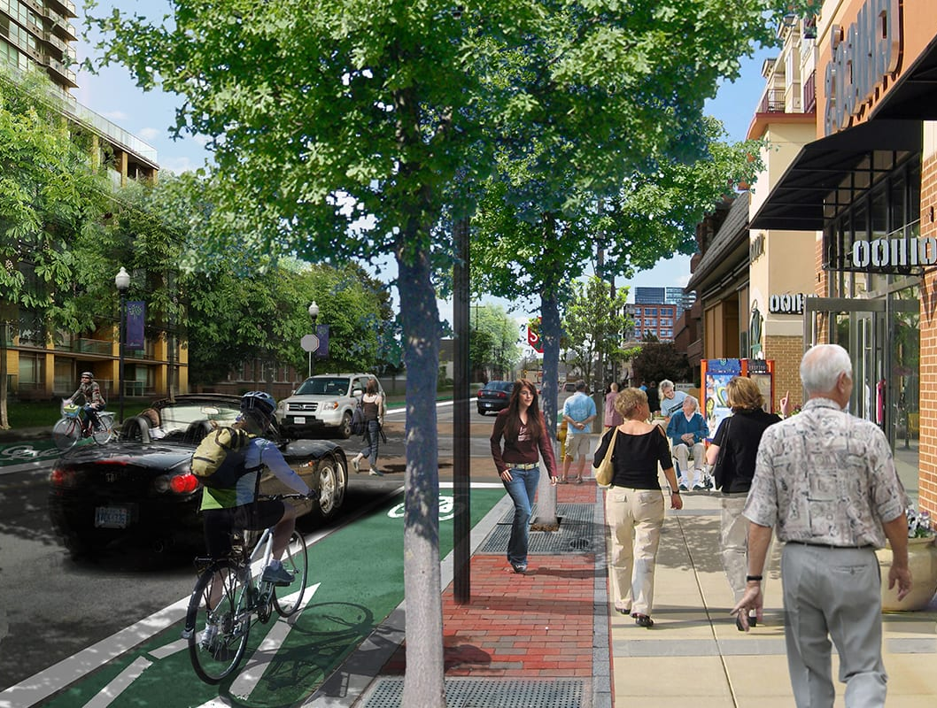




Municipal Transportation Project Development
Wednesday, January 26, 2022
9:00 a.m. to 10:00 a.m.

Slide 13
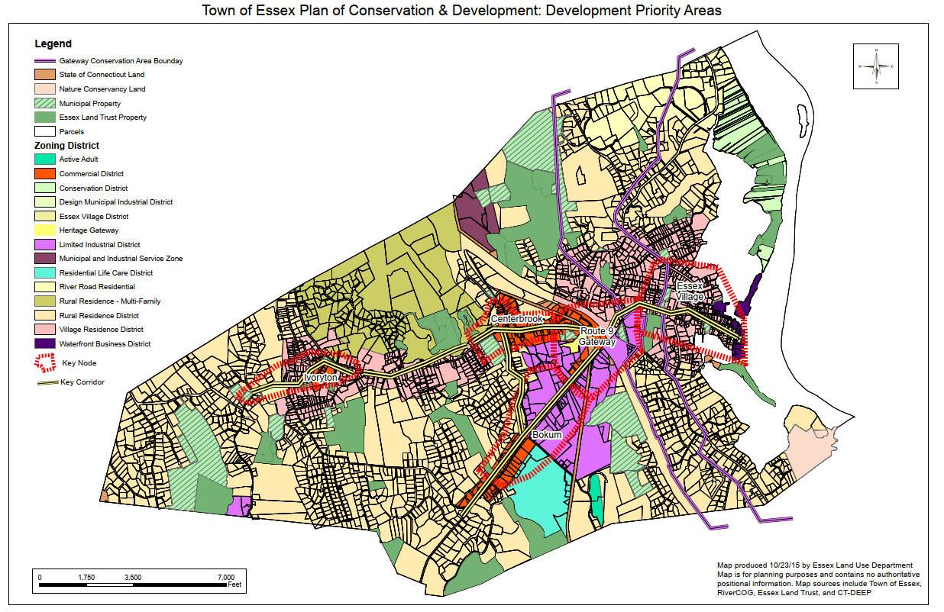
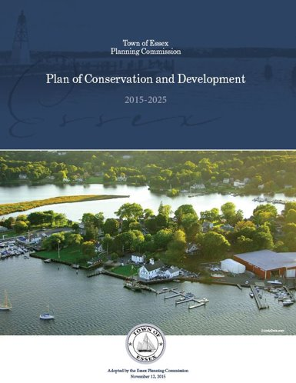
Start With Planning
Plan of Conservation & Development
Big-picture goals – connectivity, sustainability, investment
Specific
projects
and
initiatives

Slide 14
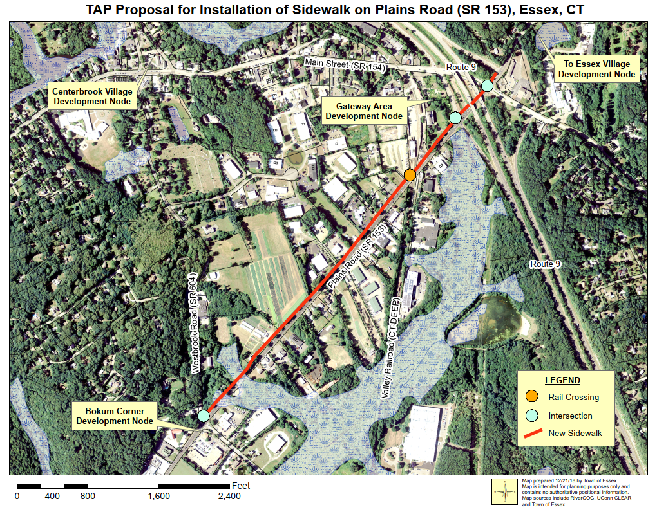
Preliminary Design and Costs
Use your GIS
Sketching out narratives
Preliminary discussions with funders – State Agencies, COGS

Slide 15
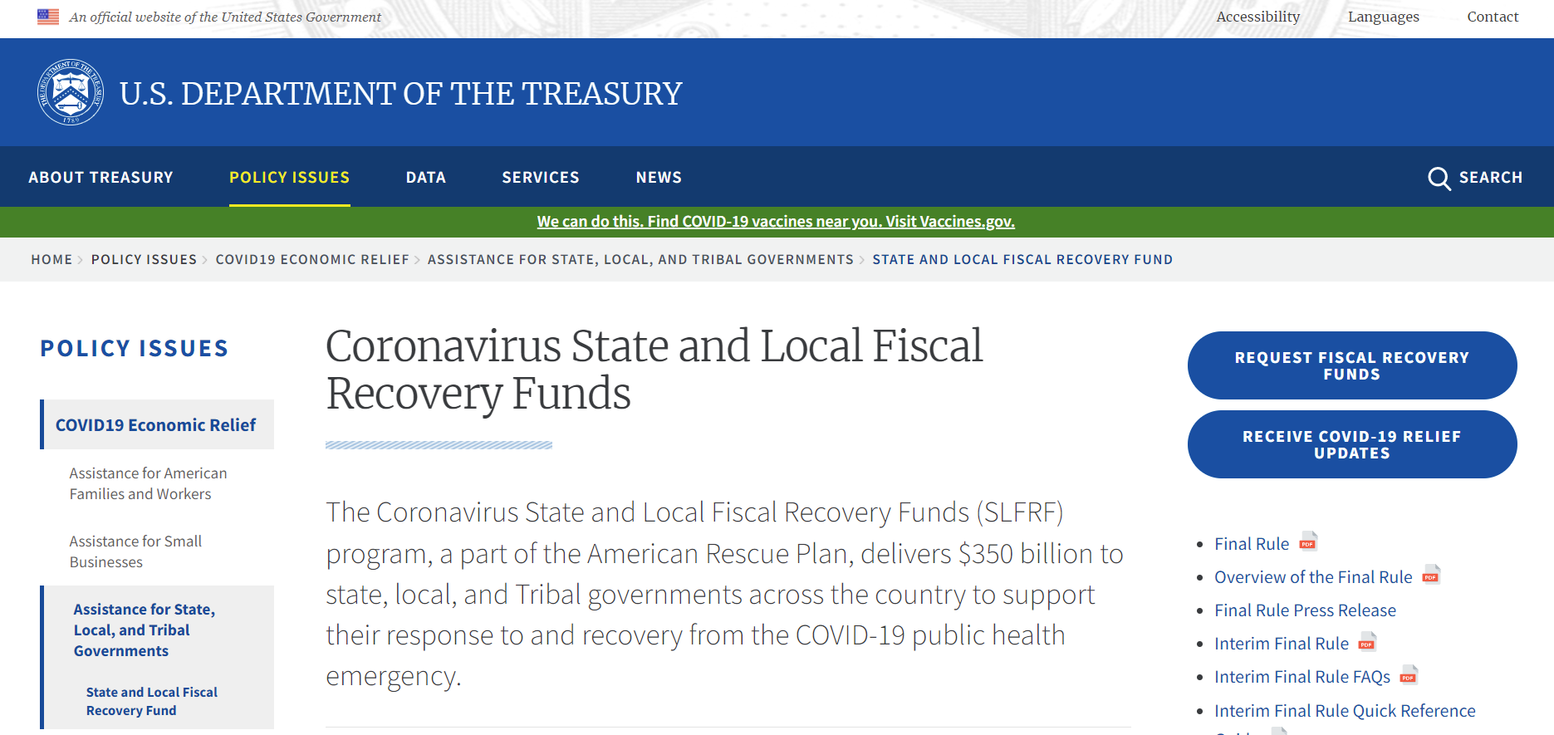
Invest in Design
Many grants are construction only
Municipality may need to spend 5-15% up front – may need political support
Creative use of ARPA funds?
https://tinyurl.com/ARPARuling0122

Slide 16
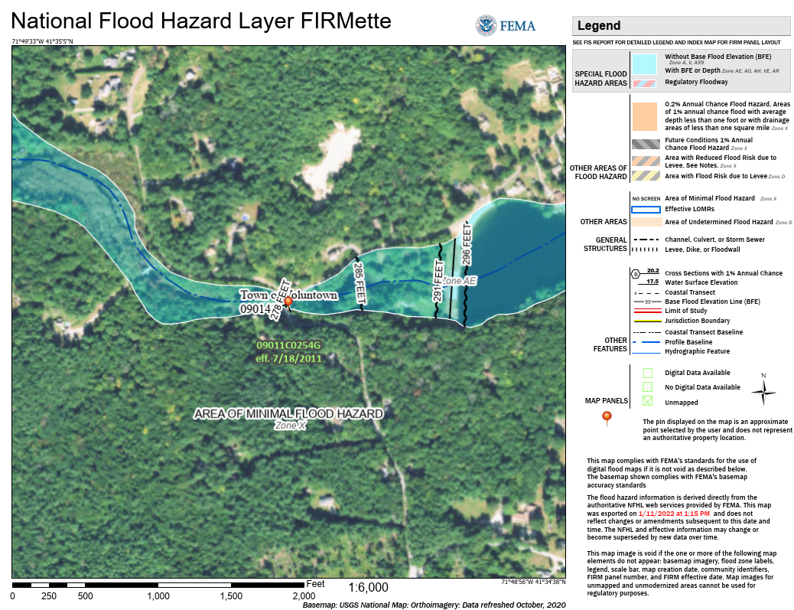
Environmental Due Diligence
Surveys, wetlands, FEMA
Understand the funder – State vs. Federal $$$
Pre-approvals with local wetlands, etc.

Slide 17
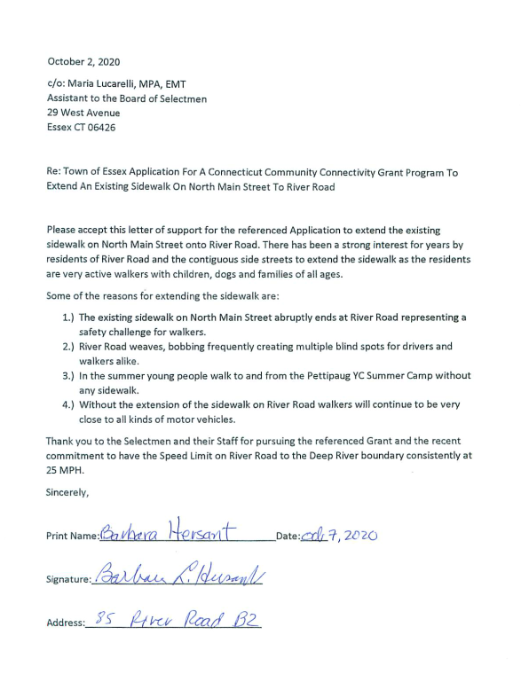
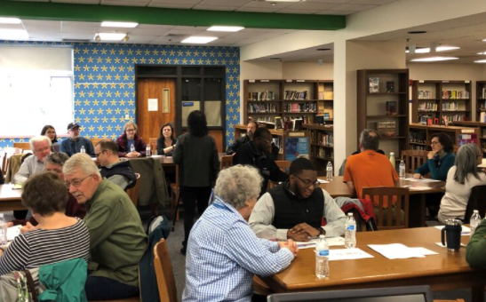
Rally Community Support
Public engagement
Stakeholder letters

Slide 18

Tell The Story
Narrative is important, tying back to big picture
“Make them cry”

Slide 19
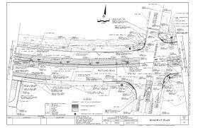
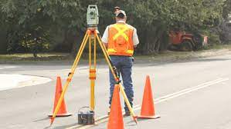
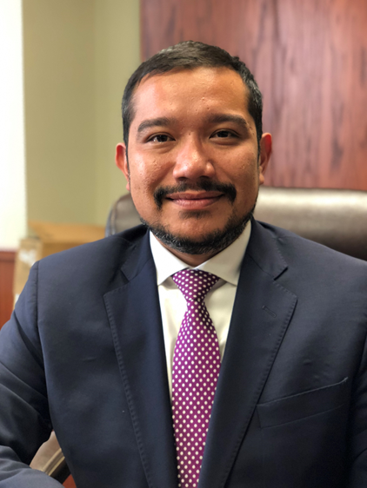
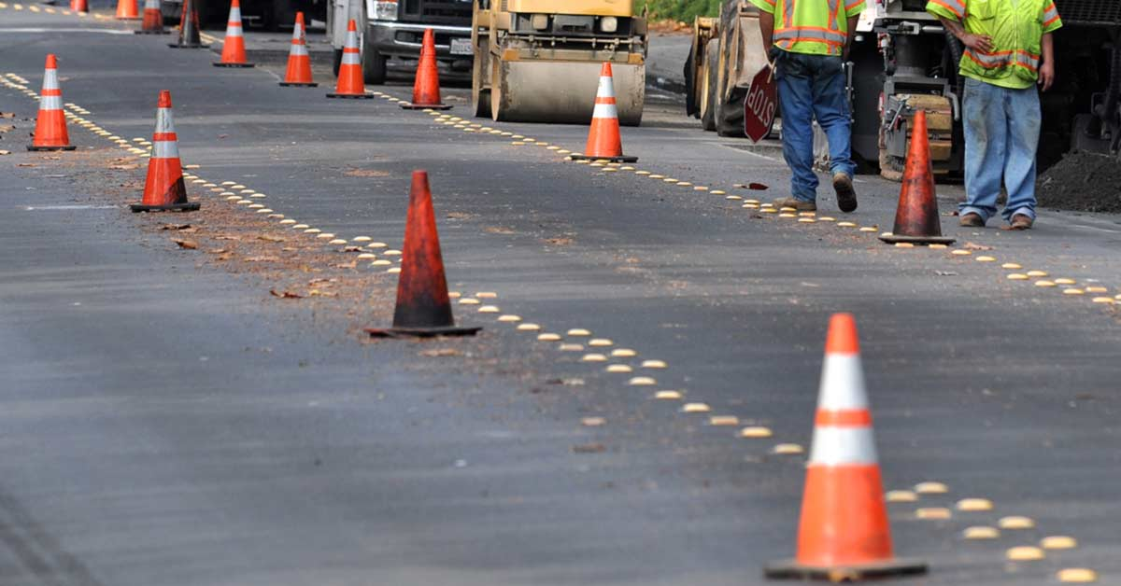
From Planning to Construction
Insights from a
Design and Construction
Project Manager
Jamil Miranda, PE
Project Manager
Senior Vice President
M&J Engineering, PC

Slide 20


Shovel-Ready
Planning is complete
Approvals are in place
The community is ready
Funding is secured
Drawings and specifications are ready for bid

Slide 21
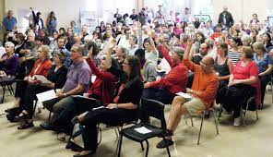
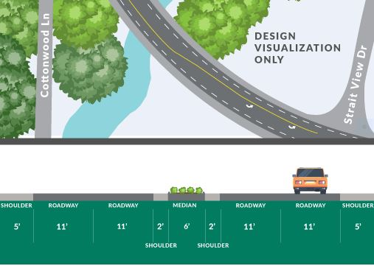
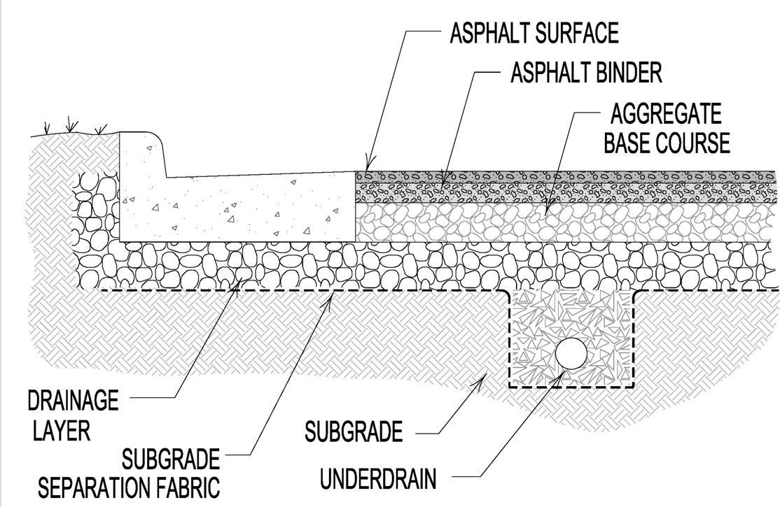
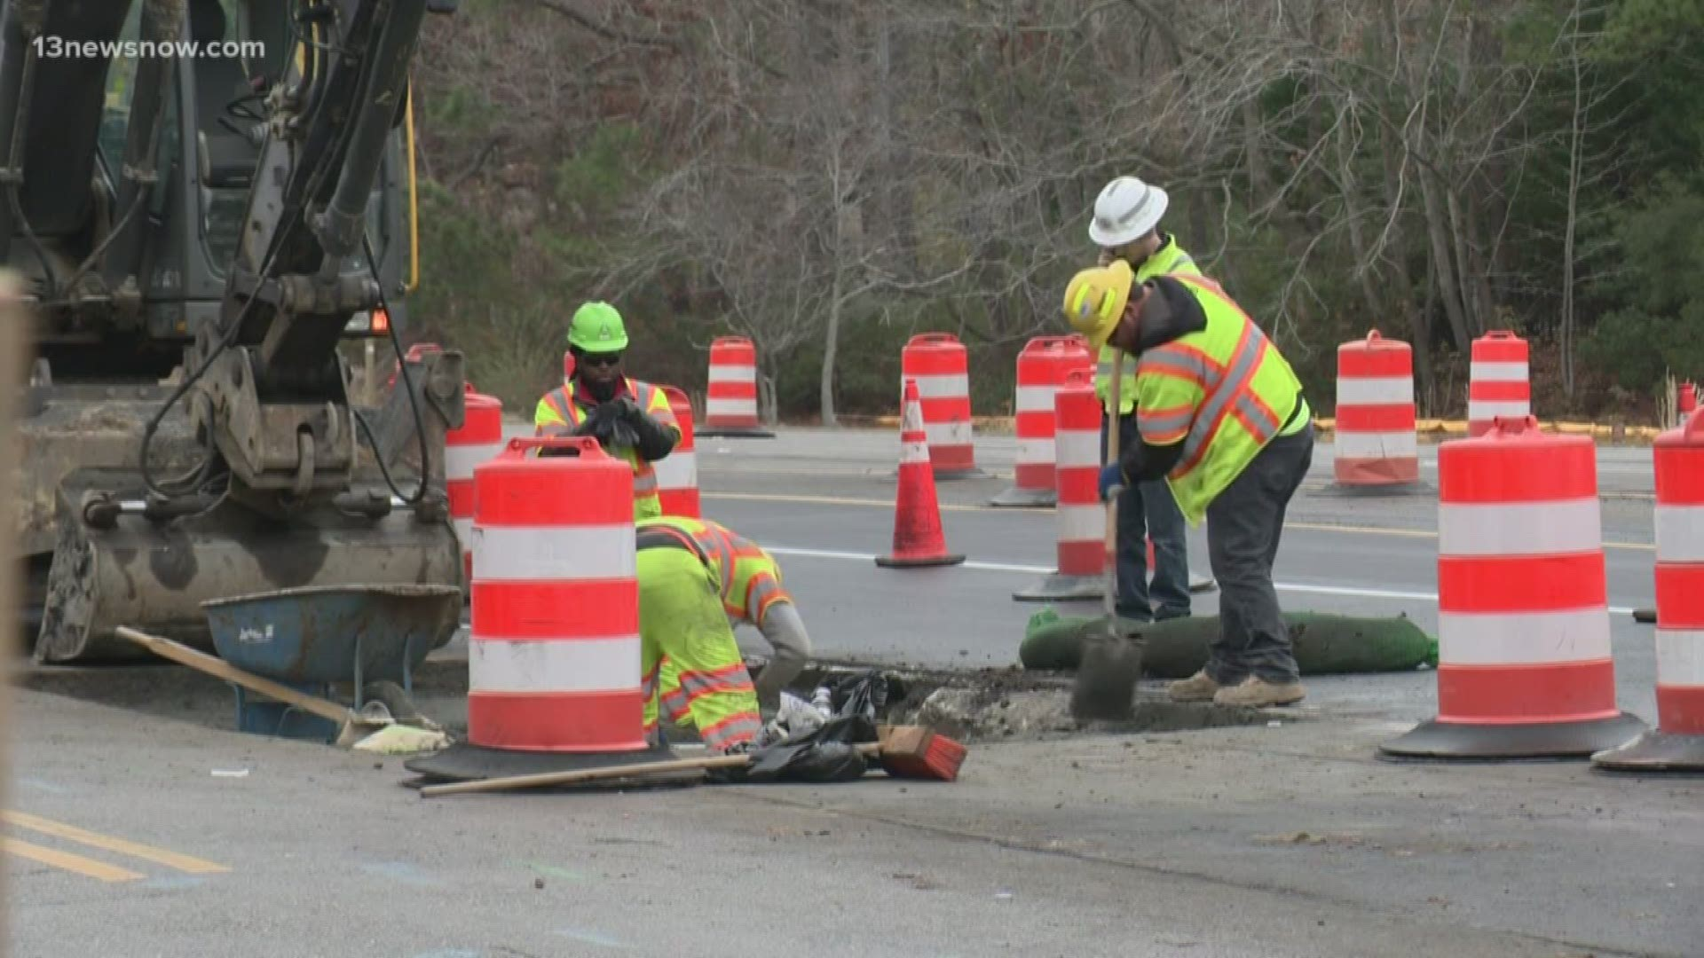
Phases of Design Development
Conceptual Design
Preliminary through Final Design
Construction and Bid Documents
Kick-off
Meeting
30% Design
60% Design
90% Design
Commonly required for grant applications

Slide 22
Kick-off Meeting
Kick-off
Meeting
Conceptual Design
Preliminary through Final Design
Construction and Bid Documents
Setting the stage for success
Planning and Zoning
Emergency Responders
Public Works
Facilities
Utilities
Key Community Stakeholders
Project goals, cost, and schedule are defined
Stakeholders critical to the project development process are identified
Surrounding neighborhood impact is understood
Chain of Command is established
Activities

Slide 23
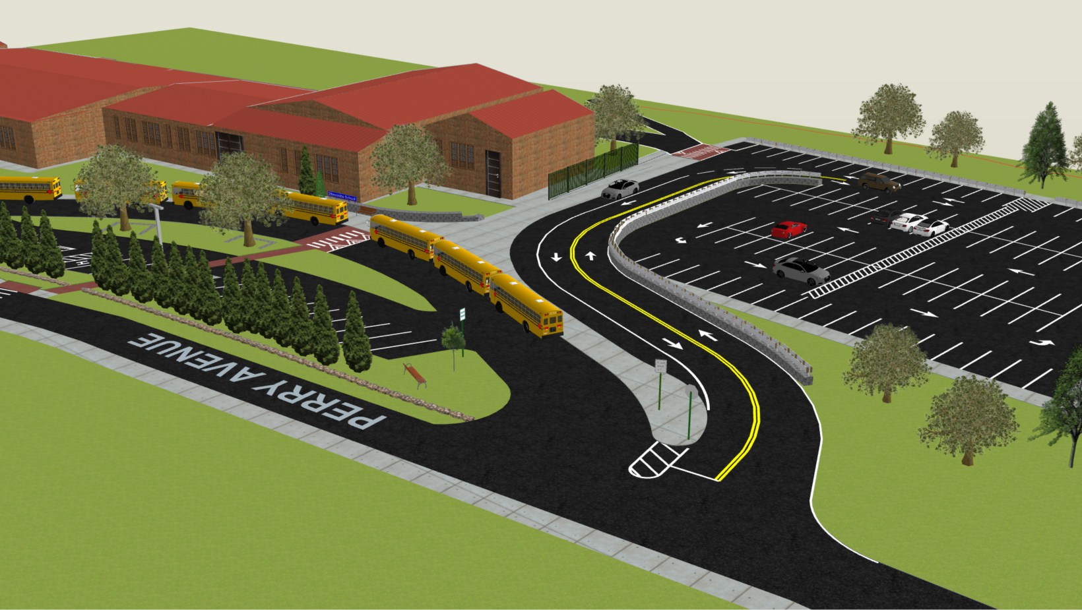
Conceptual Design
Kick-off
Meeting
Conceptual Design
Preliminary through Final Design
Construction and Bid Documents
A comprehensive understanding of the project is developed
Conceptual drawings are created
Review existing information (studies, plans, reports)
Conduct a site visit
Evaluate existing conditions:
  Site surveys
  Wetland delineation (if necessary)
  Impact of vegetation
  Underground/above-ground utilities
Conduct Stakeholder/Public Information Meetings
Develop design criteria
Activities

Slide 24
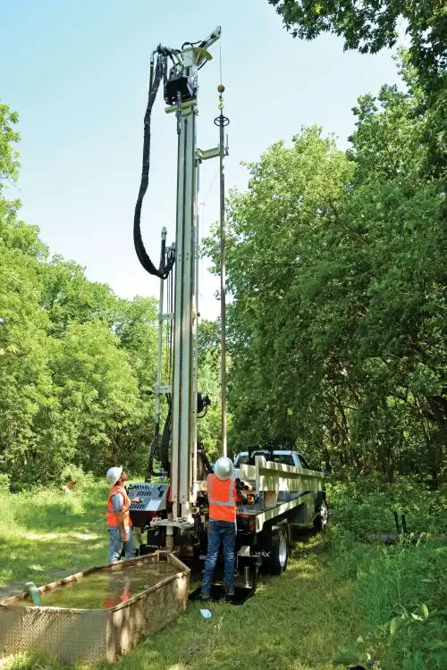
Preliminary Design
Kick-off
Meeting
Conceptual Design
Preliminary through Final Design
Construction and Bid Documents
Commonly required for grant applications
30%
Major design elements are identified
Project scope, schedule and budget are defined
Design is advanced through analysis of:
    Local codes
    Traffic studies
    Geotechnical
    Underground utilities
    Drainage
  Submit to municipality for review and comment
Activities

Slide 25
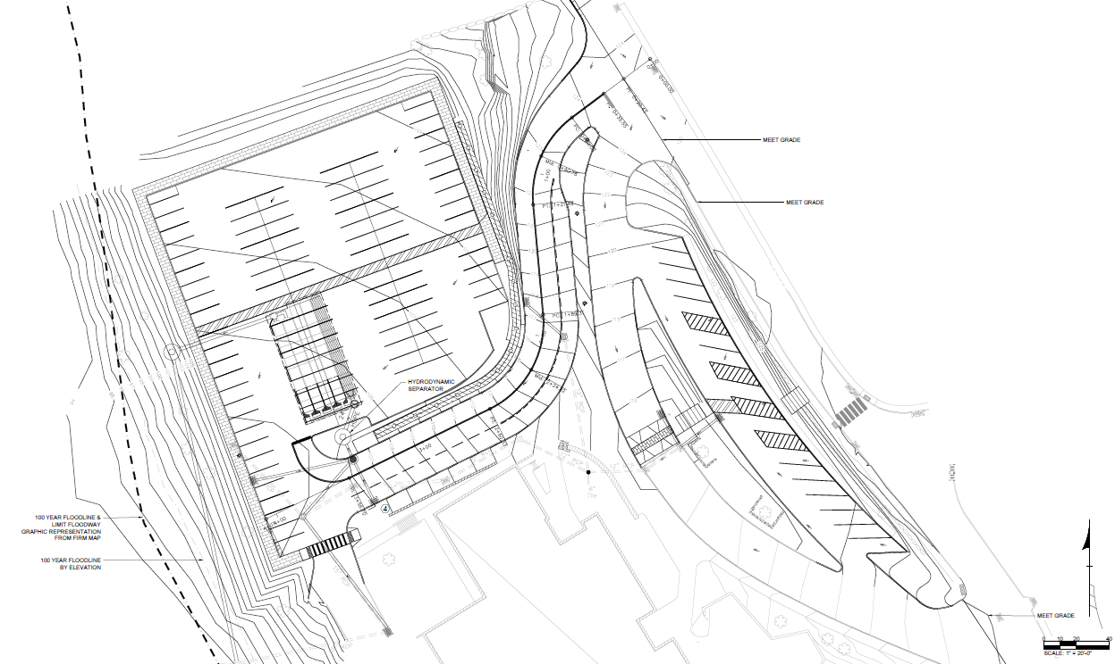
Semi-Final Design
Kick-off
Meeting
Conceptual Design
Preliminary through Final Design
Construction and Bid Documents
60%
Constructability is confirmed
No more significant design changes are anticipated
30% plan review comments are addressed
Design is advanced with a focus on:
  Constructability
  Budget considerations and modifications
  Potential issues or concerns
Submit to municipality for review and comment
Activities

Slide 26
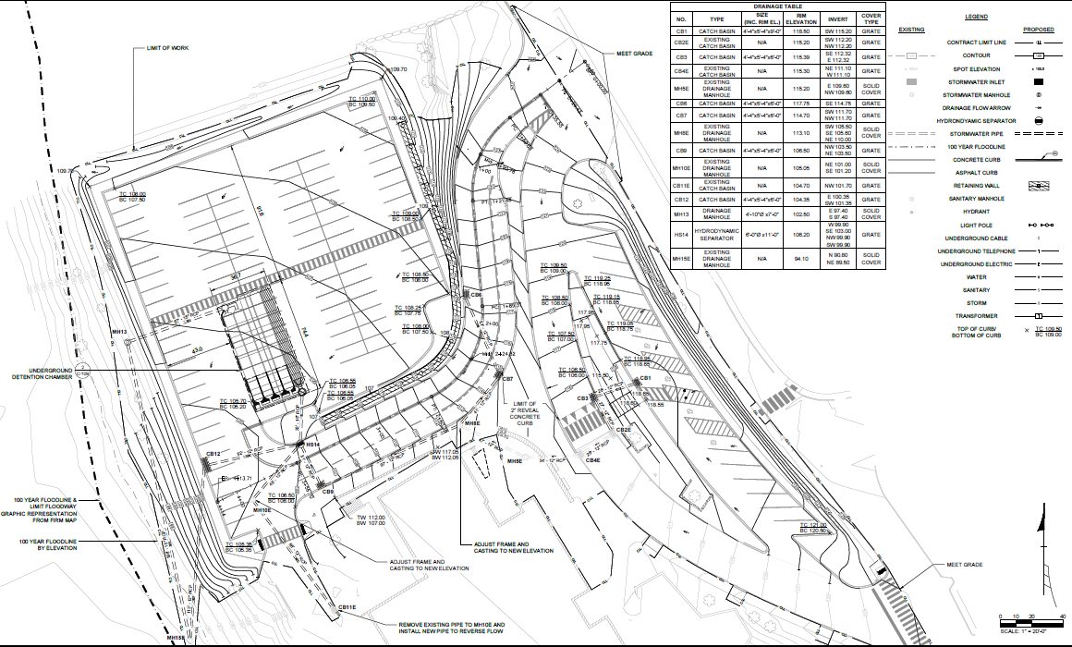
Final Design
Kick-off
Meeting
Conceptual Design
Preliminary through Final Design
Construction and Bid Documents
90%
Project design is nearly complete
60% plan review comments are addressed
Permitting agencies, funding agencies, and Quality Control offer comments
Bid viability is confirmed
Engineer's cost estimate is prepared for bid​
Permit package​ is finalized
Activities
Submit to municipality for review and comment

Slide 27
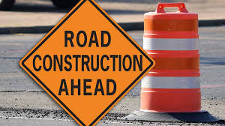
Construction and
Bid Documents
Kick-off
Meeting
Conceptual Design
Design Development
Construction and Bid Documents
Documents for contractor bids/quotes are prepared
Construction drawings and specifications are developed
Value Engineering is performed
Final construction documents are prepared
RFQs/RFPs are written
Project goes out to bid
Activities

Slide 28

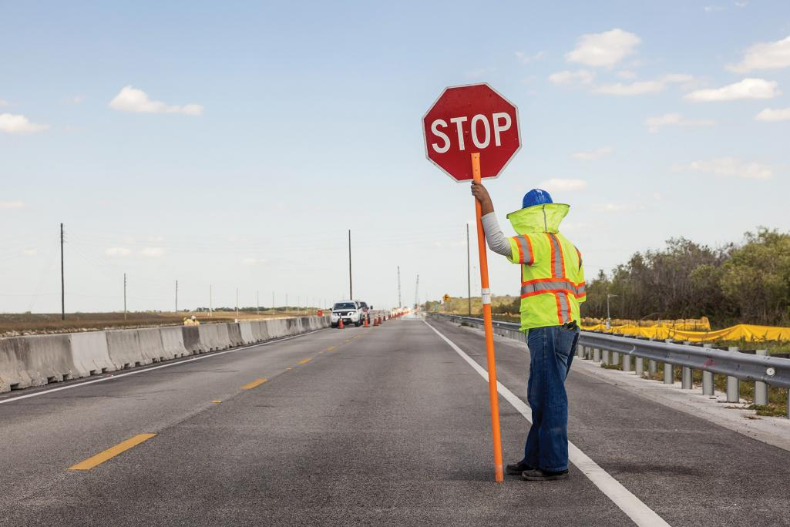
Common Pitfalls
Issues that impact progress
Lack of stakeholder buy-in
Right-of-way
Utility coordination
Delay in design and document review
Permit approval
Constructability review
"Scope Creep"
Construction oversight

Slide 29

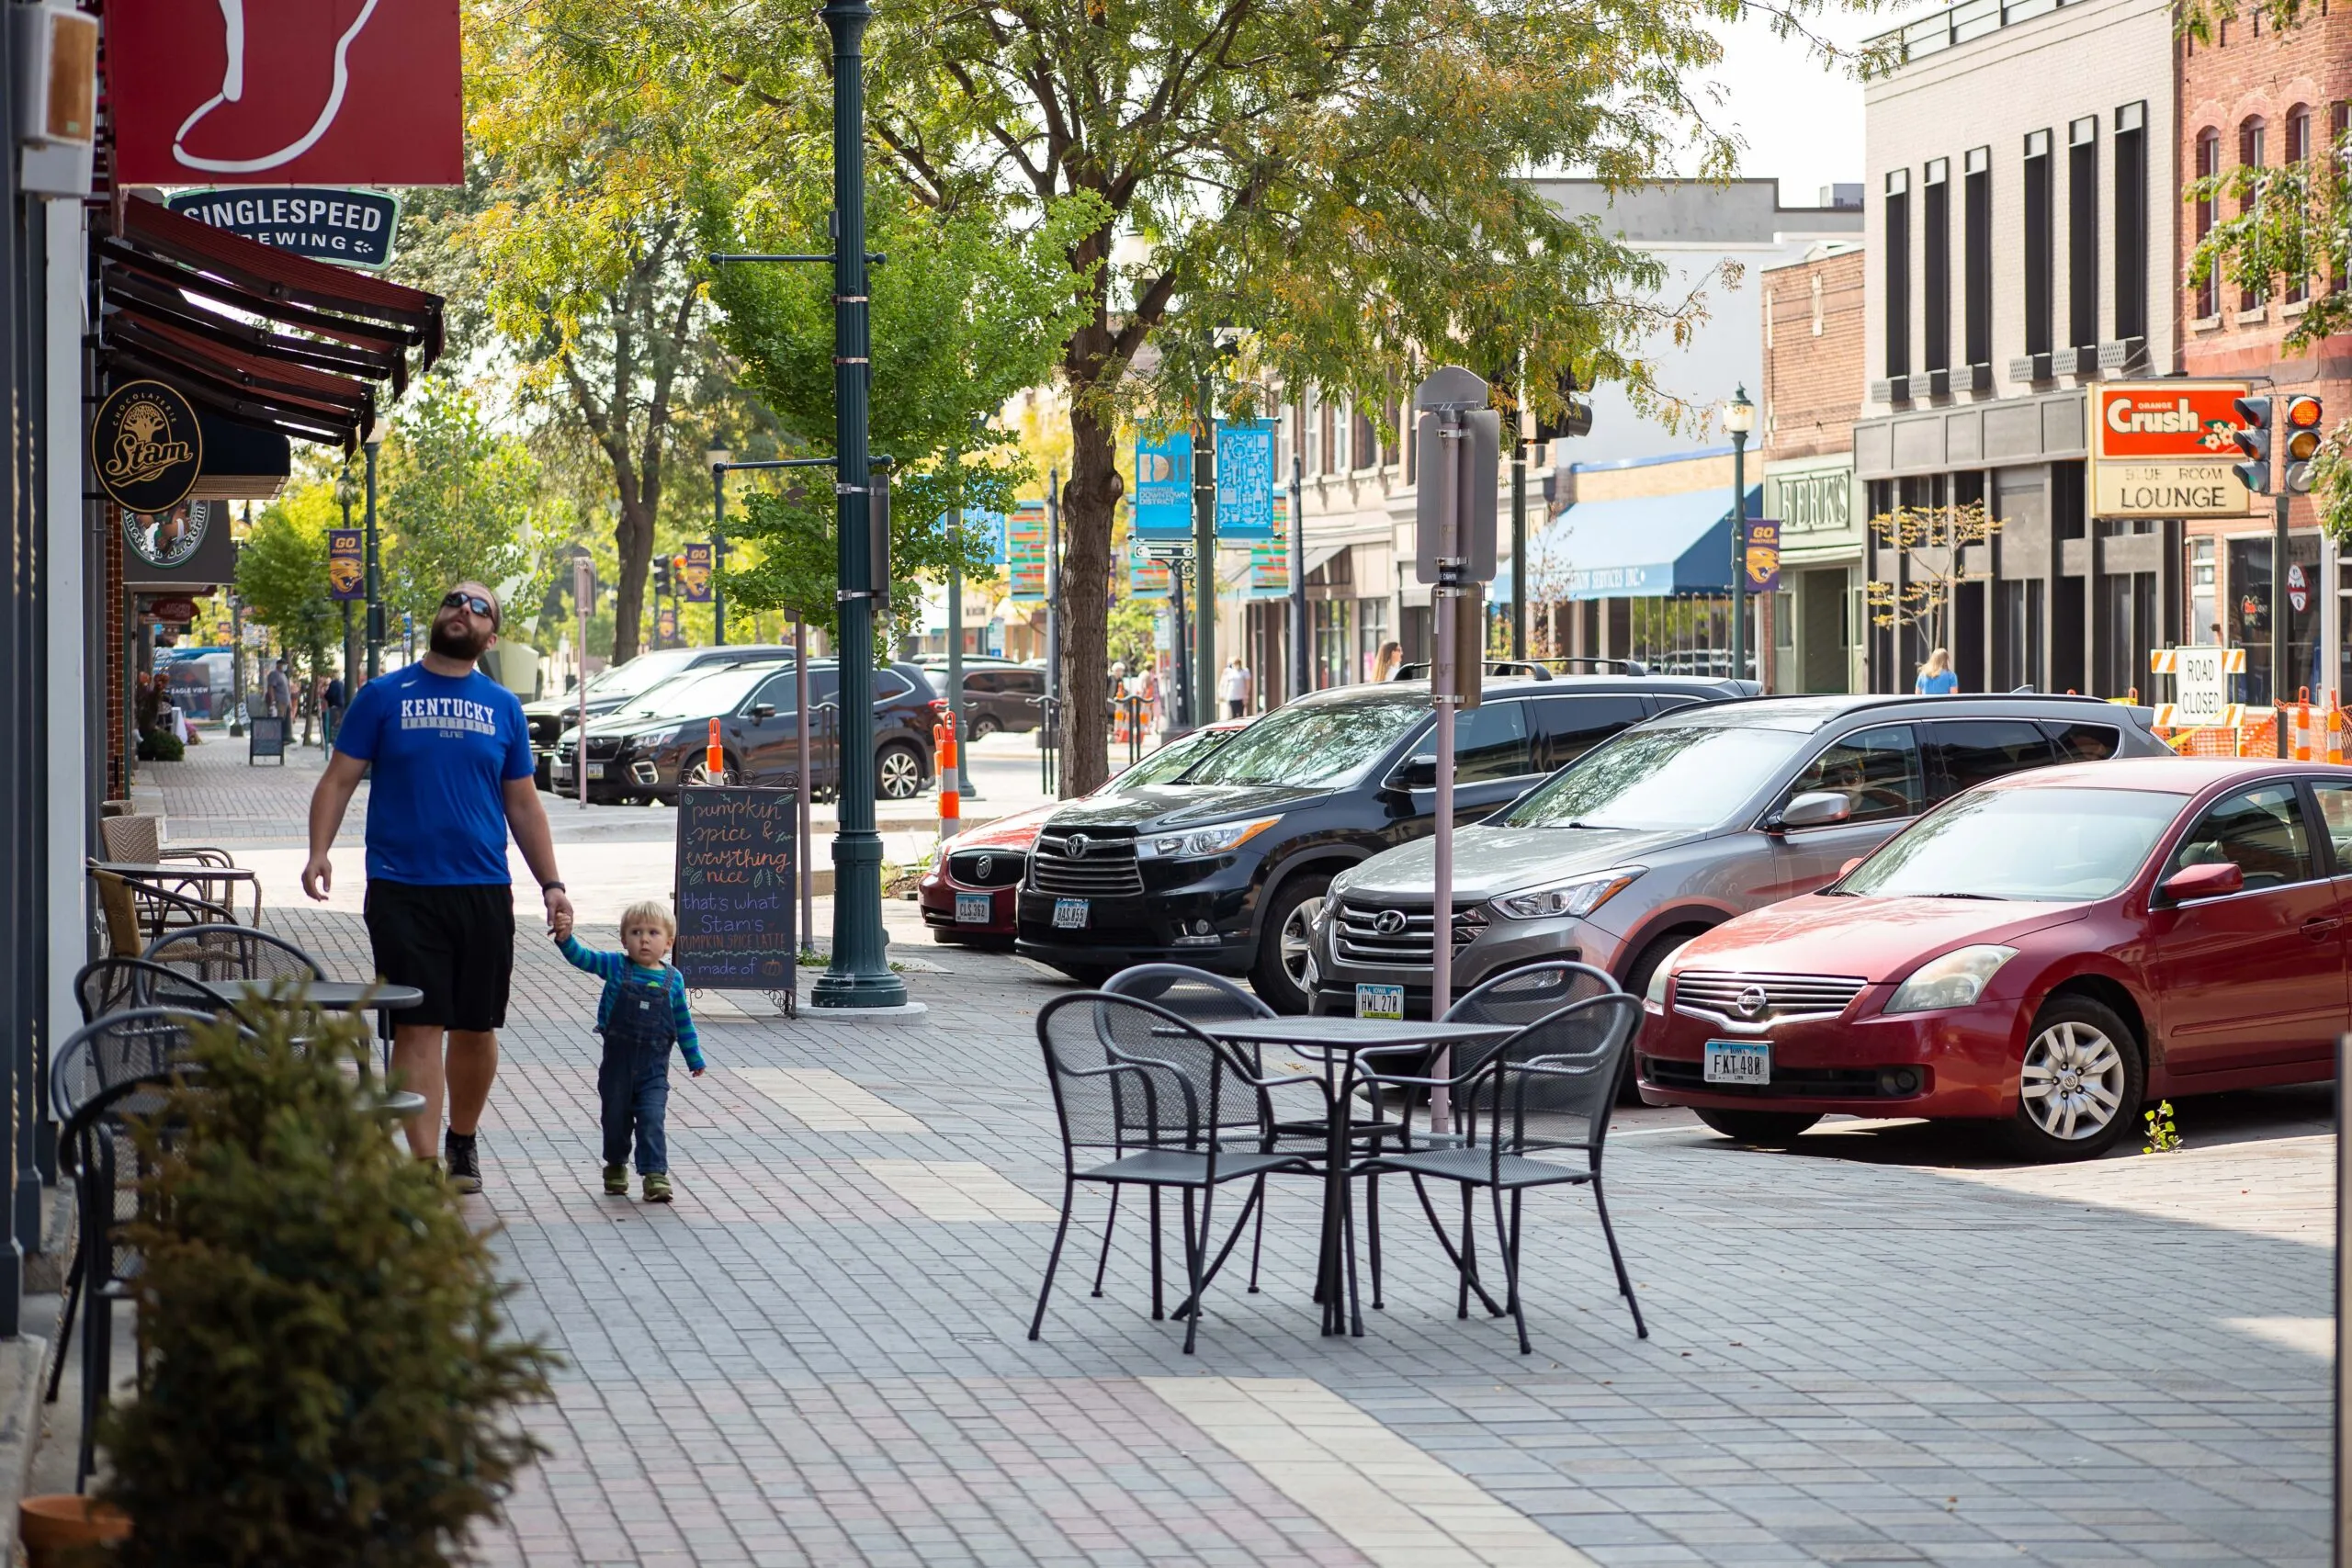
Keys to Success
What successful projects have in common
“Shovel-worthiness“
Comprehensive understanding of existing conditions
Clear understanding of project goals
Stakeholder buy-in with documented project support
Well-developed, constructable design
Clear and accurate Request for Qualifications/Proposals

Slide 30

Question & Answer Session
Thank you for your time!

