Slide 1
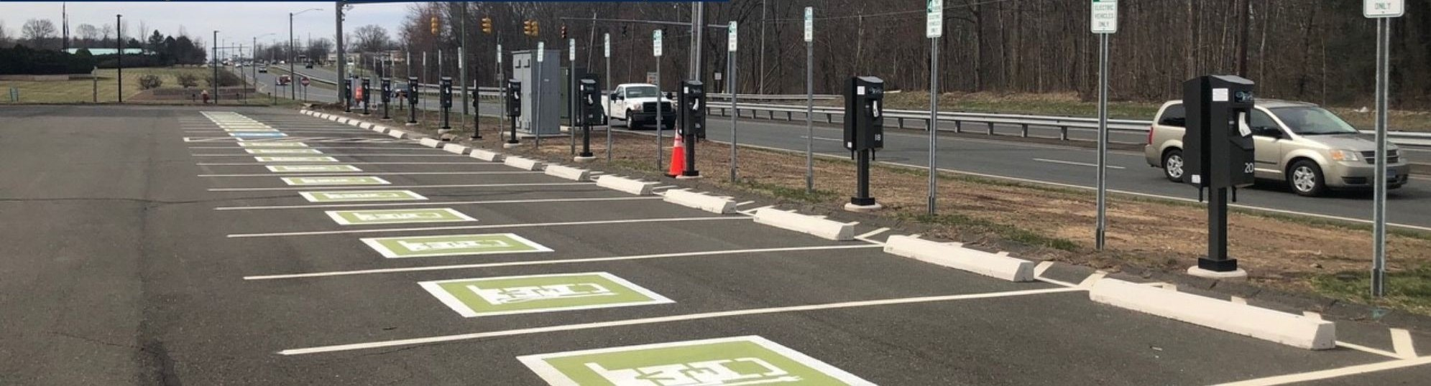
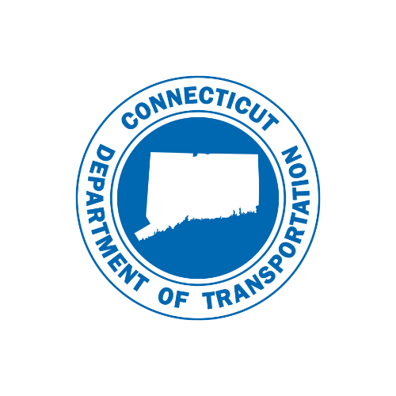
CT Department of Transportation
Existing Programs – overview
TRIP
IIJA - New Formula Programs
Resources
Competitive Grant Opportunities
Highway Safety Office Programs
Kimberly Lesay
Bureau Chief of Policy and Planning
COST
Planning & Economic Development Conference
November 17, 2022

Slide 2
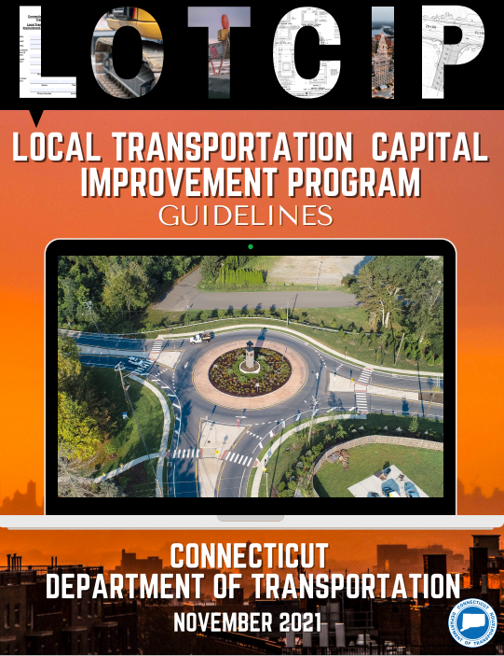
LOTCIP – Local Transportation Capital Improvement Program
LOTCIP
State funds distributed to the 9 Cogs based on federal population model
Mirrors STBG eligibility of roadway classification, urbanized areas
  Urban collector or higher, rural minor collectors not eligible
  Sidewalk projects may be eligible
  Bridges over 20-foot span
  Multi-Use trails (not recreational)
Town pays 100% design costs (local share), LOTCIP funds construction phase.
$67M / year last two fiscal years (‘22 & ‘23)
Highway Design-Local Roads - LOTCIP (ct.gov)
Vitalij Staroverov, P.E.
Transportation Supervising Engineer
Phone:(860) 594-2582, FAX: (860) 594-3218
Email: Vitalij.Staroverov@ct.gov
LOTCIP-Guidelines-November-2021-Final-Web.pdf (ct.gov)
Notes:
LOTCIP provides State funding instead of specific Federal funding for STBG Urban program roadways and facilities. Only the Rural component of the Federal STBG program, as may be revised, allows expenditures on rural minor collectors.
In general, LOTCIP projects must be located on a roadway classified as an urban collector or higher on the Department’s Functional Classification database.
Rural minor collector roadways are not eligible in LOTCIP.
Functional Classification Maps are available on the Department’s website at: https://portal.ct.gov/DOT/PP_SysInfo/Functional-Classification-Maps.
Stand-alone sidewalk projects may be considered eligible along other roadway classifications.
• Bridge improvements may be eligible on other roadway classifications as long as the Federal definition (20 feet or greater existing span length) of a bridge is met.
• Multi-use trails are considered eligible under LOTCIP; however, recreational trails are ineligible.
o A multi-use trail is generally considered a form of infrastructure that supports multiple transportation and recreational opportunities such as pedestrian activities, bicycling, in-line skating, and wheelchair users. Multi-use trails typically conform to established standards relative to facility width, geometry, surface type, and accessibility.
Recreational trails are those that primarily serve a limited group of users and provide limited function due to the characteristics of the facility, such as width, geometry, and surface type

Slide 3
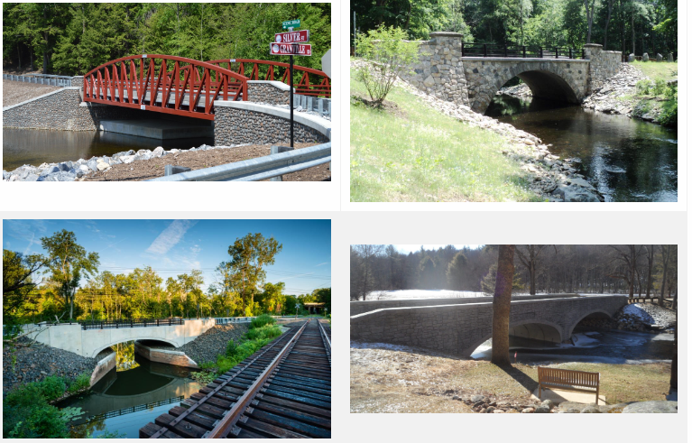
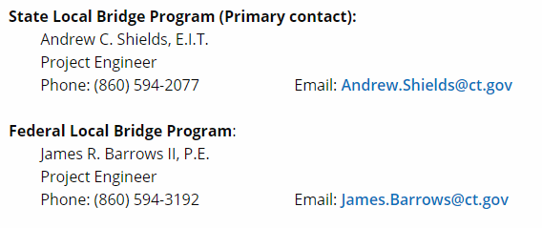
Local Bridge Programs
State Local Bridge Program (SLBP)
Bridges less than 20’ span
50% State (Design & Construction)
Commitment to Fund letters are drafted
Federal Local Bridge Program (FLBP)
80/20 - now 100% possible for all phases
  Design, ROW & Construction
Construction inspection by the DOT’s Office of Construction
Town will hold and maintain the contract for construction
Any projects obligated on or after July 1, 2022, will be eligible
  Existing DMS projects will be converted if the design completion is after July 1, 2022
Funding available through Federal Fiscal Year 2026
CTDOT Local Bridge Program
Notes:
For the SLBP, we have evaluated all the applications and the commitment to fund letters should be going out soon to all the towns that had their bridges accepted. We did draft all the commitments up, so they are likely in the signature loop with Bart.
FLBP
the Department came out with the Design Managed by State (DMS) projects, or State Administered. The DMS program was started as a pilot and then made open to all municipalities in 2019.
For DMS projects, the Department will administer and manage the all phases of the project at NO COST to the municipality.
For the Design Phase, the Department utilizes its Consultant Liaisons and On-Call Design Consultant for the perform the Design of the bridge
With the new infrastructure bill, 100% funding is available to the Towns for their eligible bridges for all 3 phases of the project. So they can get a bridge designed and built at no cost to the Town. We made a presentation to the Towns earlier in July
This will be done using two different funding The STBG is 80% federal funding, and the State will chip in the remaining 20% - The other source is the new Bridge Investment Formula Program

Slide 4
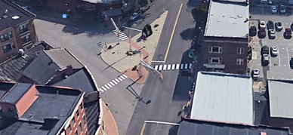
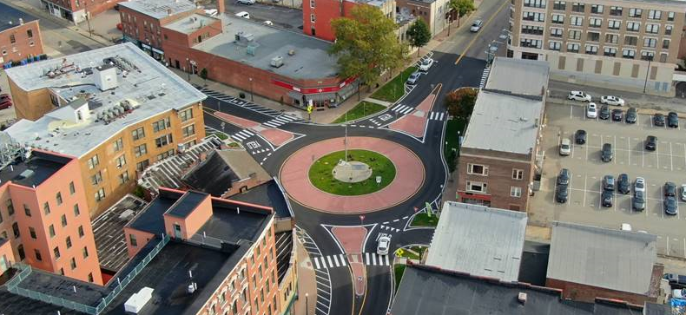
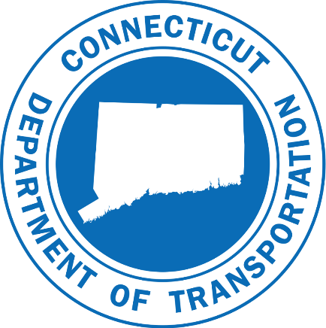
Community Connectivity
Open to all 169 towns
Next solicitation expected in January 2023
  Applications due June/July
Extended timeframe for application prep
  Focus on project readiness
All other guidance will remain
Previous awardees
  Current projects must be to a point where final design submission has been approved in order to be eligible
More information at:
  CT Connectivity CCGP
Notes:
The goal of the Community Connectivity Program is to make conditions safer and more accommodating for active transportation users, thereby encouraging more people to use these healthy and environmentally sustainable modes of travel.
Competitive grant program open to all 169 of Connecticut’s cities and towns.
Next solicitation anticipated for January of 2023 with applications due to the Department in June-July (Actual dates will be announced with solicitation). Anticipate awards by October.
Anticipate approx. $10 million available to award this round.
With extended timeframe for application preparation in this round, more focus will be on project readiness. Looking for projects that have some level of development that have identified any challenges and can move forward quicker.
All other guidance will be the same as previous rounds.
To be eligible, previous awardees must have advanced their current project to the point where a final design submission has been approved by the Department.
More information on the website at: CT Connectivity CCGP
The Community Connectivity Program, managed by our Project Coordination team, was initiated in 2018, It Seeks to improve accommodations for bicycles and pedestrians in urban , suburban and rural community centers and provides construction funding for local initiatives that are determined to best contribute to the goal of the program
Pictured here are before and after pictures of the Norwich Roundabout, constructed with CCGP funds.
Project removed multiple traffic signals, improved traffic flow, slowed through vehicles and created safer crossings for pedestrians.

Slide 5
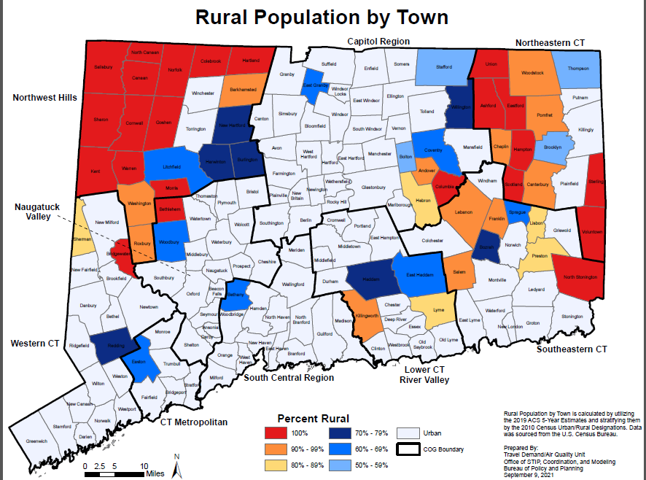
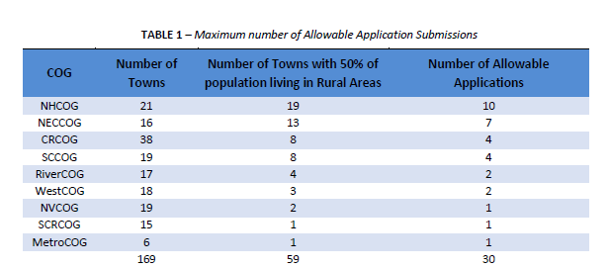
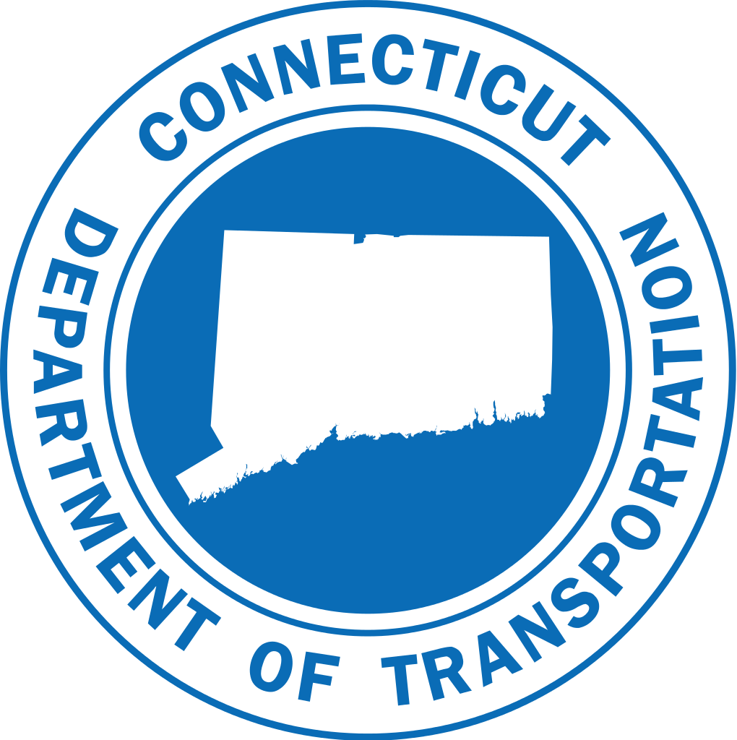
Transportation Rural Improvement Program
Rural Towns with > 50% of population in rural areas
COGs will solicit & prioritize
DOT will make final selection & administer funds to the town
Up to 5M in State funding over 3 years starting FY ’23
300K minimum
Transportation Rural Improvement Program (ct.gov)
Notes:
The Transportation Rural Improvement Grant Program, (TRIP) provides state funds to municipal governments for Infrastructure improvements in Rural and Small Towns. Activities may include transportation capital projects such as construction, modernization, or major repair of infrastructure.
.. It is important to note that grants will be awarded to municipalities on a competitive basis and this funding source is limited.
Rural municipalities can apply for grants through their respective Council of Government (COG).
To be eligible, Towns must have greater than 50% of their population living in a rural area (mapping is provided on website).
Municipalities are eligible to apply for one grant per solicitation
Grants can be used for 100% of construction costs to fund most roadway capital improvements
Design and rights-of-way costs are not eligible and are considered the local match.
Additional information can be found on the program website at: Transportation Rural Improvement Program (ct.gov)

Slide 6
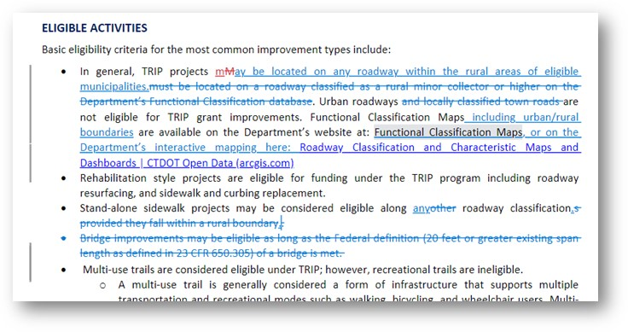
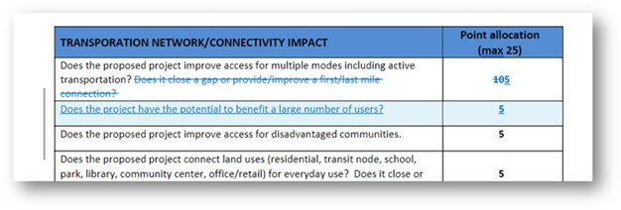
Transportation Rural Improvement Program
Roadways classified as “Local” outside of an urban boundary, will also be eligible under the program
Stand-alone sidewalk projects may be considered
Clarification on eligibility of bridges
Project rating criteria has been updated
Application closing date will be extended to April 28th 2023.
Craig Babowicz, Transportation Supervising Planner
Project Coordination Unit | Office of Strategic Planning & Projects
Bureau of Policy & Planning | Connecticut Department of Transportation
P (860)594-2158 E craig.babowicz@ct.gov
Notes:
Program guidelines were modified after release to allow locally classified rural roads to be eligible for funds under this program (notification of the change was sent to COG’s and published on the TRIP website).
Email 11/9 in response to comments received:
1.Roadways classified as “Local” outside of an urban boundary, as identified by the Department’s Functional Classification Mapping, will also be eligible under the program.
2. Clarification on the eligibility of sidewalks – Stand-alone sidewalk projects may be considered along any roadway classification within an eligible town.
3. Clarification on eligibility of bridges – Now that all roads within a rural area are eligible, the following statement is no longer necessary and was removed from the guidelines: “Bridge improvements may be eligible as long as the Federal definition (20 feet or greater existing span length as defined in 23 CFR 650.305) of a bridge is met. “
4. The Project rating criteria has been updated to include a possible maximum of 5 points for projects that can show a benefit for a larger number of users.
5.

Slide 7
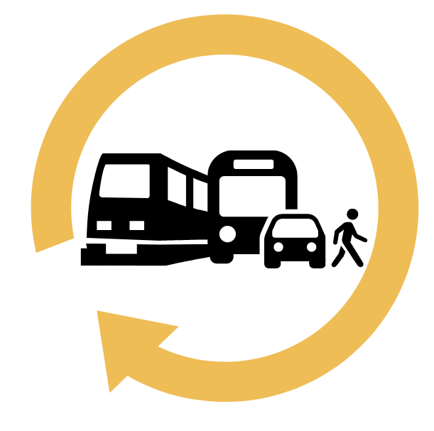

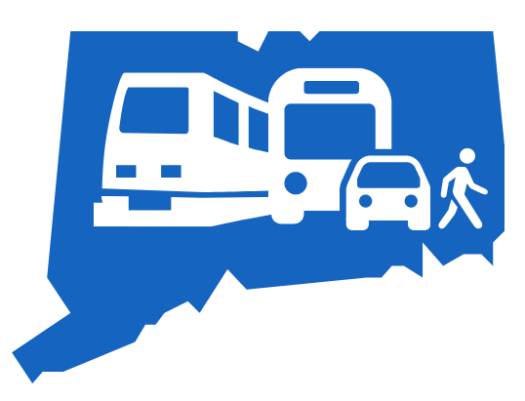
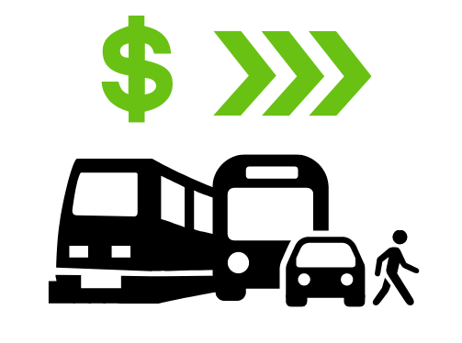
Overview of IIJA
Reauthorizes federal surface transportation programs for FY 2022 - FY 2026
Unlike the 2008 Recovery Act, IIJA is long-term, continuous investment in transportation infrastructure, not a "Shovel Ready" Stimulus program
What it means for Connecticut: $5.38 billion in formula-based funding over five years - a $1.62 billion increase over FAST Act (last reauthorization)
Provides for over $100 billion in competitive grant opportunities between FY 2022 and FY 2026
Notes:
IIJA is a 5-year surface transportation reauthorization bill with increased funding levels - that also includes $100 billion for competitive grant programs.

Slide 8
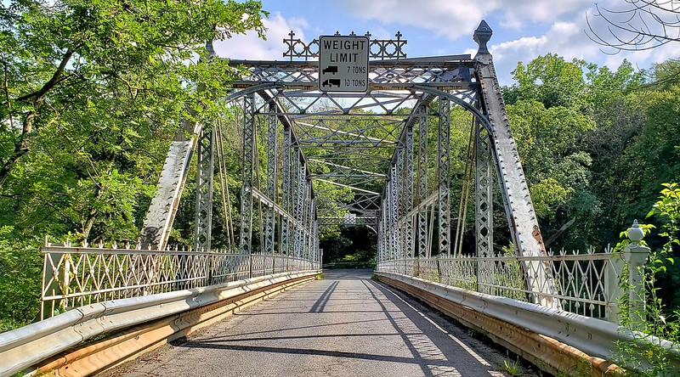

New Formula Funding Programs
Bridge Formula Program
To replace, rehabilitate, preserve, protect and construct highway bridges
15% set aside for "off system" bridges
EV Charging Infrastructure
Formula funding from FHWA to build reliable network of fast chargers
$52 million in formula funding for Connecticut over 5 years
EV infrastructure installation, operation, maintenance & data sharing
Establish an interconnected network for data collection, access & reliability
Increased Research & Development
Nearly half of structurally deficient bridges in Connecticut are local bridges | Yankee Institute

Slide 9

New Formula Funding Programs
Formula Carbon Reduction Program
Development of Carbon Reduction Strategy
$79 million in formula funding for Connecticut over 5 years (Largely Allocated to TMAs / based on population)
Establish or Operate traffic monitoring, management & control facilities or programs
Truck Stop electrification
On & off-road facilities for bike/ped
Congestion management technology
Energy efficient lights & signals
PROTECT (Promoting Resilient Operations for Transformative, Efficient & Cost Saving Transportation)
Development of a Resilience Improvement Plan and Vulnerability Assessment (= increased federal share)
$90 million in formula funding for Connecticut over 5 years
Projects that increase the resilience of state highway assets
Culvert improvements
Pump stations to prevent flooding
Scour protection
Notes:
CRP is similar to CMAQ but do not require calculations to be completed for all projects such as deployment of alt fuel vehicles (fleets) and chargers
Allocations already set to urban areas but about 1M to population areas <5000
Development of a Carbon Reduction Strategy
In consultation with MPOs
Update every 4 years
Disbursement of Allocated Funds
DOT will be conducting Outreach / Training
Will be asking MPO’s & COGs to aid in prioritization

Slide 10
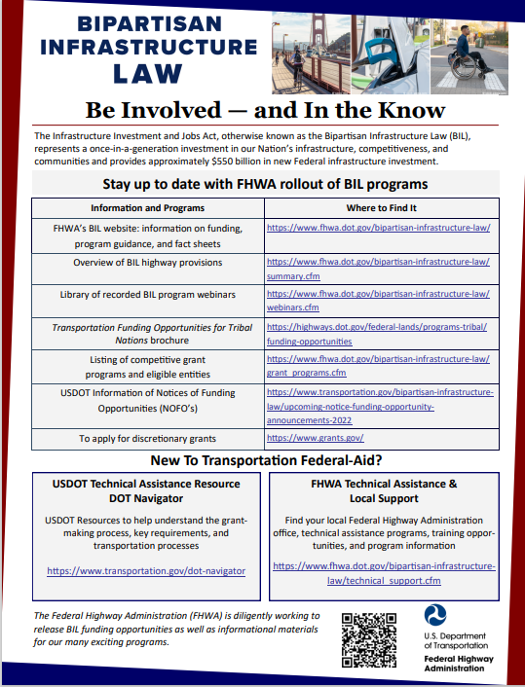
Resources
Funding, Guidance, Fact Sheets
Webinars
Grants
NoFos
Technical Support
BIL Website
  Bipartisan Infrastructure Law - FHWA | Federal Highway Administration (dot.gov)
BIL - Be involved and in the know (dot.gov)
Competitive Grant Programs
  Bipartisan Infrastructure Law - Competitive Grant Programs | Federal Highway Administration (dot.gov)
Fact Sheets available
  Bipartisan Infrastructure Law - Fact Sheets | Federal Highway Administration (dot.gov)

Slide 11
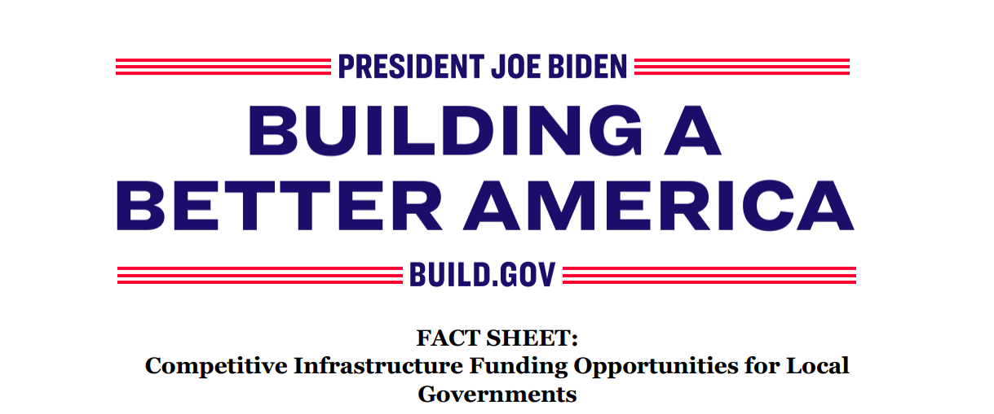
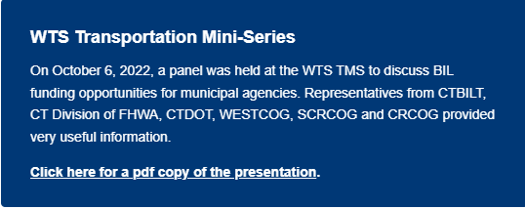
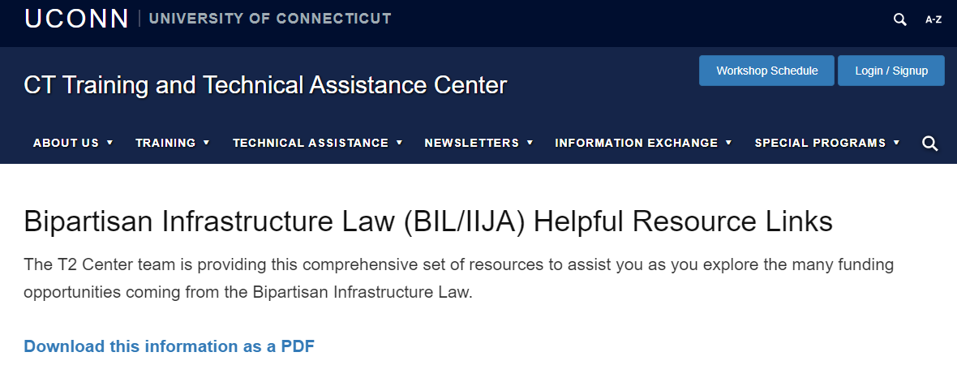
More Resources
25 Funding Opportunities for Local Governments
Technical Support and Training
  Federal-aid Essentials for Local Public Agencies
  BIL Resources | T2 Center (uconn.edu)
BIL-Factsheet-Local-Competitive-Funding.pdf (whitehouse.gov)
Notes:
The Federal-aid Essentials for Local Public Agencies is a transportation resource designed to help local agency professionals navigate the Federal-aid Highway Program. Federal-aid Essentials is structured for busy agency staff who want further understanding of Federal-aid policies, procedures, and practices.
Topics include: Federal-aid Program Overview, Finance, Right-of-Way, Environment, Civil Rights, Project Development, and Project Construction and Contract Administration.

Slide 12
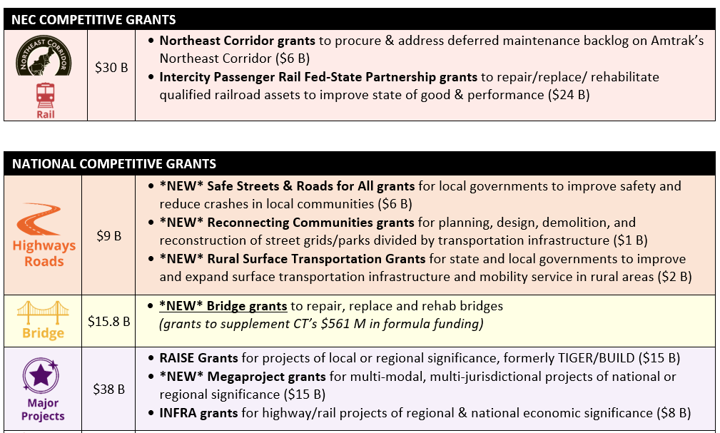
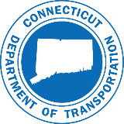
Overview of Discretionary Federal Grant Opportunities
Notes:
​switching gears to Grants - expecting 100 billion to be available nationwide
25 Competitive Infrastructure Funding Opportunities – Not all DOT – many of possible interest are through Dept of Energy
Some are new, some are continuations of existing programs
They differ in Sub-allocation (who will be eligible recipients), and the criteria for selection, as well as dates they will be open for applications

Slide 13
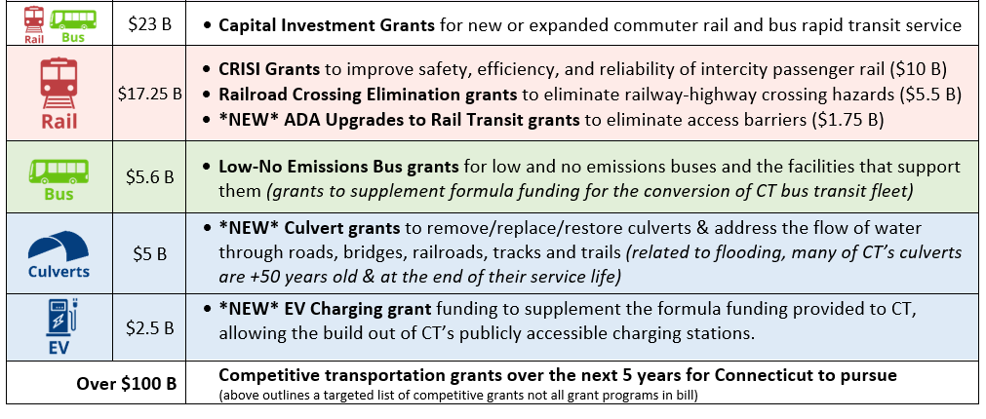
Overview of Discretionary Federal Grant Opportunities

Slide 14
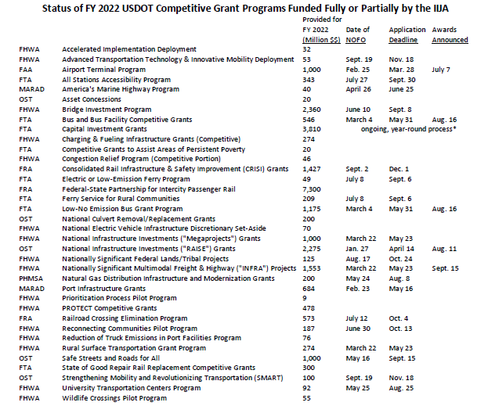
Overview of Discretionary Federal Grant Opportunities

Slide 15
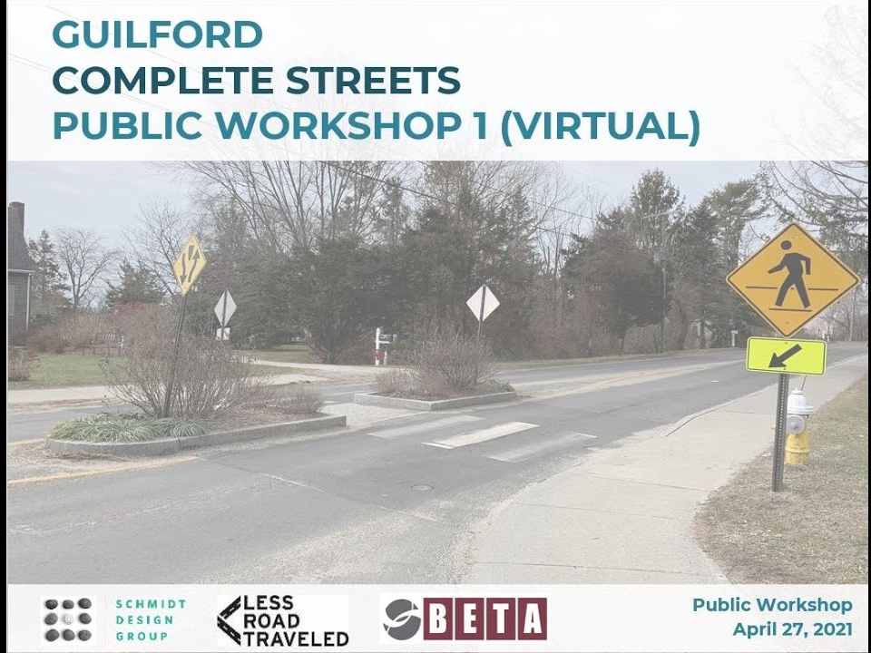
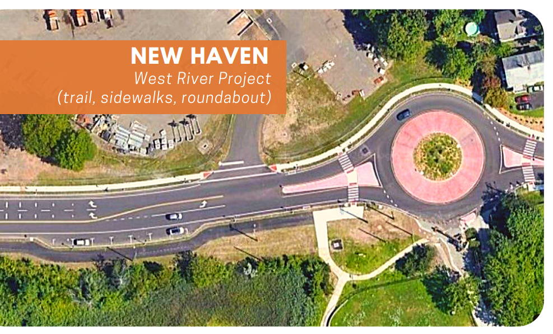
Safe Streets and Roads for All
IIJA authorizes $6 billion over 5 years in Safe Streets grants
Safe Streets and Roads for All is open to MPOs and Local Governments, not State DOTs.
The new grant program will support Vision Zero planning efforts, as well as capital projects to improve safety for all users.
SS4A Fact Sheet (usdot.gov)
Bipartisan Infrastructure Law - Safe Streets and Roads for All (SS4A) Fact Sheet | Federal Highway Administration (dot.gov)
Application deadline September 15th
Notes:
​Safe Streets and Roads for All – This new $5 billion competitive grant program at the Department of Transportation will provide funding directly to and exclusively for local governments to support their efforts to advance “vision zero” plans and other complete street improvements to reduce crashes and fatalities, especially for cyclists and pedestrians.

Slide 16
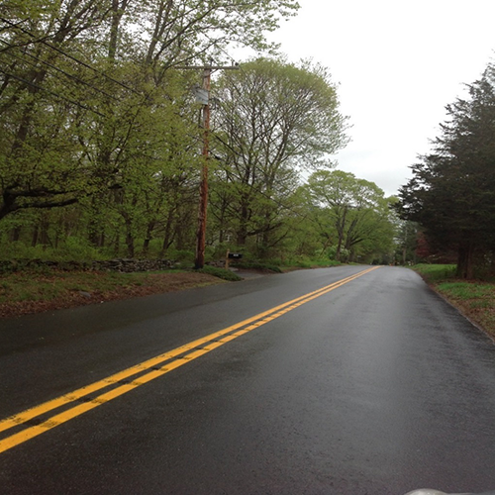
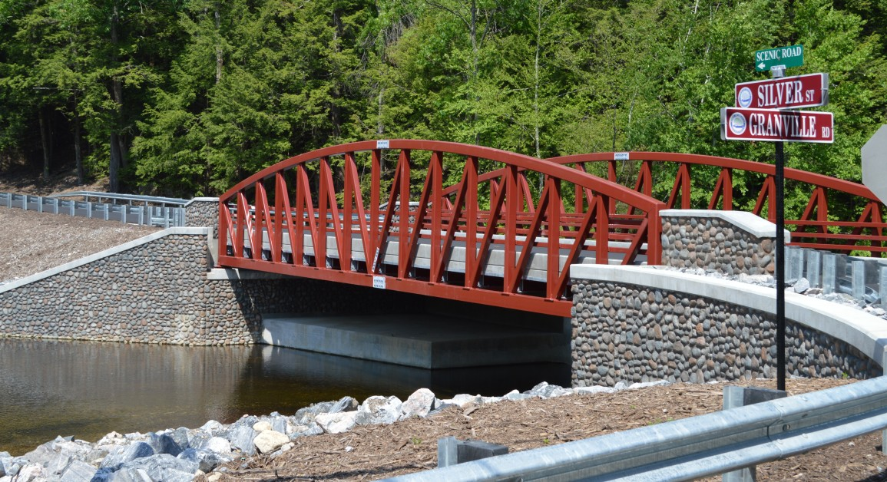
Rural Surface Transportation Grants
IIJA authorizes $2 billion over 5 years in Rural Transportation grants
New competitive grant program to “improve and expand the surface transportation infrastructure in rural areas”
Includes on-demand mobility projects
Applications can be for bundled projects in a region
Application deadline May 23rd
Notes:
​Rural Surface Transportation Grant - This new $2 billion competitive grant program will improve and expand surface transportation infrastructure in rural areas, increasing connectivity, improving safety and reliability of the movement of people and freight, and generate regional economic growth. This amount includes specific set asides for small projects ($200 million), rural roadway lane departure improvements ($300 million).

Slide 17
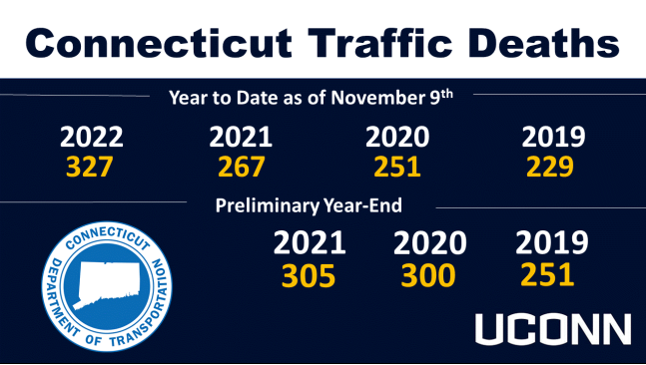
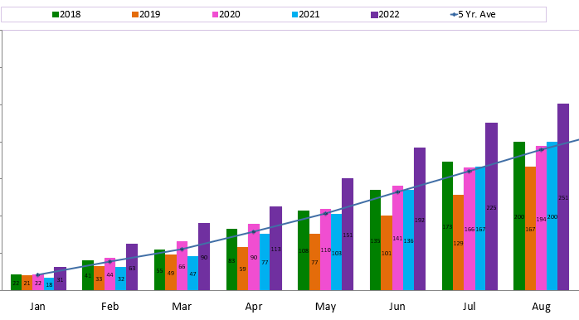
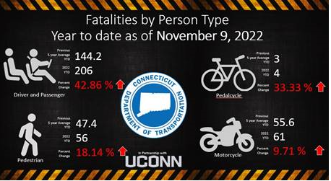
Connecticut Crash Trends
* 2020 and later data are preliminary and from CTDOT sources; data from prior years are from NHTSA FARS final files
HSO

Slide 18
HSO Examples of grants funded
  Comprehensive DUI Enforcement
  Drug Recognition Program (DRE)
  Underage Drinking Program
  High School Outreach Programs
  Cannabis Education
  Occupant Protection Enforcement
  Child Passenger Safety Training and Education
  Distracted Driving Enforcement
  High School Outreach Programs
  Speed and Aggressive Driving Enforcement
  Watch for Me CT (Pedestrian Awareness Program)
  Multiple additional media campaigns aimed at new law education and older road user safety
  Bike and Pedestrian Education and Training
  Motorcycle Rider Training and Education
  Traffic Records System
HSO
Notes:
These are reimbursable grants
CT Highway Safety Office Program Areas
Impaired Driving
Occupant Protection / Child Passenger Safety
Distracted Driving
Speed & Aggressive Driving
Bike and Pedestrian Safety
(Non-Motorized)
Motorcycle Safety
Traffic Records
Crash Data & Analysis

Slide 19
Questions?
Kimberly Lesay
Kimberly.Lesay@ct.gov
Bureau Chief
Policy and Planning
  Joseph Cristalli
  Highway Safety Office
  Joseph.Cristalli@ct.gov

Slide 20
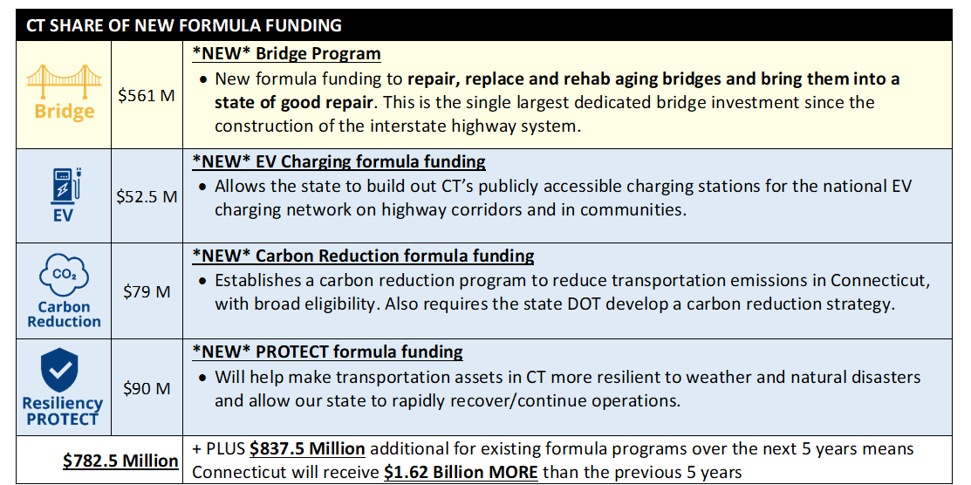
Overview of New Federal Formula Programs
Notes:
These are the expected program amounts over the next 5 years for CT

Slide 21
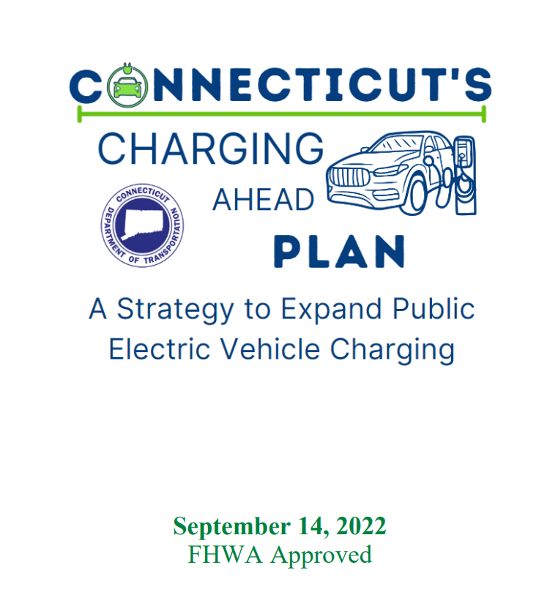
Funding Climate Mitigation with the Bipartisan Infrastructure Law
National Electric Vehicle Infrastructure Program
NEVI Plan approved by FHWA September 14, 2022
1st Round of State of CT Competitive Grants
$7.7 million available for first fiscal year
Fast chargers on Alternative Fuel Corridors
  1-mile drivable distance from exit ramp
  Publicly accessible
  50-mile maximum gap between chargers
Additional funds will be available for nationally competitive grants
Notes:
states are required to fully build out their FHWA designated Alternative Fuel Corridors (AFCs) before funding EV charging in other locations across the state. As a result, program planning and this plan focus largely on this Phase 1 of the NEVI program, which is prioritizing the build-out of fast charging along Connecticut’s existing AFCs to ensure residents and travelers were always within range of a charging station while traveling along the state’s interstate highways.

Slide 22
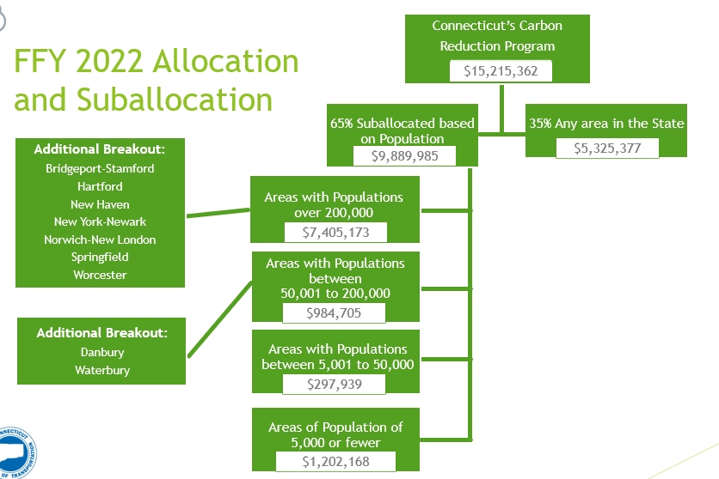
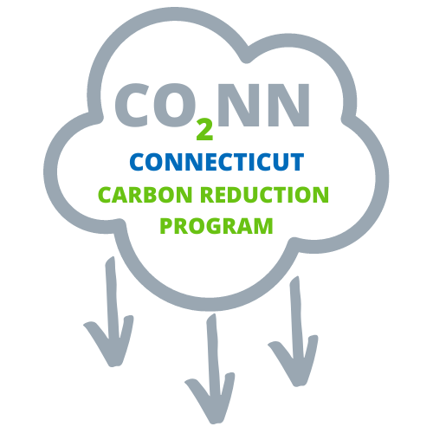
Funding Climate Mitigation with the Bipartisan Infrastructure Law
Development of a Carbon Reduction Strategy
In consultation with MPOs
Update every 4 years
Disbursement of Allocated Funds
DOT will be conducting Outreach / Training
Will be asking MPO’s & COGs to aid in prioritization
Carbon Reduction Program

