Slide 1

October 2022
Economic Update

Slide 2
State Budget | Fiscal Stability
Strong financial governance puts Connecticut in a solid position to weather potential economic downturns
Closing FY 22 with a budget surplus of $1.3 billion (6.1% of General Fund), for the fourth consecutive year
Midterm adjustments provided tax relief totaling over $600 million—the largest tax cut in state history
The “rainy-day” fund is maxed out at its statutory cap of 15% General Fund or $3.3 billion
Strong savings have allowed the state to contribute an additional $5.8 billion in supplemental payments towards unfunded pension liabilities, saving taxpayers $500 million per year and $12 billion over the next 25 years
All four credit agencies upgraded our ratings in the last 18 months, including Moody's for the first time in 20 years

Slide 3
State Budget | Over $600 million in Tax Cuts
Largest Tax Cut in CT history
Gas Tax Suspended through November 30, saving residents $0.25/gallon each time at the pump
Child Tax Rebate $250 per-child for lower and middle-earning families
Car Taxes Lowers the mill rate from 45 mills to 29 mills, giving property tax relief for an additional 1.7 million vehicles in 103 cities/towns
Property Tax Credit Increase The credit will be increased from $200 to $300, available to more people and no longer limited to those over 65
Pension & Annuity Income Tax Elimination There will be no more income taxes on pension & annuities
Earned Income Tax Credit (EITC) The credit will increase from 30.5% to 41.5%

Slide 4
State Budget | Investments to Drive Business Development
Strategic investments in workforce development, technology and childcare
Federal Infrastructure Bill $6.04 billion over 5 years to CT
Workforce Development $145 million to expand the CareerConnect program, provide wrap around services for workers, and address the shortage of nurses and mental health professionals
Child Care & Mental Health Approximately $100 million in new investments in childcare and $28 million for mental health-related grants
Broadband & Technology Expands capacity and resiliency of CEN, provides rail commuters with on-board, high-speed internet access

Slide 5
Overall Trends | Employment
Unemployment rate continues to decline, keeping pace with the region
Unemployment Rate vs US and Region
(January 2021 - September 2022)
Source: CT Dept of Labor and Bureau of Labor Statistics, seasonally adjusted data

Slide 6
Overall Trends | Labor Force Participation
CT's labor force participation rate continues to increase and outperform the nation
Labor Force Participation Rates*
(January 2021 - September 2022)
Connecticut’s labor force participation rate is currently 2.3% above the US rate (compared to approximately 4.0 % pre COVID), but it continues to grow steadily.
Opportunity: Workforce development, increase childcare funding, Paid Family Medical Leave for all help get residents back into the labor force.
For CT's labor force participation to get back to pre-COVID levels relative to the US, another 41,000 employees and job-seekers need to enter our labor force.
*The LFPR is the percentage of the working-age population that is either working or actively looking for work.
Source: Bureau of Labor Statistics, seasonally adjusted data

Slide 7
Challenges | Job Vacancies
CT’s job openings rate exceeded the national rate in August
Job Openings Rate*
(January 2019-August 2022)
Connecticut’s job openings rate is on an upward trend and raises the need to expand our labor force.
Opportunity: Recent budget invests $110 million in workforce development, training residents to fill open jobs in fields such as manufacturing, healthcare, IT, construction, clean energy, and bioscience.
*The job openings rate is the number of job openings as a percent of total jobs.
Source: Seasonally adjusted JOLTS data, Bureau of Labor Statistics

Slide 8
Momentum | Record New Business Growth
Business formation is up 40% since pre-pandemic - highest since 2006
High Propensity Business applications* climb from around 800 to over 1,100 per month
June 2005 – September 2022
Business formation is the highest since before the 2007-2008 financial crisis
40% Increase
*High propensity businesses are those with a high likelihood of hiring employees, and include those that indicate they are hiring, purchasing a business or changing organizational type, or are in manufacturing, retail, health care or restaurant/food services (US Census definition).
Source: DECD calculations of US Census HPB application data retrieved from the St. Louis Federal Reserve Bank (FRED) database. Not seasonally adjusted, 12-month moving average.

Slide 9




DECD Priorities | Communities and Businesses
1
  Workforce
  Broaden the base of skilled workers to meet increasing industry demand
2
  Communities
  Attract and retain talent by investing in vibrant and affordable communities for all
A thriving,
inclusive
CT economy
  Innovation
  Support growth and generate inclusive economic opportunity within CT’s most innovative and specialized industries
3
4
  Business Environment
  Improve CT’s environment and reputation for starting and growing businesses

Slide 10


DECD Priorities | Communities and Businesses
JobsCT Support business attraction & expansion; reward employers that locate and grow in CT
Small Business Express 2.0 Public & private matching funds to support small businesses, creating/retaining jobs via loans and grants, 50% for underbanked and underrepresented business owners
Innovation Corridor Public & private matching funds to seed up to three transformational projects to drive jobs, innovation, and business formation in our largest cities
Smart Manufacturing Creating & retaining thousands of jobs through training and other programs via recapitalization of Manufacturing Innovation Fund
Connecticut Communities Challenge Competitive grant program to spur investment and vibrancy in CT's main streets through high-quality, transit-oriented development
Community Investment Fund Five-year, $875M bonding to fund qualifying projects for municipalities, community development corporations, and nonprofits
Brownfield Redevelopment Returning sites across the state to productive re-use, including mixed-use, residential, commercial, industrial, retail and open space
Tourism, Marketing, Arts & Culture Create a new, youthful and vibrant, diverse perception of the state, fund arts and other entertainment organizations that add vibrancy to Connecticut communities.
DECD “earn as you grow” incentives reduce reliance on bonding while providing transparent support to businesses looking to grow jobs in Connecticut

Slide 11
DECD Priorities | Change Perception
    Complete revamp of www.CTvisit.com and www.ChooseCT.com
    Reimagine and rehabilitate CT Welcome Centers
    Promote mix of experiences both well-known/traditional and new/unexpected
    Strengthen industry relationships, including airports, associations and partners of all sizes
    Refine CTForMe.com first-person stories from young residents, over 300 local businesses to attract talent and show cool things to do
    Fund Arts and organizations experiencing pandemic-related economic impact i.e, CT Summer Museums offering free admission to kids

Slide 12





DECD Priorities | Expand Tourism
Broaden our reach in international, domestic, drive markets, with year-round campaigns
  IMPACT
  TAXES
  JOBS
  OVERNIGHTS
  WEB VISITS
$15.5B
in total economic impact supported by traveler spending
$2.2B
in tax revenues
147.5K
leisure/
hospitality jobs; up 16% YOY
+22%
increase in occupancy YOY; RevPAR up 63%
~7M
CTvisit.com
visitors per year; up 43% YOY
Source: 2019 Tourism Economics study.
Source: 2019 Tourism Economics study.
Source: April 2022 CT Dept. of Labor.
Source: STR January-April 2022.
Source: January- May, 2022 Google Analytics.

Slide 13


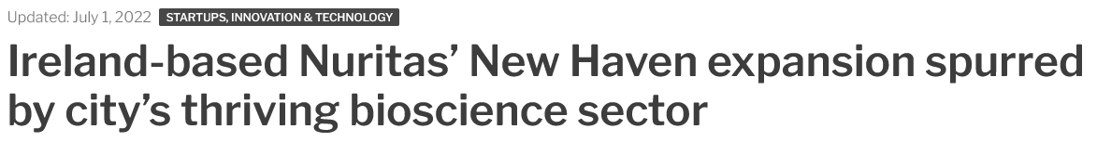
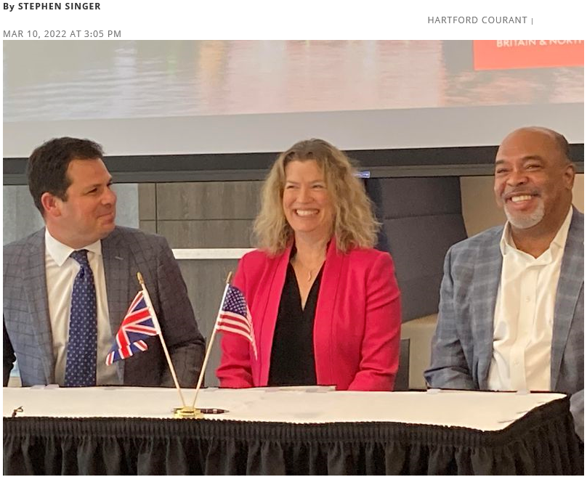
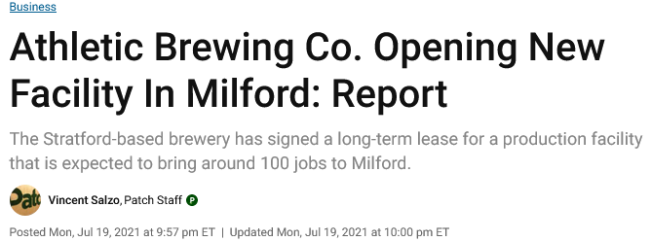

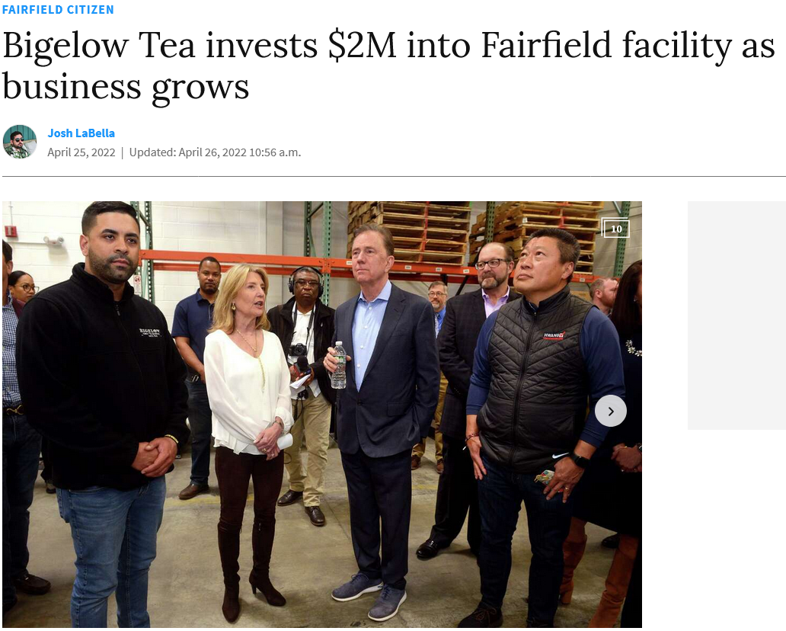
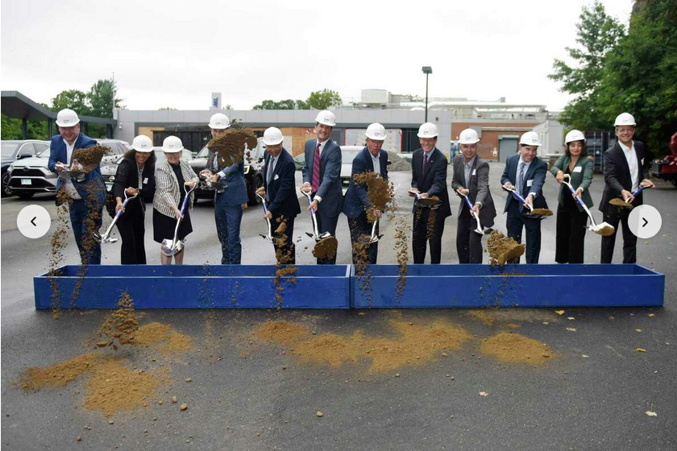

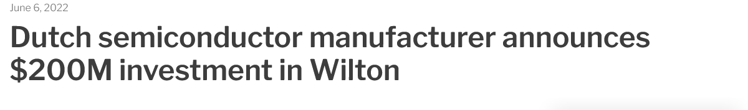

DECD Priorities | Partnership with CT Innovations & AdvanceCT
Notes:
Add headlines

