Slide 1

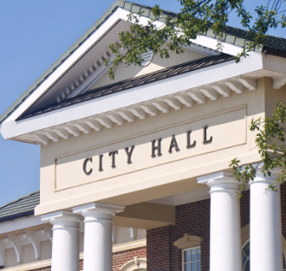




COST Workshop for Municipal Officials
Cybersecurity Preparedness
January 9, 2024
Christopher J. Wardrop, CIC, CRM, SVP
USI Public Entity Practice

Slide 2










Introduction to USI and our Public Entity Practice
State & Federal Governments
Cities, Towns, Counties, Villages
Public Utilities, Authorities and Special Districts
Public School Districts
Our specialty - locally and nationally
Life Safety including Fire/EMS
Transportation [Bus, Rail, Air]
Quasi-Public Entities
[Housing, Education, Regional Service]
Government Contractors
| 1

Slide 3

Your phone rings right now…a cyber incident happening at town hall….What would you do, and how would you respond?
| 2

Slide 4
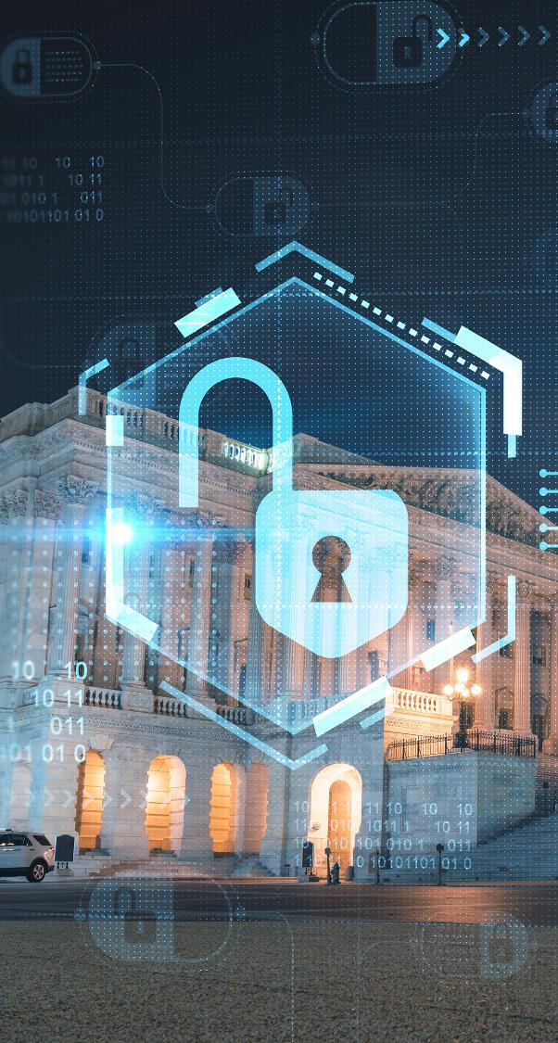
Municipal Cybersecurity Challenges
Limited budget and/or personnel to implement new or maintain existing cyber security measures.
Inexperience and lack of formal cyber incident response plan or crisis response team
Increasing exposures – criminals are more politically and financially motivated - (“Social Engineering” Fraud and Computer Crime criminal schemes have become more sophisticated)
Multiple networks and/or systems across different municipal departments
Changing federal and state privacy and breach notification laws
Several key drivers and trends continue to impact and influence public entities.
| 3

Slide 5
What does your “Incident Response Plan” (IRP) look like?
Key Elements:
Internal contact list with roles/responsibilities (including spokesperson (s) for public relations/media.
External contact list including key vendors and legal counsel.
Cyber insurance new incident hotline information.
Criteria for responses (size/scope criteria)
List of post-incident activities and timeline
Appropriate IRP storage location and edition date.
Rehearse, review, repeat
Incident Response Plans – the key to responding efficiently
| 4

Slide 6
Who’s on your “Incident Response Team?
Internal:
The Internal Team
First Selectman/Town Manager/Administrator
Finance Director
CIO/I.T. Director
Human Resource Manager
Law Enforcement leader
Legal representative
| 5

Slide 7
Who’s on your “Incident Response Team? (continued)
External:
The External Team
Legal representative
Insurance broker/advisor
Cyber insurance carrier (including “breach coach”
I.T. service provider (if applicable)
Government agencies (if applicable)
Key vendors (if applicable)
| 6

Slide 8
“Cyber” Incident Examples
Ransomware demands thru malware insertion (multiple towns each year the past five+ years)
Business email compromise
  New Haven Public Schools
  Manchester Public Schools
  Town of Farmington
Employee paycheck direct deposit
MOVEit file storage data theft/ransomware attacks
Target Corp (thru HVAC vendor)
| 7

Slide 9
Third-Party/Vendor Cyber Exposures – Where They Lurk….
Remote I.T. services - Outsourcing, private vendors, RESC’s?
Remote or direct access to I.T./O.T. - Building management system vendors/contractors (broad range of building services, including HVAC, access control, security, power, lighting, fire systems, elevator and escalator controls, smart whiteboards, and clinical systems.
Point of service money collection: food service, park/rec, senior center, etc.
Fire/EMS (billing vendors)
What or who else?
**Important to review your contract/agreement with them**
| 8

Slide 10
Cyber Insurance 101
| 9

Slide 11
Why purchase cyber insurance?
“Pre-assembled” external incident response team including breach coach, I.T./forensics services, ransomware negotiator, public relations
Covers municipal expenses in responding to a cyber incident
Covers third party liability exposures when municipality is alleged to be responsible
Ancillary resources/services including IRP templates, basic employee education, and vendor discounts.
| 10

Slide 12
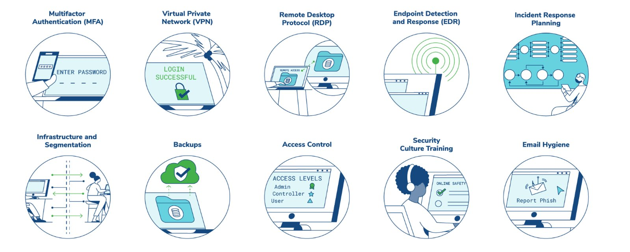
“Top 10”Cyber Underwriting Focus Areas 2023-24
**A good guide to compare against your internal cyber-security measures**
|11

Slide 13
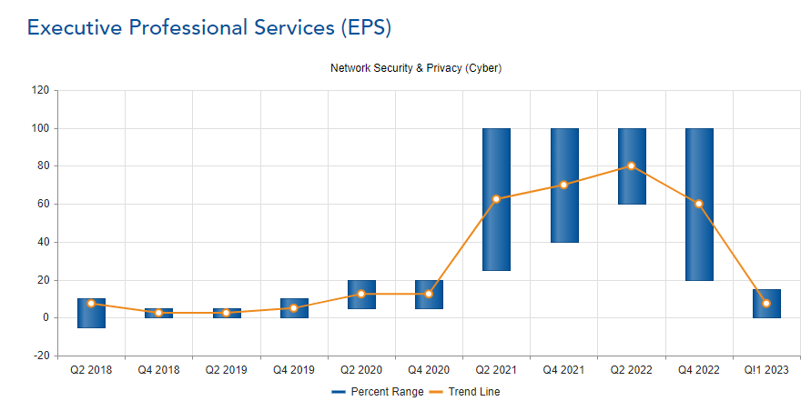
Cyber Premium Trends & Why They Matter
Source: USI Insurance Services
| 12

Slide 14
Other resources and final thoughts
| 13

Slide 15
Questions?
Thank You from
USI Insurance Services!
Christopher Wardrop, CIC, CRM, SVP
Christopher.wardrop@usi.com
860-614-4051
| 14

