Slide 1
CRCOG Infrastructure Resources: LOTCIP and ezIQC
Kim Bona, CRCOG
COST Planning & Development Conference 2022
November 17, 2022

Slide 2
State & Local Infrastructure Resources
LOTCIP (Local Transportation Capital Improvement Program)
ezIQC (Indefinite Quantity Construction)

Slide 3
LOCAL TRANSPORTATION CAPITAL IMPROVEMENT PROGRAM (LOTCIP)
State funding through CRCOG for transportation projects:
Reconstruction
Pavement rehabilitation
Sidewalk
Bridge
Multi-trail projects

Slide 4
LOCAL TRANSPORTATION CAPITAL IMPROVEMENT PROGRAM (LOTCIP)
Eligibility requirements:
LOTCIP projects – must be located on roadways functionally classified as urban collector or higher.
Bridge improvements - eligible on any roadway classification, however bridges on minor collectors and local roads must have length of 20 feet or more.
Stand-alone sidewalk projects and pedestrian improvements – may be located on roadways of any classification.
Minimum project cost estimate of $300,000.

Slide 5
What is ezIQC?
COMPETITIVELY BID CONSTRUCTION PROGRAM
The ezIQC® program is a competitively-bid, on-call service for construction projects since 2009.
Roads and Bridges program launched in January 2017.
Both the consultant, Gordian Group, and the contractors who perform the work are competitively bid.

Slide 6
When to use ezIQc?
FASTER AND SIMPLER, COMPETITIVE SAVINGS
Time-sensitive projects and emergency work.
  Limited scheduling windows
  End of year funding
Project backlogs and pending work.
Advance work for large projects or supplement in-house expertise.
Replacement-in-Kind projects.
Small to medium size projects.

Slide 7
Is the funding source eligible for ezIQC?
Federal funding – generally, yes.
ARPA
CARES
BIL/IIJA
State and Local funding – sometimes.
LOTCIP – no, although CRCOG continues to work with CTDOT
STEAP – sometimes, depending on issuing agency.
Community Connectivity Grant – yes.

Slide 8
How does ezIQC work?
PROCUREMENT PROCESS
CRCOG competitively bids for the Job Order Contracting consultant and the regional contractors
  Two Types:
    General Construction
    Roads and Bridges
  Regional Contract Term:
    Regional contracts - one year with optional 1-year extensions, up to a maximum of 3 years.
Pricing is provided by a standard “task catalog” which is competitively awarded upfront, saving time on bidding individual projects.
Gordian works with you to conduct a full scope review and provide a quote to fit your project and budget needs.

Slide 9
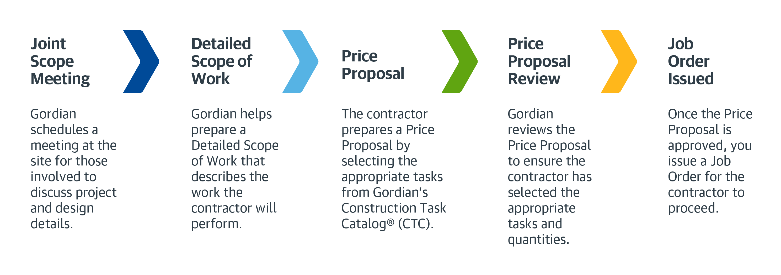
5 Step Job Order Process
1
2
3
4
5

Slide 10
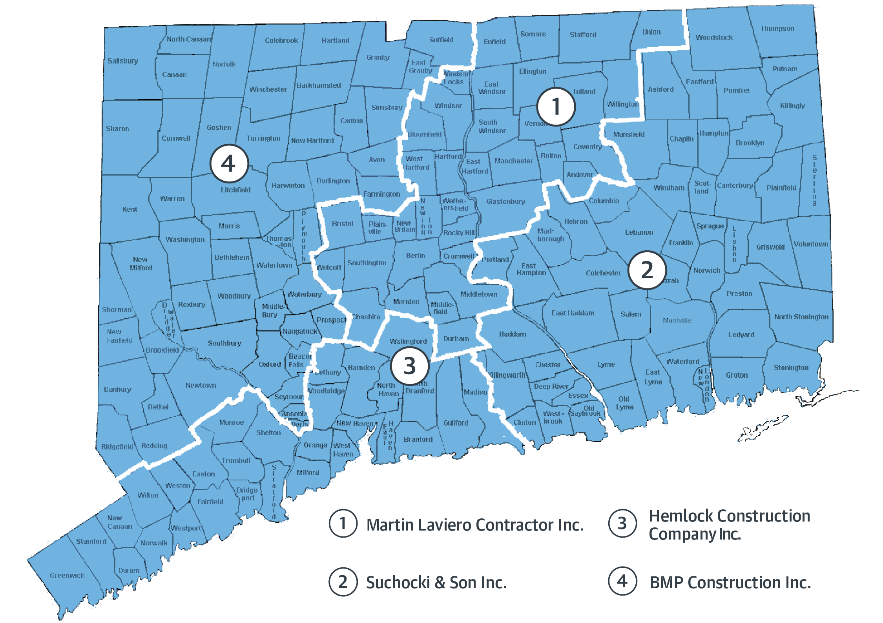
ezIQC in Connecticut – CRCOG – Roads and Bridges

Slide 11
Program Advantages
FASTER AND SIMPLER COMPETITIVE SAVINGS
Multiple projects with a single competitively bid contract.
Compare prices easily and clearly.
On-call contractors for maintenance, repair, upgrades for variety of projects. i.e., guiderails, paving, sidewalks, airline trails, underground storage tank (UST) removal, and more.
Minimal change orders.
Saves time and money on procurement procedures!

Slide 12
Questions?
Kim Bona
(860) 724-4292
kbona@crcog.org

Slide 13
THANK YOU

