Slide 1
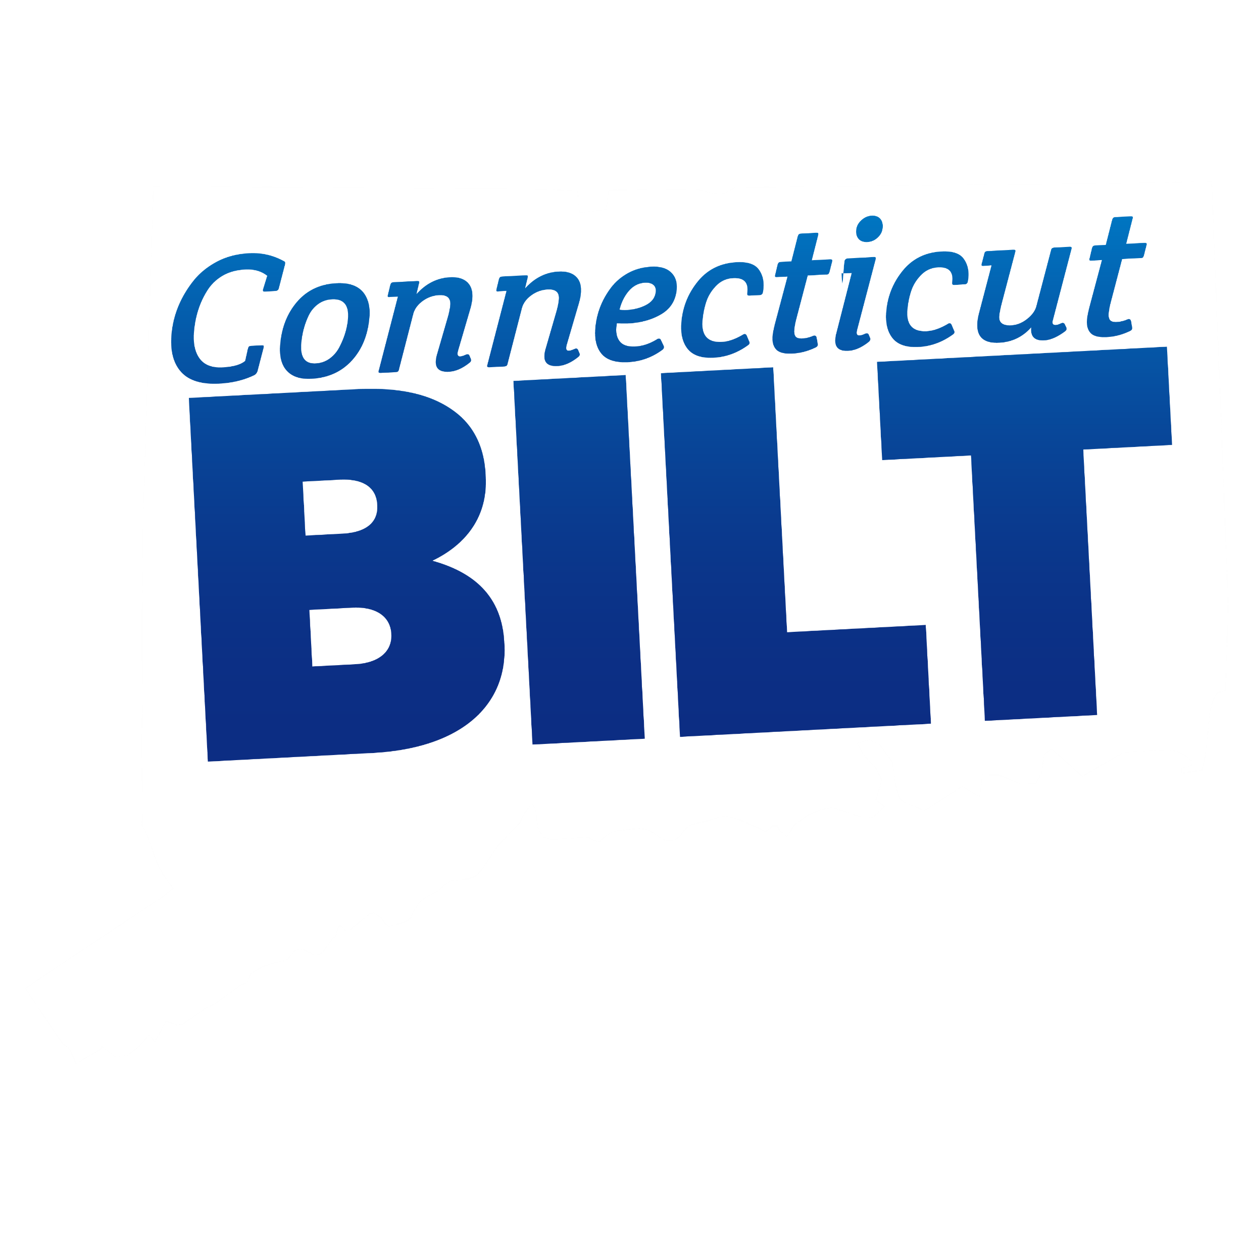


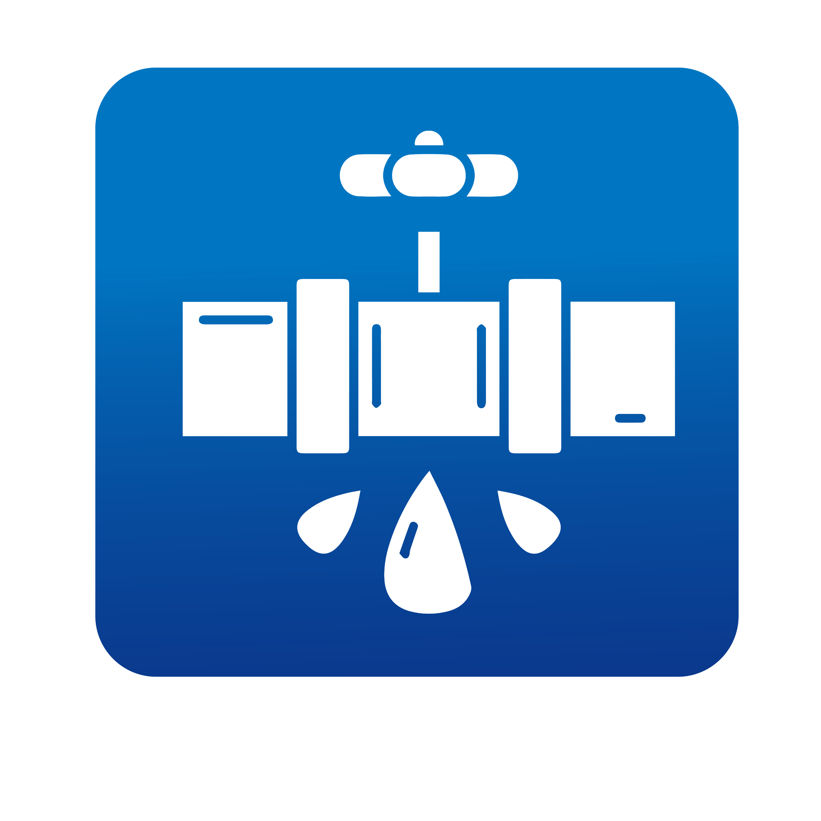
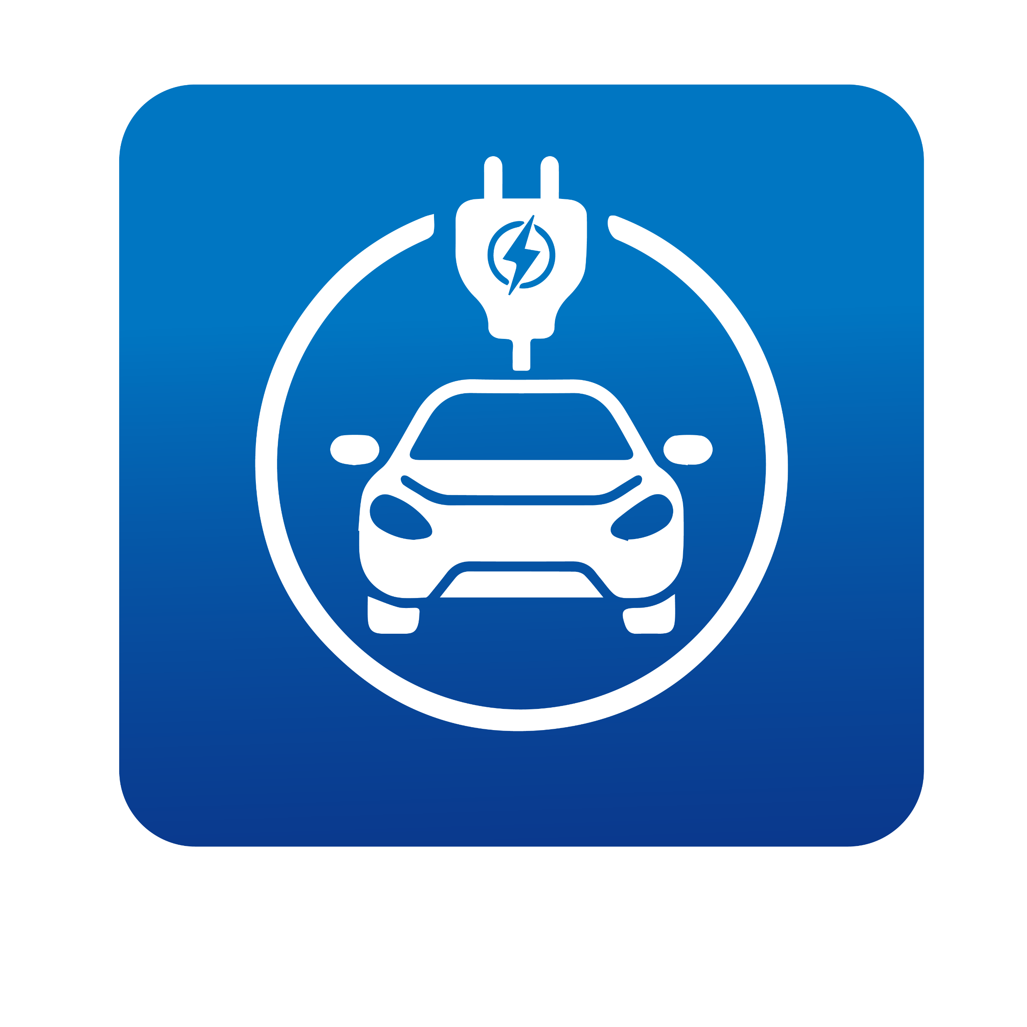

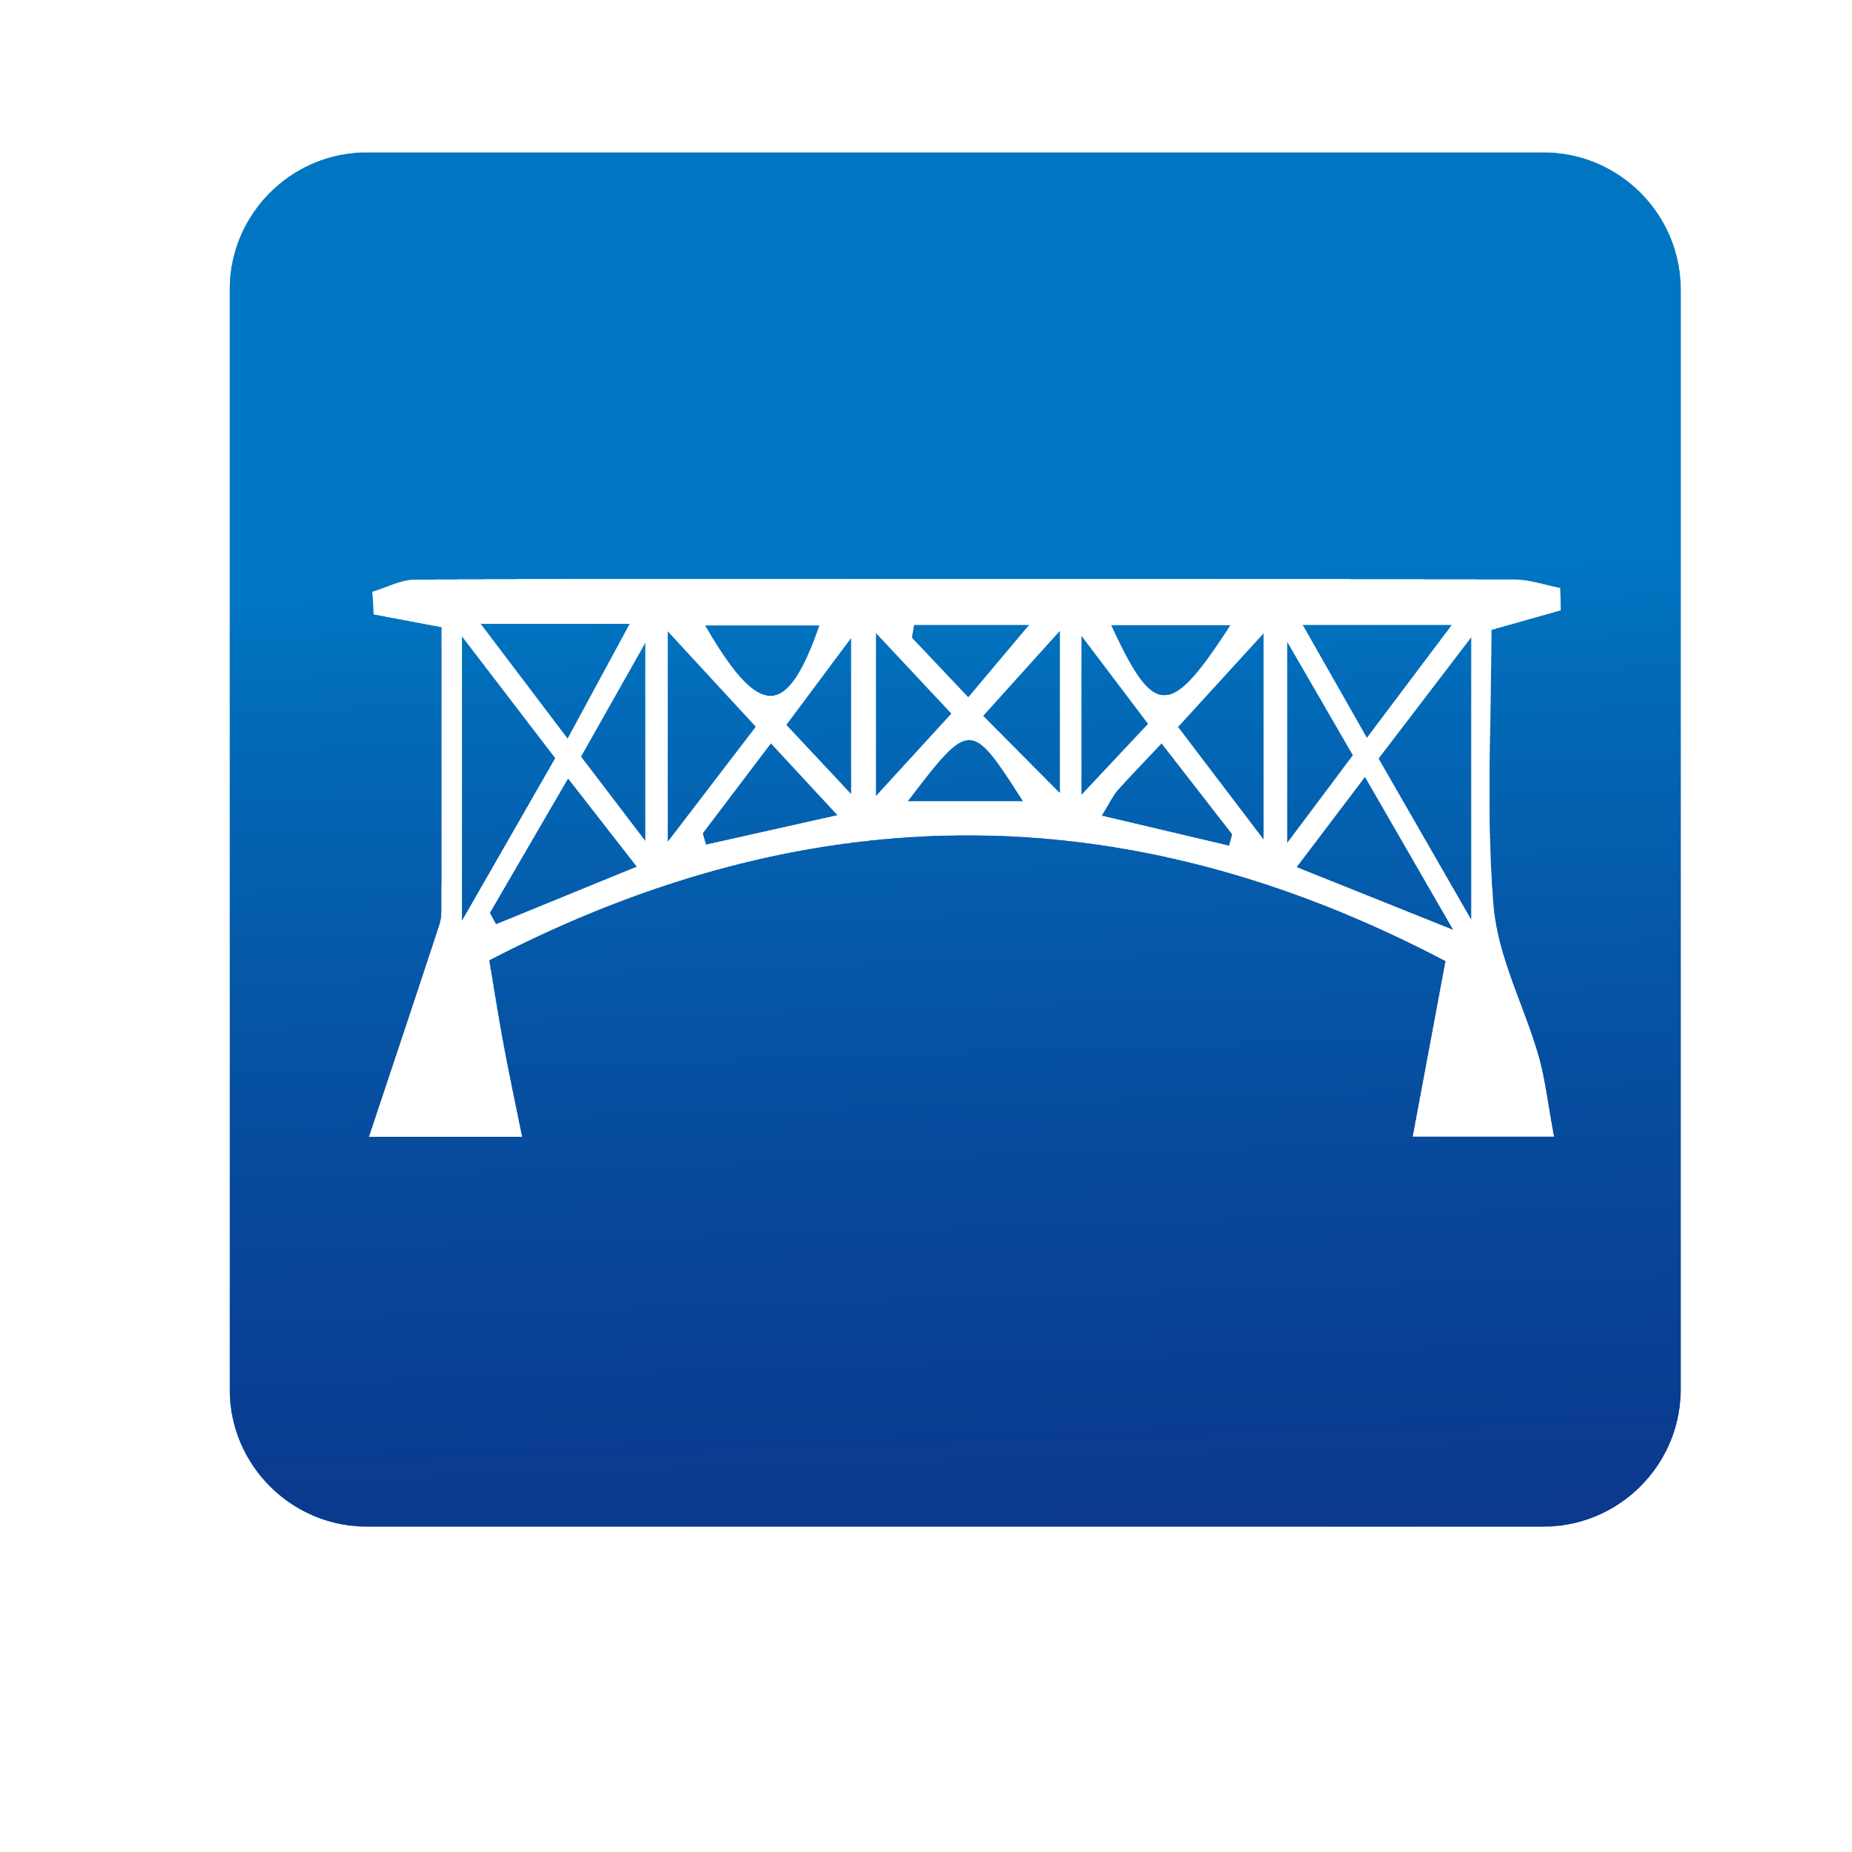


COST’s 2023
Connecticut Town Meeting
1/11/23

Slide 2

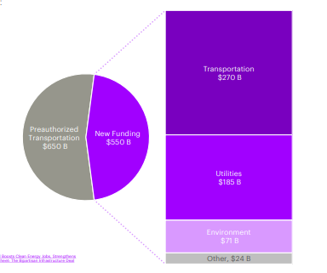
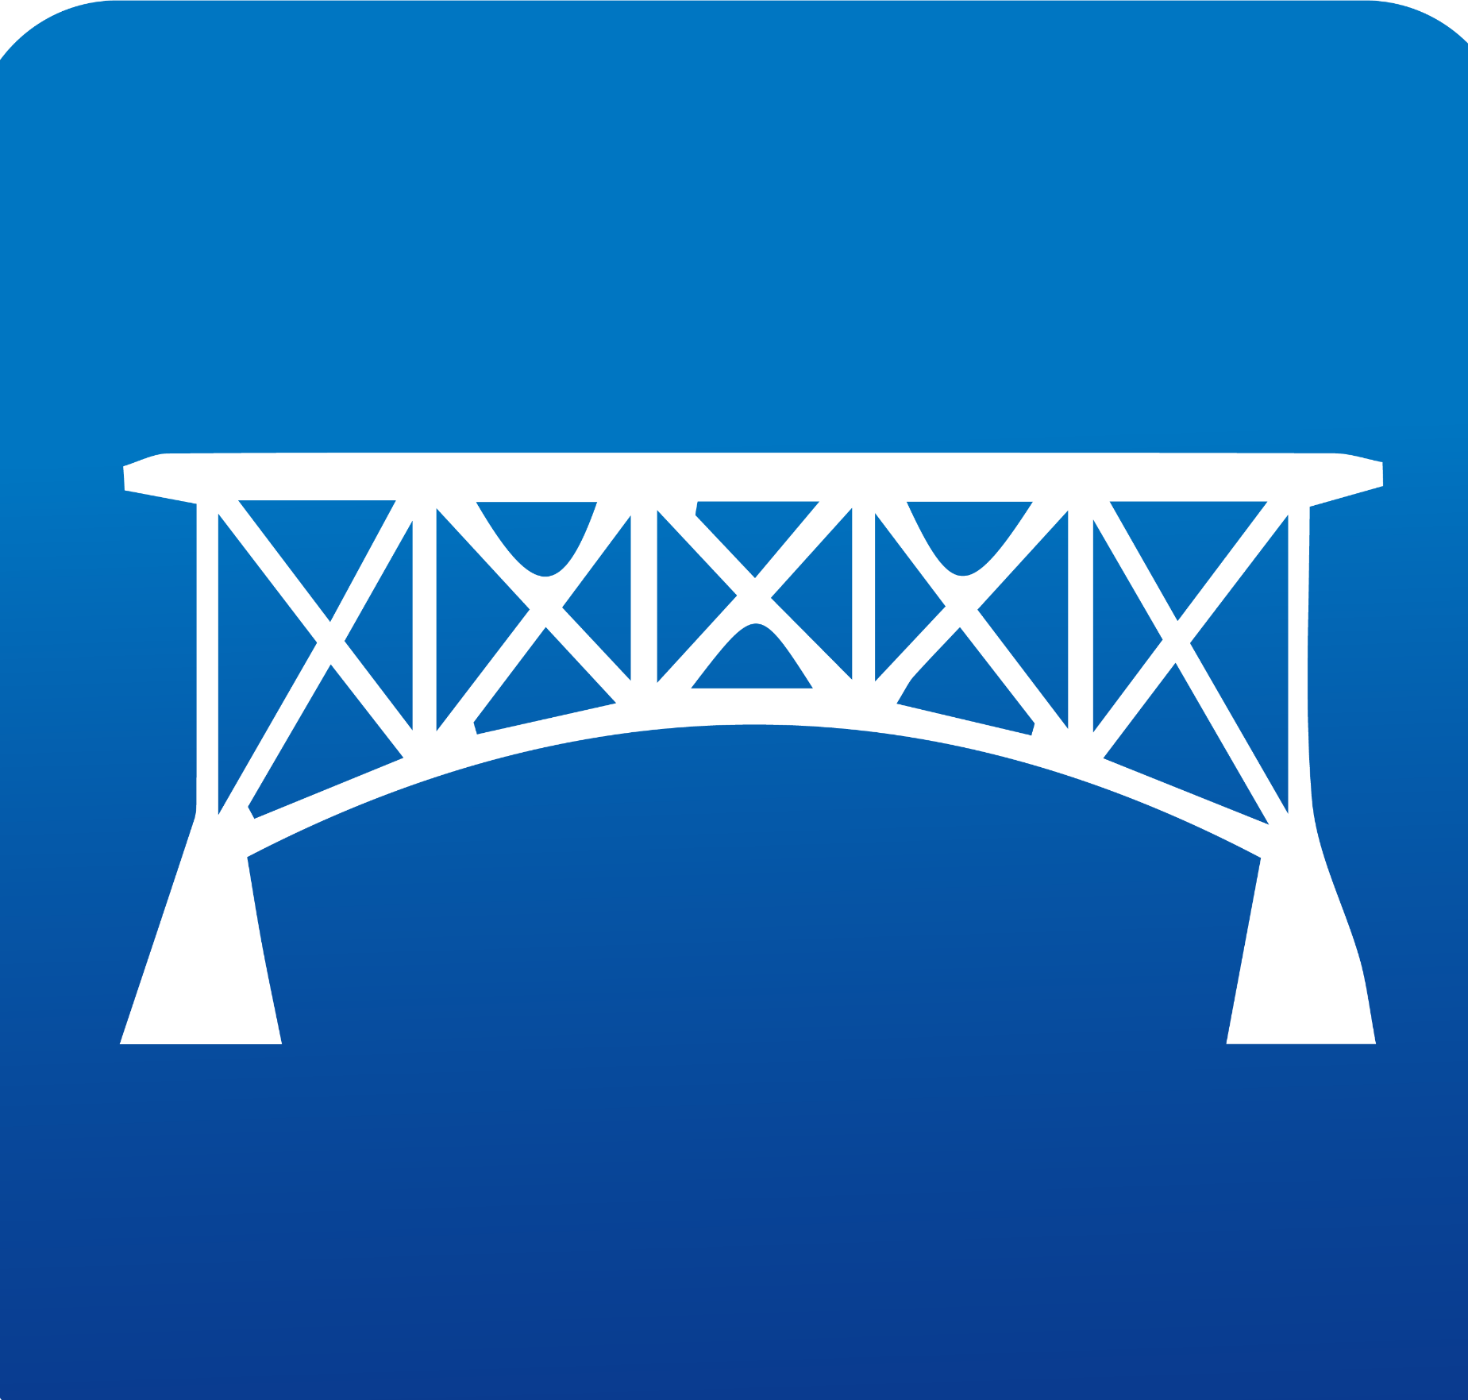


The Infrastructure Investment and Jobs Act (BIL)
The law is comprised of $1.2T including $550B in net new spending in addition to $650B in already authorized funds
Signed into law November 2021
  19 federal agencies
  380 unique programs
Historic investments in the nation’s core infrastructure needs
Combines incremental funding for existing programs, plus many net-new opportunities
Surface Transportation Reauthorization
  Next 5 years of funding
  New programs and objectives
Transportation
$270B
Preauthorized Transportation
$650B
New Funding
$550B
Utilities
$185B
Environment
$71B
Other $24B
Source: https://www.whitehouse.gov/briefing-room/statements-releases/2021/11/08/fact-sheet-the-bipartisan-infrastructure-deal-boosts-clean-energy-jobs-strengthens-resilience-and-advances-environmental-justice/

Slide 3






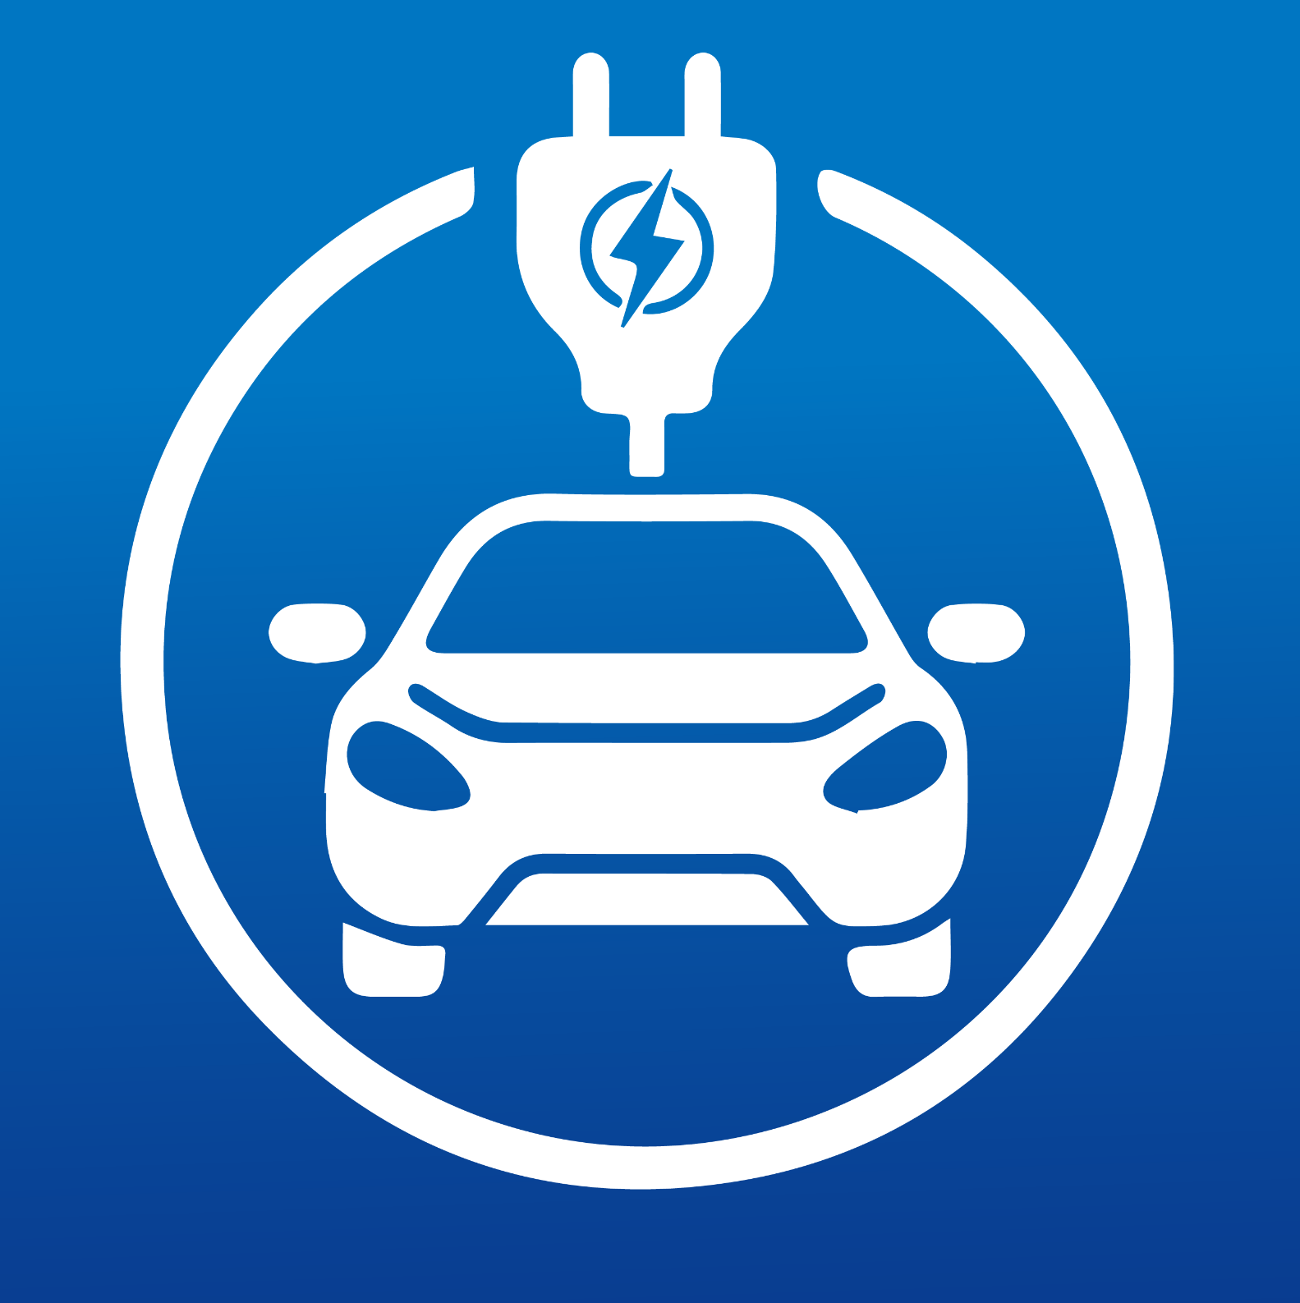
Objectives of CTBILT team
Drive long-term gains for CT with BIL investments through a focus on climate mitigation & resilience, workforce & economic development, and smart growth
Rapidly apply for and deploy funds
Maximize funding impact through matching and partnerships
Empower agencies to recommend, design, and implement projects
Coordinate across New England States as well as other agencies on shared opportunities and challenges
Ensure equitable benefit from infrastructure investments
Facilitate innovation through robust stakeholder engagement
“Building the Plane as We Fly It!”

Slide 4
IIJA & Connecticut
Connecticut’s Portion
  $6.04 Billion over 5 years (FY 22-26)
  Received $2.2 Billion to date
    Funding has been allocated through various programs, both competitive and formula grants
Mix of formula funding and competitive grants
Implementation timelines vary by program
Source: CONNECTICUT_The-Infrastructure-Investment-and-Jobs-Act-State-Fact-Sheet.pdf (whitehouse.gov)

Slide 5
BIL Coordination Support
DRS Commissioner and Senior Advisor to the Governor for Infrastructure
Mark Boughton
Deputy Advisor
Stephen Nocera
DRS/OPM DPM
Program Associate
Tayler Thorpe
DRS/OPM DPM
IIJA Fellow
Possible IRA Fellow
DOT Fellow
DEEP Fellow
OWS Fellow
Possible Additional Fellow

Slide 6


Competitive Grant Philosophy

Slide 7
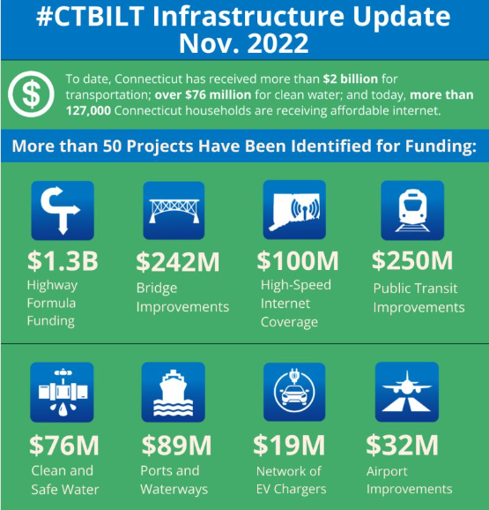
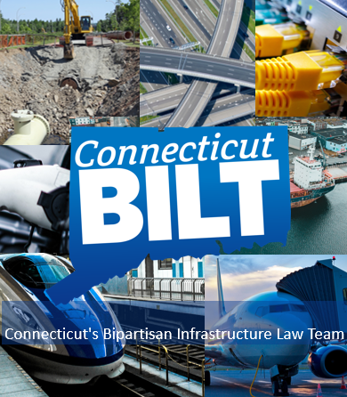
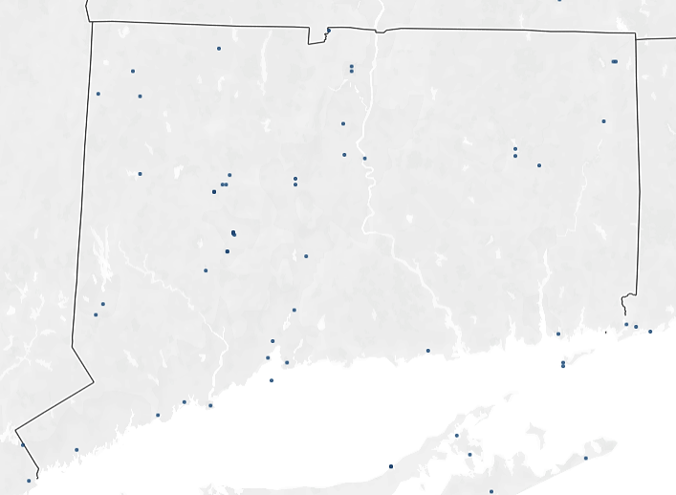
What We’ve Accomplished… So Far!
Announced BIL Projects in Connecticut as of Nov 2022
Source: Bipartisan Infrastructure Law (BIL) Maps Dashboard

Slide 8
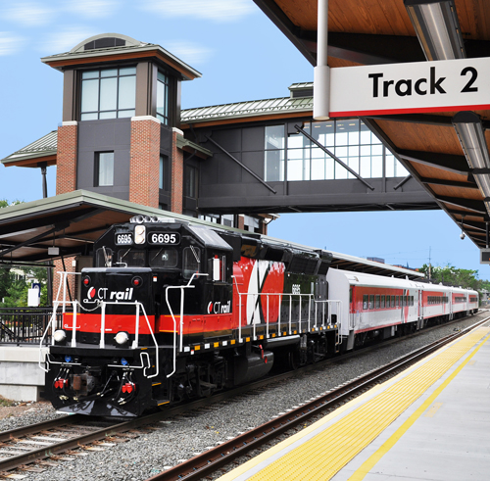
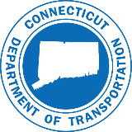





CTDOT
Over $1.6 billion has been announced for Connecticut’s roads, bridges, roadway safety, and other major projects. (Highway Formula Funding + Formula Bridge Funding + RAISE program money)
Won funding for Accessibility Improvements at Ansonia, Beacon Falls and Seymour Stations that serve the Waterbury Line -$29.6 million
Awarded funding for Gold Star Bridge Repairs, improving the bridge in New London & Groton - $158 million
$242 million received for Connecticut Bridges (Figure does not including Gold Star Bridge award)
$2 million in Local and Regional Project Assistance Grants for Stamford’s West Main St Corridor Planning
2022 IIJA Highlights

Slide 9

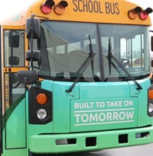
DEEP
2022 IIJA Highlights
$36.5 million for Bridgeport Harbor for Coastal Storm Risk Management, Hurricane, And Storm Damage Reduction
National Electric Vehicle Infrastructure Formula Program & National Electric Vehicle Infrastructure Formula Program - $132.3 million
Grants for EV School buses in Cornwall, Falls Village, Sharon, and Hartford – $8.8 million in EPA’S clean school bus program dollars thus far
127,000 households in Connecticut are enrolled in the Affordable Connectivity Program and growing
Connecticut will receive at least $100 million for high-speed internet infrastructure

Slide 10
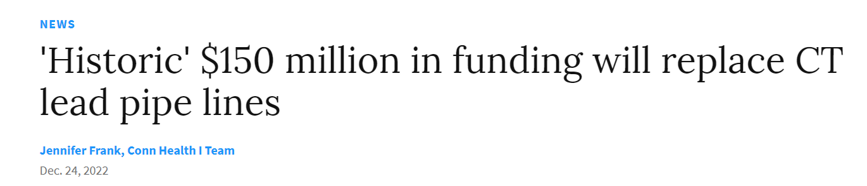



DPH
2022 IIJA Highlights
Drinking Water State Revolving Fund - $17.9 million
Drinking Water State Revolving Fund Lead Service Lines Replacement - $28.3 million
Drinking Water State Revolving Fund Emerging Contaminants (incl. PFAS) - $7.5 million
Clean Water State Revolving Fund - $21.8 million
Clean Water State Revolving Fund, emerging contaminants- $1.1 million

Slide 11


Justice 40 Initiative
What is the Justice40 Initiative?
For the first time in our nation’s history, the Federal Government has made it a goal that 40 percent of the overall benefits of certain Federal investments flow to disadvantaged communities that are marginalized, underserved, and overburdened by pollution.
The BIL is part of Justice40
Each program has specific guidance

Slide 12
Final Thoughts and Reminders
Guidance not yet issued on many new programs. Check out build.gov, ctbilt.ct.gov and the NGA
Local economic development teams need to start identifying projects and ensure that design has begun and there is a clear timeline for permits, approvals, etc.
Applying for projects without any skin in the game will lower the competitiveness of the application.
Be patient, it may take a few years for the project to be successful.
Talk to your towns and other COGS – Coordinate your strategy
Be Regional

Slide 13
Resources
Resource | Organization
The Guidebook to the BIL | The White House
CT IIJA Factsheet | The White House
NGA IIJA Implementation Resources | National Governors Association
Key Dates for USDOT Opportunities - 2023 | USDOT
Bipartisan Infrastructure Law Programs at Department of Energy | DOE
Bipartisan Infrastructure Law Technical Assistance Guide | The White House
Build.gov | The White House
CTBILT Homepage | CTBILT

Slide 14
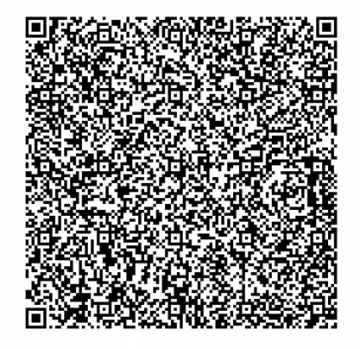
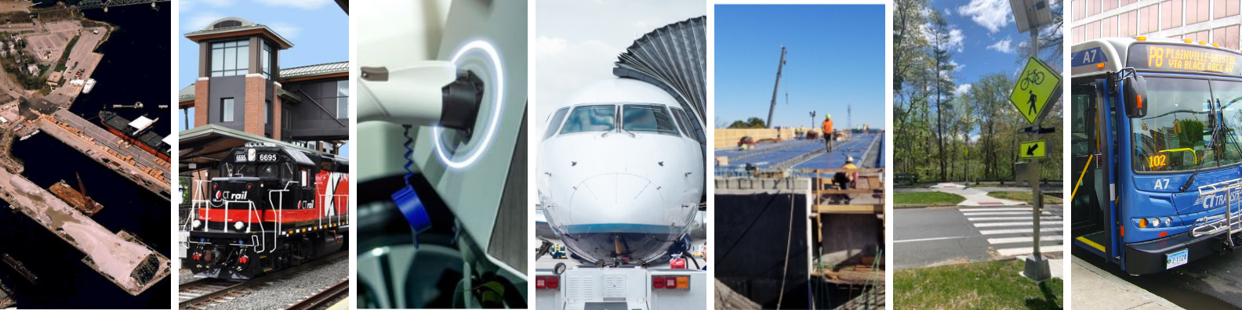
Contact Information
Mark Boughton
Senior Advisor for Infrastructure
Stephen Nocera
Deputy Program Advisor for Infrastructure
Tayler Thorpe
Program Associate for Infrastructure

